Slide 1
Bioinformatics Data Management
Lecture 3
Structured Databases
MARC: Developing Bioinformatics Programs
July 2009
Alex Ropelewski
PSC-NRBSC
Bienvenido Vélez
UPR Mayaguez

Slide 2
Bioinformatics Data Management

Slide 3
Structured Databases: Outline
Structured Databases at a Glance - Characteristics
Advantages of Structured Databases
Data Independence
Disadvantages of Structured Databases
Examples of Structured Databases
Hierarchical Databases
Networked Databases
Relational Databases
XML Databases

Slide 4
Structured Databases at a Glance
All information organized in same way (Data Model)
Language available to
describe (create) the database
insert data
manipulate data
update
Language establishes an abstract data model: Data Independence
Programs using language can work across systems
Facilitates communication and sharing data

Slide 5
Data Independence
Application
Data Model
Tables, relations
OS and File System
Files, directories
Objective:
Shield apps from changes in “physical” platform specific layers

Slide 6
Disadvantages of Structured Databases
Model may not fit data needs
Example: How to represent proteins in table format
Approach #1 – Store one residue per column
AccNum | Name | AA1 | AA2 | AA3 | … | AA517
AAA16331 | G-gamma globin | M | G | H
AAA51693 | Aldehyde Dehydrogenase | M | L | R | … | S
Wasted space
Must make number of columns = max length of any possible sequence
What is this number?

Slide 7
Disadvantages of Structured Databases
Model may not fit data needs
Approach #2 – Store one residue per rows
AccNum | AAPos | AA | Name
AAA16331 | 1 | M | G-gamma globin
AAA16331 | 2 | M | G-gamma globin
… | … | … | …
AAA51693 | 1 | M | Aldehyde Dehydrogenase
… | … | … | …
Difficult to recover sequence in string form using DML

Slide 8
Disadvantages of Structured Databases
Model may not fit data needs
Approach #3 – Put aminoacid sequence in one attribute
AccNum | Name | Sequence
AAA16331 | G-gamma globin | “MGHFTEEDKA….”
AAA51693 | Aldehyde Dehydrogenase | “MLRAAARFPGP….”
… | …
Must analyze sequence using program outside SQL
Loose some benefits of Data Model

Slide 9
A Simple Relational Example
Intuitively model consists of tables
Rows are objects or “entities”
Columns are “attributes” of entities
Attributes cross reference other tables
Proteins
Scientists
AccessionNum | Name | DiscBy | SeqBy
P201 |  | 2 | 3
Q303 |  | 2 | 1
R32 |  | 3 | NULL
Num | Name | Last | Country
1 | John | Doe | England
2 | Jane | Doe | England
3 | Hugh | Nicholas | USA
Intuitively:
Protein P201 discovered by Jane Doe
Hugh discovered R2 and sequenced P201
Primary key
Primary key

Slide 10
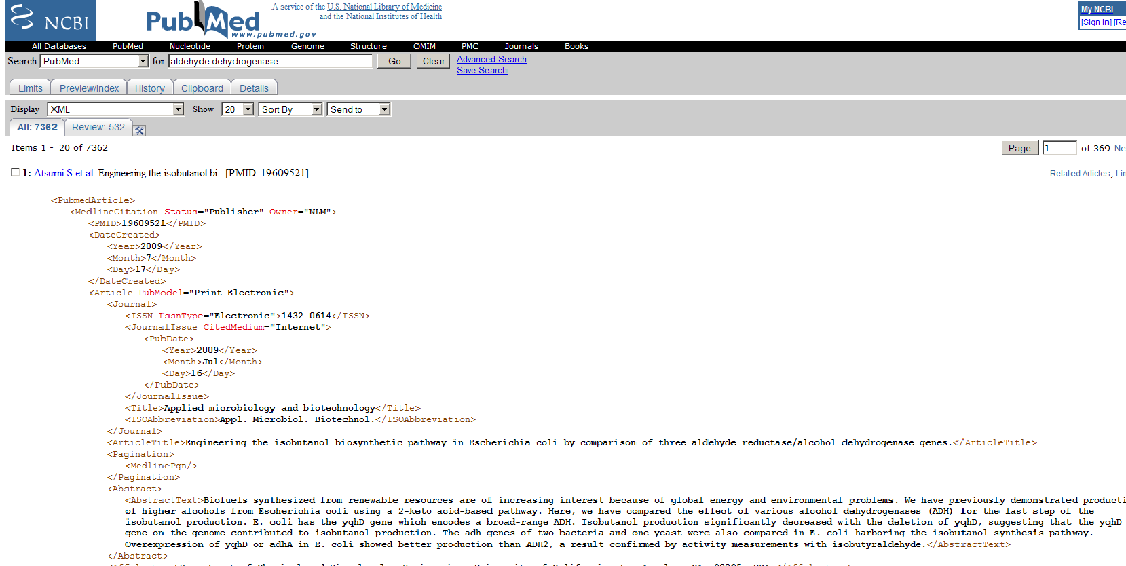
Structured Databases: Other examples
XML Databases
Query language = XPATH/XQUERY
Notes:
Ncbi snapshot del xml de aldehide dehydrogenase

Slide 11
Relational Databases: Outline
Introduction and Examples
Relational Database Design by Example
entities and relational diagrams
normal forms
SQL (Sequel) Language
SQL Data Manipulation
Select
Joins
Updates and deletes
Inserts

Slide 12
Relational Databases: Timeline
Originally proposed by E.F. Codd in 1970
First research prototypes in early 80’s:
Ingres @ UC Berkeley
System R @ IBM
Today the market exceeds $20B annually
Edgar F. Codd

Slide 13
Relational Databases Products
Commercial
Oracle
MS SQL Server
IBM DB2
Open Source
MySQL
Postgres
SQLite

Slide 14
Example Relational Database Design
Goal: Store results from multiple sequence search attempts
Leverage SQL to analyze large result set
Entities to be stored: Matching sequences with scores for each search matrix
Acc# | Definition | Source | Matrix | eValue | SearchDate
P14555 | Group IIA Phospholipase A2 | Human | Pam70 | 4.18 E-32 | 7/21/07
P81479 | Phospholipase A2 isozyme IV | Indian Green Tree Viper | Pam70 | 2.68 -E52 | 7/21/07
P14555 | Group IIA Phospholipase A2 | Human | Blosom80 | 3.47 E-33 | 7/20/07
P81479 | Phospholipase A2 isozyme IV | Indian Green Tree Viper | Blosom80 | 1.20 E-54 | 7/20/07
Problems: Lots of redundant information

Slide 15
Dealing with Redundancy
Normalization
Sequences
AccNum | Definition | Source
P14555 | Group IIA Phospholipase A2 | Human
P81479 | Phospholipase A2 isozyme IV | Indian Green Tree Viper
Matches
Acc# | Date | Matrix | eValue
P14555 | 7/21/07 | Pam70 | 4.18 E-32
P81479 | 7/21/07 | Pam70 | 2.68 -E52
P14555 | 7/20/07 | Blosom80 | 3.47 E-33
P81479 | 7/20/07 | Blosom80 | 1.20 E-54
Foreign key
Still redundant

Slide 16
Dealing with Redundancy
Normalization
Sequences
Acc# | Definition | Source
P14555 | Group IIA Phospholipase A2 | Human
P81479 | Phospholipase A2 isozyme IV | Indian Green Tree Viper
Matches
Acc# | Run# | eValue
P14555 | 1 | 4.18 E-32
P81479 | 1 | 2.68 -E52
P14555 | 2 | 3.47 E-33
P81479 | 2 | 1.20 E-54
Runs
Run# | Matrix | Date
1 | 7/21/07 | Pam70
2 | 7/20/07 | Blosom80

Slide 17
Basic Normal Forms
First Normal Form
Table must be flat; no multi-valued attributes
Second Normal Form
All non-key attributes determined by whole primary key
Third Normal Form
All non-key attributes can ONLY depend on whole primary key directly
Others…

Slide 18
Entity Relationship Diagrams
Sequences
sequences
Acc# | Definition | Source
n
Matches
Acc# | Run# | eValue
n
Runs
Runs
Run# | Matrix | Date
N-to-N relations model as table

Slide 19
Entity Relationship Diagrams
Organism
ID | Name | Description
1 | Cod worm | Pseudoterranova decipiens
2 | Human | Homo sapiens
Organism
1
No table necessary for one-to-many rel’s
n
Sequence
Sequence
Acc# | SrcID | Name
CAA77743 | 1 | Hemoglobin
AB647031 | 2 | Hemoglobin
one-to-many relationships

Slide 20
Simple Query Language (SQL)
Organization
Data definition/schema creation
Data manipulation
Insertion
Manipulation
Updates
Removals
A standard (ISO) since 1987

Slide 21
SQL Data Definition Language (DDL)
The CREATE statement
Sequences
Runs
Acc# | Definition | Source
Run# | Matrix | Date
CREATE TABLE Sequences( AccNum int,
Definition varchar (255), Source varchar(255) )
Matches
Acc# | Run# | eValue
CREATE TABLE Runs( RunNum int, Matrix varchar(255),
Date date)
CREATE TABLE Matches(
AccNum int, RunNum int, eValue int)

Slide 22
SQL Data Manipulation Language (DML)
Foundation is relational algebra
An algebra on relations with three basic operations:
Operation | Description
Projection | Select subset of attributes of a table
Selection | Select subset of entities in a table
Join | Merge two tables into one
All three operations yield a new table as the result

Slide 23
Relational Algebra - Projection
Selects a subset of attributes or columns
Sequences
Acc# | Definition | Source
CAM22514 | Hemoglobin alpha | Mus Musculus
CAO91797 | Hemoglobin X | Mus Musculus
ABG47031 | Hemoglobin | Homo Sapiens
πAcc#, Source(Sequences)
Intuitively:
Find organism that each sequence belongs to
Acc# | Source
CAM22514 | Mus Musculus
CAO91797 | Mus Musculus
ABG47031 | Homo Sapiens

Slide 24
Relational Algebra - Selection
Selects a subset of entities or rows
Sequences
Acc# | Definition | Source
CAM22514 | Hemoglobin alpha | Mus Musculus
CAO91797 | Hemoglobin X | Mus Musculus
ABG47031 | Hemoglobin | Homo Sapiens
Intuitively:
Find all sequences from Mus Musculus
σSource=Mus Musculus (Sequences)
Sequences
Acc# | Definition | Source
CAM22514 | Hemoglobin alpha | Mus Musculus
CAO91797 | Hemoglobin X | Mus Musculus
No reason to keep organism is result

Slide 25
Relational Algebra: Projection and Selection
πAcc#, Definition(σSource= Mus Musculus(Sequences))
Sequences
Acc# | Definition | Source
CAM22514 | Hemoglobin alpha | Mus Musculus
CAO91797 | Hemoglobin X | Mus Musculus
ABG47031 | Hemoglobin | Homo Sapiens
Acc# | Definition | Source
CAM22514 | Hemoglobin alpha | Mus Musculus
CAO91797 | Hemoglobin X | Mus Musculus
σSource= Mus Musculus (Sequences)
Acc# | Definition
CAM22514 | Hemoglobin alpha
CAO91797 | Hemoglobin X
πAcc#, Definition (Sequences)

Slide 26
Relational Algebra - Natural Join
Sequences
Organisms
AccNum | Definition | SourceID
CAM22514 | Hemoglobin alpha | 1
CAO91797 | Hemoglobin X | 1
ABG47031 | Hemoglobin | 2
SourceID | Name
1 | Mus Musculus
2 | Homo Sapiens
Sequences
Organisms
AccNum | Definition | SourceID | Name
CAM22514 | Hemoglobin alpha | 1 | Mus Musculus
CAO91797 | Hemoglobin X | 1 | Mus Musculus
ABG47031 | Hemoglobin | 2 | Homo Sapiens
Requires attributes for join to have same name

Slide 27
Relational Algebra - Inner Join
Sequences
Organisms
AccNum | Definition | SrcID
CAM22514 | Hemoglobin alpha | 1
ABG47031 | Hemoglobin | 2
NPO34535 | Hemoglobin zeta | 3
SrcID | Name
1 | Mus Musculus
2 | Homo Sapiens
Sequences
Organisms
sequences.SrcID = organisms.SrcID
AccNum | Name | SrcID | Name
CAM22514 | Hemoglobin alpha | 1 | Mus Musculus
ABG47031 | Hemoglobin | 2 | Homo Sapiens
Rows without matching attributes excluded
Can name attribute explicitly

Slide 28
Relational Algebra - Left Join
Sequences
Organisms
AccNum | Definition | SrcID
CAM22514 | Hemoglobin alpha | 1
ABG47031 | Hemoglobin | 2
NPO34535 | Hemoglobin zeta | 3
SrcID | Name
1 | Mus Musculus
2 | Homo Sapiens
Sequences
Organisms
sequences.SrcID = organisms.SrcID
AccNum | Name | SrcID | Name
CAM22514 | Hemoglobin alpha | 1 | Mus Musculus
ABG47031 | Hemoglobin | 2 | Homo Sapiens
NPO34535 | Hemoglobin zeta | 3 | NULL
Tuples (rows) on left table without matches have NULL values on attributes of right table

Slide 29
SQL Select - Projection
Selects a subset of attributes or columns
Sequences
Acc# | Definition | Source
CAM22514 | Hemoglobin alpha | Mus Musculus
CAO91797 | Hemoglobin X | Mus Musculus
ABG47031 | Hemoglobin | Homo Sapiens
πAcc#, Source(Sequences)
SELECT Acc#, Source
FROM Sequences
Acc# | Source
CAM22514 | Mus Musculus
CAO91797 | Mus Musculus
ABG47031 | Homo Sapiens

Slide 30
SQL Select - Selection
Selects a subset of entities or rows
Sequences
Acc# | Definition | Source
CAM22514 | Hemoglobin alpha | Mus Musculus
CAO91797 | Hemoglobin X | Mus Musculus
ABG47031 | Hemoglobin | Homo Sapiens
σSource=Mus Musculus (Sequences)
SELECT *
FROM Sequences
WHERE Source= ‘Mus Musculus’
Sequences
Acc# | Definition | Source
CAM22514 | Hemoglobin alpha | Mus Musculus
CAO91797 | Hemoglobin X | Mus Musculus
“*” means “all” attributes
No reason to keep organism is result

Slide 31
SQL Select: Projection and Selection
πAcc#, Definition(σSource= Mus Musculus(Sequences))
Sequences
Acc# | Definition | Source
CAM22514 | Hemoglobin alpha | Mus Musculus
CAO91797 | Hemoglobin X | Mus Musculus
ABG47031 | Hemoglobin | Homo Sapiens
SELECT SeqNum, Org
FROM Sequences
WHERE Source= Mus Musculus
Acc# | Definition | Source
CAM22514 | Hemoglobin alpha | Mus Musculus
CAO91797 | Hemoglobin X | Mus Musculus
σSource= Mus Musculus (Sequences)
Acc# | Definition
CAM22514 | Hemoglobin alpha
CAO91797 | Hemoglobin X
πAcc#, Definition (Sequences)

Slide 32
SQL Select - Natural Join
Sequences
Organisms
AccNum | Definition | SourceID
CAM22514 | Hemoglobin alpha | 1
CAO91797 | Hemoglobin X | 1
ABG47031 | Hemoglobin | 2
SourceID | Name
1 | Mus Musculus
1 | Mus Musculus
2 | Homo Sapiens
Sequences
SELECT *
FROM Sequences
NATURAL JOIN Organisms
Organisms
AccNum | Definition | SourceID | Name
CAM22514 | Hemoglobin alpha | 1 | Mus Musculus
CAO91797 | Hemoglobin X | 1 | Mus Musculus
ABG47031 | Hemoglobin | 2 | Homo Sapiens

Slide 33
SQL Select - Inner Join
Sequences
Organisms
AccNum | Definition | SrcID
CAM22514 | Hemoglobin alpha | 1
ABG47031 | Hemoglobin | 2
NPO34535 | Hemoglobin zeta | 3
SrcID | Name
1 | Mus Musculus
2 | Homo Sapiens
SELECT *
FROM Sequences
INNER JOIN Organisms
on sequences.SrcID = organisms.SrcID
Sequences
Organisms
sequences.SrcID = organisms.SrcID
AccNum | Name | SrcID | Name
CAM22514 | Hemoglobin alpha | 1 | Mus Musculus
ABG47031 | Hemoglobin | 2 | Homo Sapiens
Rows without matching attributes excluded
Can name attribute explicitly

Slide 34
SQL Select - Left Join
Sequences
Organisms
AccNum | Definition | SrcID
CAM22514 | Hemoglobin alpha | 1
ABG47031 | Hemoglobin | 2
NPO34535 | Hemoglobin zeta | 3
SrcID | Name
1 | Mus Musculus
2 | Homo Sapiens
SELECT *
FROM Sequences LEFT OUTER JOIN Organisms
ON Sequences.SrcID = Organisms.SrcID;
Sequences
Organisms
sequences.SrcID = organisms.SrcID
AccNum | Name | SrcID | Name
CAM22514 | Hemoglobin alpha | 1 | Mus Musculus
ABG47031 | Hemoglobin | 2 | Homo Sapiens
NPO34535 | Hemoglobin zeta | 3 | NULL
Tuples (rows) on left table without matches have NULL values on attributes of right table

Slide 35
SQL UPDATE Statement
Matches
Acc# | Date | Matrix | eValue
P14555 | 7/21/07 | Pam70 | 4.18 E-32
P81479 | 7/21/07 | Pam70 | 2.68 -E52
P14555 | 7/20/07 | Blosom80 | 3.47 E-33
P81479 | 7/20/07 | Blosom80 | 1.20 E-54
UPDATE Matches
SET Date = ‘7/22/07’
WHERE Date = ‘7/21/07’
Matches
Acc# | Date | Matrix | eValue
P14555 | 7/22/07 | Pam70 | 4.18 E-32
P81479 | 7/22/07 | Pam70 | 2.68 -E52
P14555 | 7/20/07 | Blosom80 | 3.47 E-33
P81479 | 7/20/07 | Blosom80 | 1.20 E-54

Slide 36
SQL DELETE Statement
Matches
Acc# | Date | Matrix | eValue
P14555 | 7/21/07 | Pam70 | 4.18 E-32
P81479 | 7/21/07 | Pam70 | 2.68 -E52
P14555 | 7/20/07 | Blosom80 | 3.47 E-33
P81479 | 7/20/07 | Blosom80 | 1.20 E-54
DELETE FROM Matches
WHERE Date = ‘7/21/07’
Matches
Acc# | Date | Matrix | eValue
P14555 | 7/20/07 | Blosom80 | 3.47 E-33
P81479 | 7/20/07 | Blosom80 | 1.20 E-54
ADVICE: BE CAREFUL WITH DELETE. THERE IS NO EASY UNDO

Slide 37
SQL Select with SORT BY
Matches
Acc# | Date | Matrix | eValue
P14555 | 7/21/07 | Pam70 | 4.18 E-32
P81479 | 7/21/07 | Pam70 | 2.68 -E52
P14555 | 7/20/07 | Blosom80 | 3.47 E-33
P81479 | 7/20/07 | Blosom80 | 1.20 E-54
SELECT * FROM Matches
ORDER BY eValue ASC
Matches
Acc# | Date | Matrix | eValue
P81479 | 7/20/07 | Blosom80 | 1.20 E-54
P81479 | 7/22/07 | Pam70 | 2.68 -E52
P14555 | 7/20/07 | Blosom80 | 3.47 E-33
P14555 | 7/22/07 | Pam70 | 4.18 E-32

Slide 38
SQL Data Manipulation
Grouping Results and Aggregates

Slide 39
Filling-Up the database - Insert
Organisms
SrcID | Name
1 | Mus Musculus
2 | Homo Sapiens
INSERT INTO Organisms
Values (3, ‘C. Elegans’)
Organisms
SrcID | Name
1 | Mus Musculus
2 | Homo Sapiens
3 | C. Elegans
Good when you know the attributes of all entities c-priori

Slide 40
Filling-Up the database
Approach #2: Input from file (CSV)
Under construction
Tricky to set data types handled correctly

Slide 41
Case Study: Analyzing Results of Multiple BLAST Runs with alternative search matrices
Steps at a Glance
Install and configure tools
Python environment including BioPython
Database system (SQLite)
Design the relational database schema
Write Python functions to insert results into database
Analyze data using SQL queries

Slide 42
Case Study (Step 1): Install Tools
Windows version
Install Python interpreter
Download installer from www.python.org
Run installer and verify installation
Install BioPython
Download installer from www.biopython.org
Run installer and verify installation
Install SQLiteMan
Download SQLiteMan query browser from www.sqliteman.com
Run installer and verify installation

Slide 43
Case Study (Step 1): Install Tools
Mac OS version
UNDER CONSTRUCTION

Slide 44
Case Study (Step 2):Design Database Schema
Source | AccessionNum | Definition | Matrix | eValue | SearchDate
Human | P14555 | Group IIA Phospholipase A2 | Pam70 | 4.18 E-32 | 7/21/07
Indian Green Tree Viper | P81479 | Phospholipase A2 isozyme IV | Pam70 | 2.68 -E52 | 7/21/07
Human | P14555 | Group IIA Phospholipase A2 | Blosom80 | 3.47 E-33 | 7/20/07
Indian Green Tree Viper | P81479 | Phospholipase A2 isozyme IV | Blosom80 | 1.20 E-54 | 7/20/07

Slide 45
Case Study Step 3: Python Programming
Write Python functions to:
Run a BLAST search for the query sequence and a specific matrix
Insert results into Database
Run SQL insert queries to populate the database
Create a CSV file with all results from BLAST searches and import to DB
Run all functions together running one Blast for each one of a set of matrices

Slide 46
Case Study Step 3: Python Programming
Run a BLAST search for the query sequence and a specific matrix
From Bio.Blast import NCBIWWW
from Bio.Blast import NCBIXML
from Bio import Fasta
from sys import *
import sqlite3
def searchAndStoreBlastSearch(query, matrix_id, filename):
# Creates handle to store the results sent by NCBI website
results_handle = NCBIWWW.qblast("blastp", "swissprot", query, expect=10,
descriptions=2000, alignments=2000, hitlist_size=2000,
matrix_name=matrix_id)
# Reads results into memory
blast_results = results_handle.read()
# Creates and opens a file in filesystem for writing
save_file = open(filename, 'w')
# Store results from memory into the filesystem
save_file.write(blast_results)
#Close the file handler
save_file.close()

Slide 47
Case Study Step 3: Python Programming
Insert results into Database: Run multiple SQL insert queries
def xmlToDatabase(filename, matrix_id, dbCursor, dbConn):
blast_fileptr=open(filename)
record=NCBIXML.parse(blast_fileptr).next()
for alignment in record.alignments:
hsp=alignment.hsps[0]
storeIntoDatabase(hsp, alignment, matrix_id,dbCursor,dbConn)
blast_fileptr.close()

Slide 48
Case Study Step 3: Python Programming
Insert results into Database: Run multiple SQL insert queries
def storeIntoDatabase(hsp, alignment, matrix_id, dbCursor, dbConn):
# Insert a row of data into the table (securely)
t = (hsp.expect, hsp.score, matrix_id, alignment.accession, alignment.title,)
dbCursor.execute("insert into sequences values (?,?,?,?,?)",t)
# Save (commit) the changes
dbConn.commit()

Slide 49
Case Study Step 3: Python Programming
Insert results into Database: Create a CSV file with all results from BLAST searches
def xmlToCSV(xmlFilename, csvFilename, matrix_id):
# Create file handler
blast_fileptr=open(xmlFilename)
# Parse xml file into biopython object
record=NCBIXML.parse(blast_fileptr).next()
# Create csv file writer
csvFileWriter = csv.writer(open(csvFilename,'wb'))
# Iterate over record alignments
for alignment in record.alignments:
# Extract high score pairwise alignment object
hsp=alignment.hsps[0]
# Create record vector
record = [hsp.expect, hsp.score, matrix_id, alignment.accession, alignment.title,]
# Store record vector into csv file
csvFileWriter.writerow( record )
# Close file handler
blast_fileptr.close()

Slide 50
Case Study Step 3: Python Programming
Use all functions to run one Blast for each of a sequence of search matrices
def doIt():
print "Import fasta file"
query_file = open('P00624.fasta')
fasta = Fasta.Iterator(query_file)
query = fasta.next()
query_file.close()
print "Creating database interface"
dbConnection = sqlite3.connect(dbFileName)
dbCursor = dbConnection.cursor()
# Create tables
dbCursor.execute("DROP TABLE IF EXISTS sequences")
dbCursor.execute("CREATE TABLE IF NOT EXISTS sequences (expect real, score int, matrix text, \
accession text, description text)")
print "Iterate over matrixes"
for i in range(0,len(MatrixName)):
print "Sending blast search"
searchAndStoreBlastSearch(query, MatrixName[i], FileName[i])
print "Processing blase search"
xmlToDatabase(FileName[i], MatrixName[i], dbCursor, dbConnection)
print "Program done"
Matrixname=['PAM70','BLOSUM80']
FileName=['TestPAM70.xml','TestBLOSUM80.xml']
dbFileName='data.db3'

Slide 51
Case Study Step 3: Python Programming
Run all functions together running one Blast for each one of a set of matrices
Import CSV version
MatrixName=['PAM70','BLOSUM80']
TableName=['PAM70','BLOSUM80']
FileName=['TestPAM70.xml','TestBLOSUM80.xml']
CsvFileName=['TestPAM70.csv','TestBLOSUM80.csv']
def doIt():
query_file = open('P00624.fasta')
fasta = Fasta.Iterator(query_file)
query = fasta.next()
query_file.close()
for i in range(0,len(MatrixName)):
searchAndStoreBlastSearch(query, MatrixName[i], FileName[i])
xmlToCSV(FileName[i], CsvFileName[i], MatrixName[i])

Slide 52
Case Study (Step 3): Import CSV File
UNDER CONSTRUCTION

Slide 53
Case Study (Step 4): Analyze Data
Analyze data using SQL
Example 1: Finding top matches
Display sequences sorted by average score/run and number of runs where they appeared
select *, COUNT(matrix) as total
from sequences
group by accession
order by total desc

Slide 54
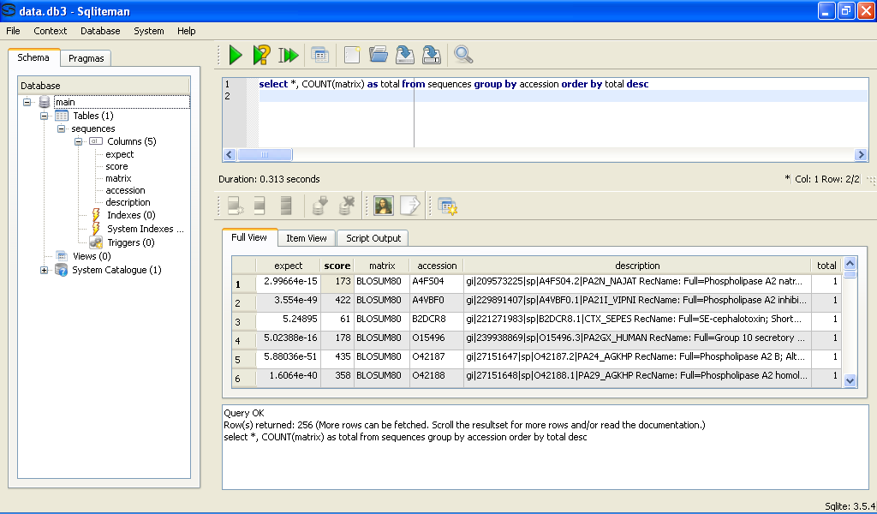
Case Study (Step 4): Analyze Data
select *, COUNT(matrix) as total
from sequences
group by accession
order by total desc
Display sequences sorted by average score/run and number of runs where they appeared

Slide 55
Case Study (Step 4): Analyze Data
Analyze data using SQL
Example 2: Finding discriminating matrices
Display sequences that only showed up in one matrix run
select *, COUNT(matrix) as total
from sequences
group by accession
having total = 1

Slide 56
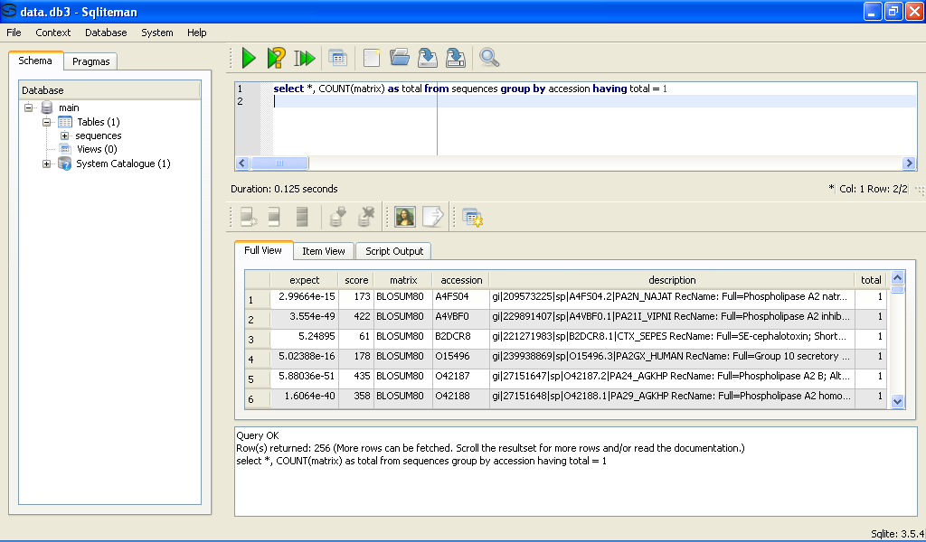
Case Study (Step 4): Analyze Data
select *, COUNT(matrix) as total
from sequences
group by accession
having total = 1
Display sequences that only showed up in one matrix run

Slide 57
Case Study: Step 4
Generate Graphic Reports using Excel

