Slide 1
The following material is the result of a curriculum development effort to provide a set of courses to support bioinformatics efforts involving students from the biological sciences, computer science, and mathematics departments. They have been developed as a part of the NIH funded project “Assisting Bioinformatics Efforts at Minority Schools” (2T36 GM008789). The people involved with the curriculum development effort include:
Dr. Hugh B. Nicholas, Dr. Troy Wymore, Mr. Alexander Ropelewski and Dr. David Deerfield II, National Resource for Biomedical Supercomputing, Pittsburgh Supercomputing Center, Carnegie Mellon University.
Dr. Ricardo Gonzalez-Mendez, University of Puerto Rico Medical Sciences Campus.
Dr. Alade Tokuta, North Carolina Central University.
Dr. Jaime Seguel and Dr. Bienvenido Velez, University of Puerto Rico at Mayaguez.
Dr. Satish Bhalla, Johnson C. Smith University.
Unless otherwise specified, all the information contained within is Copyrighted © by Carnegie Mellon University. Permission is granted for use, modify, and reproduce these materials for teaching purposes.

Slide 2
This material is targeted towards students with a general background in Biology. It was developed to introduce biology students to the computational mathematical and biological issues surrounding bioinformatics. This specific lesson deals with the following fundamental topics:
Computing for biologists
Computer Science track
This material has been developed by:
Dr. Hugh B. Nicholas, Jr.
National Center for Biomedical Supercomputing
Pittsburgh Supercomputing Center
Carnegie Mellon University

Slide 3
Bioinformatics Data Management
Lecture 3
Structured Databases
Bienvenido Vélez
UPR Mayaguez

Slide 4
Structured Databases: Outline
Structured Databases at a Glance - Characteristics
Advantages of Structured Databases
Data Independence
Disadvantages of Structured Databases
Examples of Structured Databases
Hierarchical Databases
Networked Databases
Relational Databases
XML Databases

Slide 5
Structured Databases at a Glance
All information organized in same way (Data Model)
Language available to
describe (create) the database
insert data
manipulate data
update
Language establish an abstract data model
Programs using language can work across systems

Slide 6
Advantages of Structured Databases
Data independence facilitates
portability across platforms
communication and sharing data

Slide 7
Data Independence
Application
Data Model
Tables, relatives
Data Storage
System Platform
Files, directories
Shield apps from changes in “physical” layers

Slide 8
Disadvantages of Structured Databases
Model may not fit data needs
Example:
How to represent a sequence of amino acid bases
Approach #1 - Put one base per column
Must make number of columns = max length of any possible sequence
Acc # | Name | Base 1 | Base 2 | Base 3 | … | Base max
P1 | Prot 1 | c | + | 4 | …
P2 | Prot 2 | -1 | a | a | …
Waste of space
What is this number?

Slide 9
Disadvantages of Structured Databases
Model may not fit data needs
Approach #2 - Put bases in rows
Acc # | #Base | Base | Name
P1 | 1 | c | Prot 1
P1 | 2 | + | Prot 1
P1 | 3 | q | Prot 1
… | … | … | …
Difficult to recover sequence in string form using DML

Slide 10
Disadvantages of Structured Databases
Model may not fit data needs
Approach #3 - Put string with sequence in attribute
Acc # | Name | Sequence
P1 | Prot 1 | “cfq”
P2 | Prot 1 | “taa”
… | …
Must analyze sequence using program outside SQL
Loose benefits of Data Model

Slide 11
A Simple Relational Example
Intuitively model consists of tables
Rows are objects or "entities“
Columns are "attributes“
Attributes cross reference other tables
Proteins
Scientists
# | Accession # | Name | Discoverer | Sequencer
1 | P201 |  | 2 | 3
2 | Q303 |  | 2 | 1
3 | R32 |  | 3 | -
# | Name | Last | Country
1 | John | Doe
2 | Jane | Doe
3 | Hugh | Nicholas
Statements
Protein P201 discovered by Jane Doe
Hugh discovered R2 and sequenced P201
Primary key

Slide 12
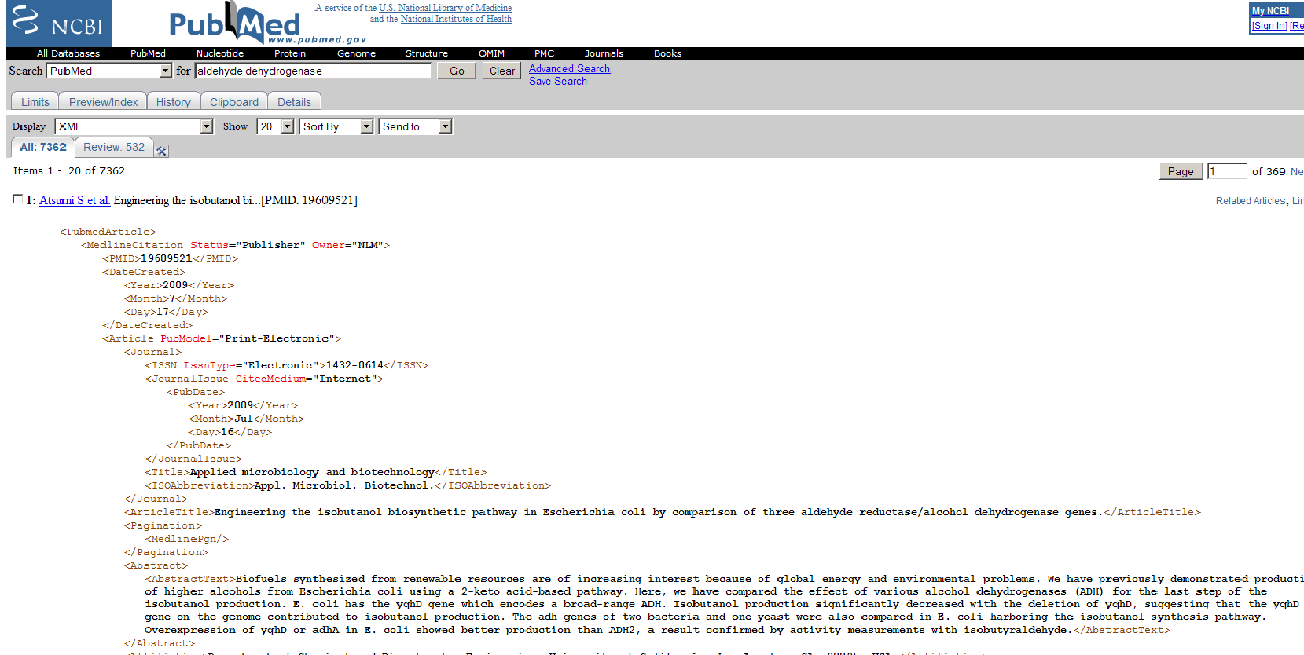
Structured Databases: Other examples
XML Databases
Query language = XPATH/XQUERY
Notes:
Ncbi snapshot del xml de aldehide dehydrogenase

Slide 13
Relational Databases: Outline
Introduction and Examples
Relational Database Design by Example
entities and relational diagrams
normal forms
SQL (Sequel) Language
SQL Data Manipulation
Select
Joins
Updates and deletes
Inserts

Slide 14
Relational Database Design By Example
Goal: Store results from sequence searches
Leverage SQL to analyze large result set
Entities to be stored:
Matching sequences with scores for each search
Approach #1
SeqNum | Name | SearchNum | Matrix | Score
1 | ALDH | 1 | Pam80
2 |  |  | Pam80
2
3
Problems: Lots of redundant information

Slide 15
Dealing with Redundancy
Normalization
Sequences
Matches
SeqNum | Name | …
SeqNum | SearchNum | Params | Score
Foreign key
Still redundant

Slide 16
Dealing with Redundancy
Normalization
Sequences
Runs
SeqNum | Name | …
RunNum | Params
1
Matches
SeqNum | RunNum | Score

Slide 17
Basic Normal Forms
First Normal Form
Table must be flat; no muti-valued attributes
Second Normal Form
All non-key attributes determined by whole primary key
Third Normal Form
All non-key attributes can ONLY depend on whole primary key
Others…

Slide 18
Entity Relationship Diagram
Sequences
sequences
SeqNum | Name | …
n
Matches
SeqNum | RunNum | Score
n
Runs
Runs
RunNum | Params
N-to-N relations model as table

Slide 19
Entity Relationship Diagram
Organism
ID | Name | Description
Organism
1
No Table
n
Sequence
Sequence
seqNum | orgNum | Name
1-to-many relationships

Slide 20
Simple Query Language (SQL)
Organization
Data definition/schema creation
Data manipulation
Insertion
Manipulation
Updates
Removals
A standard (ISO) since 1987

Slide 21
SQL Data Definition
The CREATE statement
Sequences
Runs
SeqNum | Name
RunNum | Params
CREATE TABLE Sequences( SeqNum int, Name varchar(255) )
CREATE TABLE Runs( RunNum int, Params varchar(255) )
Matches
SeqNum | RunNum | Score
CREATE TABLE Matches(
SeqNum int, RunNum int, Score int)

Slide 22
SQL Data Manipulation
Foundation is relational algebra
An algebra on relations
There basic operations of relational algebra
Operation | Description
Projection | Select subset of attributes
Selection | Select subset of entities
Join | Merge two tables into one
All three operations yield a new table

Slide 23
Relational Algebra - Projection
Sequences
SeqNum | Name | BasesNum | Org
πSeqNum, Org (Sequences)
SeqNum | Org
Intuitively:
Final organism that each sequence belongs to

Slide 24
Relational Algebra - Selection
Selects a subset of entities
Sequences
Seq # | Name | Organism
 |  | C. Elegans
 |  | C. Elegans
 |  | Human
σOrg= C. Elegans(Sequences)
Sequences
Seq # | Name | Organism
 |  | Cel
 |  | Cel
No reason to keep organism is result

Slide 25
Relational Algebra - Projection and Selection
Selects a subset of entities
Seq # | Name | Organism
 |  | C. Elegans
 |  | C. Elegans
 |  | Human
πSeqNum, Name(σOrg= C. Elegans(Sequences))
Seq # | Name | Organism
 |  | C. Elegans
 |  | C. Elegans
σOrg= C. Elegans(Sequences)
SeqNum | Name
πSeqNum, Name(Sequences)
No reason to keep organism is result

Slide 26
Relational Algebra - Natural Join
Sequences
Organisms
Seq # | Name | Org #
Name | Org #
Sequences
Organisms
Seq # | Name | Org # | Name
Requires attributes for join to have same name

Slide 27
Relational Algebra - Inner Join
Sequences
Organisms
Seq # | Name | OrgNum
OrgNumber | Name
Sequences
Organisms
sequences.orgNum = organisms.orgNumber
Seq # | Name | Org # | Name
Rows without matching attributes excluded
Can name attribute explicitly

Slide 28
Relational Algebra - Left Join
Sequences
Organisms
Seq # | Name | OrgNum
OrgNumber | Name
_
Sequences
_
Organisms
Seq # | Name | Org # | Name
Tuples (rows) on left table without matches have NULL values on attributes of right table

Slide 29
SQL SELECT Statement - Projection
Relational algebra:
πSeqNum, Org (Sequences)
SQL
SELECT [SeqNum, Org]
FROM <Sequences>
WHERE <boolean_expression>

Slide 30
SQL SELECT Statement - Selection
Relational algebra:
σOrg= C. Elegans(Sequences)
SQL
SELECT *
FROM Sequences
WHERE Org= C. Elegans
“*” means “all”

Slide 31
SQL SELECT Statement – Projection and Selection
Relational algebra:
πSeqNum, Name(σOrg= C. Elegans(Sequences))
Terminar el query de SQL
SQL
SELECT [* | <ctrl-list>]
FROM Sequence as <synonim>
{JOIN Organisms on <attribute>}
WHERE <boolean_expression>

Slide 32
Faltan unos slides iguales al slide anterior

Slide 33
SQL UPDATE Statement
Usar el schema original y hacer un query sencillo, poner las tablas originales y la tabla resultante

Slide 34
SQL DELETE Statement
Usar el schema original y hacer un query sencillo, poner las tablas originales y la tabla resultante

Slide 35
SQL Data Manipulation
Sorting Results – order by clause
Usar el schema original y hacer un query sencillo, poner las tablas originales y la tabla resultante

Slide 36
SQL Data Manipulation
Grouping Results and Aggregates
Usar el schema original y hacer un query sencillo, poner las tablas originales y la tabla resultante

Slide 37
Filling-Up the database
Approach #1: INSERT
AQUI VA UN EJEMPLO
Good when you know the attributes of all entities c-priori.

Slide 38
Filling-Up the database
Approach #2: Input from file (CSV)
AQUI VA UN EJEMPLO
Tricky to set data types handled correctly

Slide 39
Case Study: Analyzing Results of Multiple Blast Runs with alternative search matrixes
Steps at a Glance
Install and configure tools
Python environment
Database system (MySQL, Alex’s suggestion)
Create database to store results
Design schema
Write SQL structure
Write Phyton program to
Read sequence from file
Run a series of blast searches with set of different matrixes
Create a CSV file with all results
Input CSV into database
Analyze data using SQL

Slide 40
Case Study: Step 1(a)
Install Python environment (Windows version)
Download installer from
Run installer
Verify installation

Slide 41
Case Study: Step 1(a)
Install Python environment (MacOS version)
Under construction

Slide 42
Case Study: Step 1(b)
Install Database
Under construction

Slide 43
Case Study: Step 2(a)-2(b)
Design Database Schema
Run create structures on your database
Sequences
Runs
Seq # | Name | …
Run# | Params
1
Matches
Seq # | Run # | Score

Slide 44
Case Study: Step 2(c)
Run create structure on your Database
SNAPSHOT

Slide 45
Case Study Step 3(a)
Write functions to:
Read a FASTA sequence
Conduct a Blast with a given matrix and sequence and result set limit
Extract essential information for run from a Blast search
Generate CSV strings for each match sequences
Append CSV strings to result file
Correct all functions together running one Blast for each input set of metrics

Slide 46
Slides 45-50 python functions to accomplish all tasks

Slide 47
Case Study: Step 4
Import CSV into Database
SNAPSHOT
Este es el slide 51

Slide 48
Case Study: Step 5
Analyze data using SQL
Example 1: Finding top matches
Display sequences sorted by average score/run and number of runs where they appeared
SNAPSHOT

Slide 49
Case Study: Step 5
Analyze data using SQL
Example 2: Finding must *something* matrices
Display sequences in increasing number of runs, decreasing average score and matrix used
SNAPSHOT

Slide 50
Case Study: Step 6(a)
Export results back to CSV

Slide 51
Case Study: Step 6(b)
Generate Graphic Reports using *something* application

