Slide 1
Essential Computing for Bioinformatics
Lecture 2
Using Bioinformatics Data Sources
MARC: Developing Bioinformatics Programs
July 2009
Alex Ropelewski
PSC-NRBSC
Bienvenido Vélez
UPR Mayaguez

Slide 2
Essential Computing for Bioinformatics

Slide 3
Course Outline
Course Overview
Introduction to Information Needs and Databases
Unstructured Data Repositories
Query models and implementation issues
Structured Data Repositories
Query models and implementation issues
Biology-specific Repositories
Query models and implementation issues

Slide 4
Outline

Slide 5
Definition: Biological Database
Any repository containing Biological information which can be used to:
assess the current state of knowledge
Formulate new scientific hypotheses
Validate these hypotheses
Some Examples of Biological Databases
Sequence
Structure
Family/Domain
Species
Taxonomy
Function/Pathway
Disease/Variation
Publication Journal
And many other ways

Slide 6
How is Biological Information Stored?
From a computer-science perspective, there are several ways that data can be organized and stored:
In a flat text file
In a spreadsheet
In an image
In an video animation
In a relational database
In a networked (hyperlinked) model
In any combination of the above
Others

Slide 7
Sequence Data Libraries
Organized according to sequence
When one talks about “searching sequence databases” these are the libraries that they are searching
Main sources for sequence libraries are direct submissions from individual researchers, genome sequencing projects, patent applications and other public resources.
Genbank, EMBL, and the DNA Database of Japan (DDBJ) are examples of annotated collections publicly available DNA sequences.
The Universal Protein Resource (UniProt) is a comprehensive resource for protein sequence and annotation data

Slide 8
Structural Data Libraries
Contain information about the (3-dimensional) structure of the molecule
Main sources of structural data are direct submissions from researchers. Data can be submitted via a variety of experimental techniques including
X-ray crystallography
NMR structure depositions.
EM structure depositions.
Other methods (including Electron diffraction, Fiber diffraction).
The Protein Data Bank and the Cambridge Structural Database are two well-known repositories of structural information

Slide 9
Family and Domain Libraries
Typically built from sets of related sequences and contain information about the residues that are essential to the structure/function of the sequences
Used to:
Generate a hypothesis that the query sequence has the same structure/function as the matching group of sequences.
Quickly identify a good group of sequences known to share a biological relationship.
Some examples:
PFAM, Prosite, BLOCKS, PRINTS

Slide 10
Species Libraries
Goal is to collect and organize a variety of information concerning the genome of a particular species
Usually each species has its own portal to access information such as genomic-scale datasets for the species.
Examples:
EuPathDB - Eukaryotic Pathogens Database (Cryptosporidium, Giardia, Plasmodium, Toxoplasma and Trichomonas)
Saccharomyces Genome Database
Rat Genome Database
Candida Genome Database

Slide 11
Taxonomy Libraries
The science of naming and classifying organisms
Taxonomy is organized in a tree structure, which represents the taxonomic lineage.
Bottom level leafs represents species or sub-species
Top level nodes represent higher ranks like phylum, order and family
Examples:
NEWT
NCBI Taxonomy

Slide 12
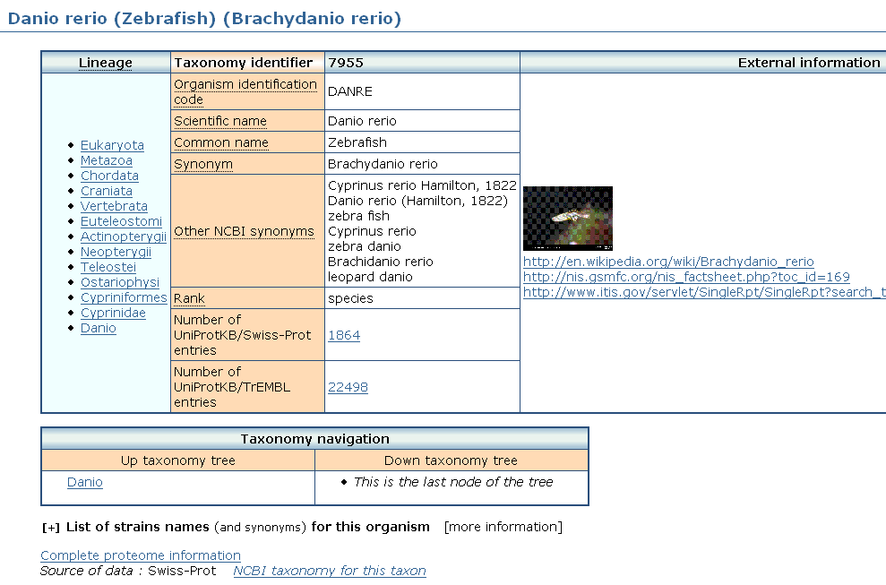
Taxonomy Libraries - NEWT

Slide 13
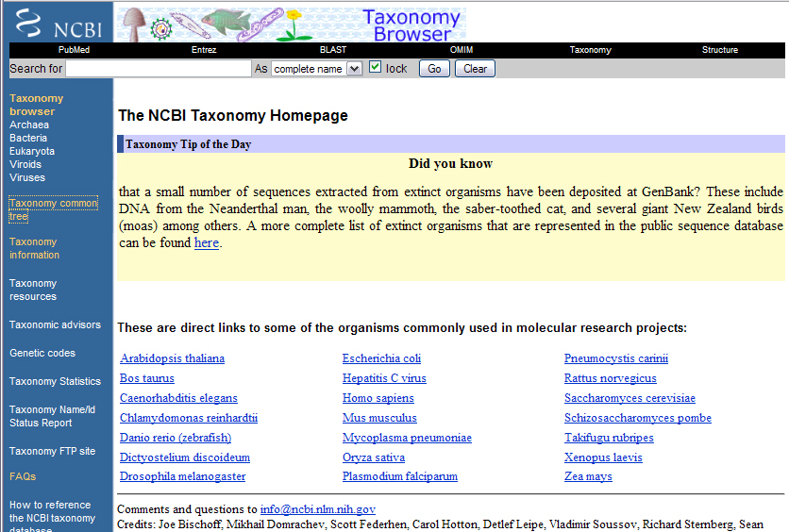
NCBI Taxonomy Browser

Slide 14
Function/Pathway
Collection of pathway maps representing our knowledge on the molecular interaction and reaction networks for:
Metabolism
Genetic Information Processing
Environmental Information Processing
Cellular Processes
Human Diseases
Drug Development
Examples:
KEGG Pathway Database
NCI-Nature Pathway Interaction Database

Slide 15
Disease/Variation
Catalogs of genes involving variations including within populations and among populations in different parts of the world as well as genetic disorders and other diseases.
Examples:
OMIM, Online Mendelian Inheritance in Man - focuses primarily on inherited, or heritable, genetic diseases in humans
HapMap - a catalog of common genetic variants that occur in humans.

Slide 16
Journal
U.S. National Library of Medicine
PubMed is the premiere resources for scientific literature relevant to the biomedical sciences.
Includes over 18 million citations from MEDLINE and other life science journals for articles back to the 1950s.
PubMed includes links to full text articles and other related resources.
Common uses of PubMed:
Find journal articles that describe the structure/function/evolution of sequences that you are interested in
Find out if anyone has already done the work that you are proposing

Slide 17
Current databases are loosely integrated
In order to prove a hypothesis one must often collect information from several independent databases and tools
Lots of time are spent converting data back and forth among the multiple specific formats required by the various tools and databases
Discovery process may take a long time, weeks or even months, to complete and tools do not effectively assist the scientist in saving intermediate results in order to continue the search from that point at a later time.
What has been done about this?

Slide 18
Integrated Information Resources
Integrated resources typically use a combination of relational databases and hyperlinks to databases maintained by others to provide more information than any single data source can provide
Many Examples:
NCBI Entrez – NCBI’s cross-database tool
iProClass - proteins with links to over 90 biological databases. including databases for protein families, functions and pathways, interactions, structures and structural classifications, genes and genomes, ontologies, literature, and taxonomy
InterPro - Integrated Resource Of Protein Domains And Functional Sites.

Slide 19
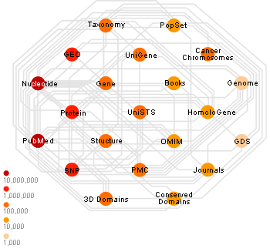
NCBI Entrez Data Integration

Slide 20
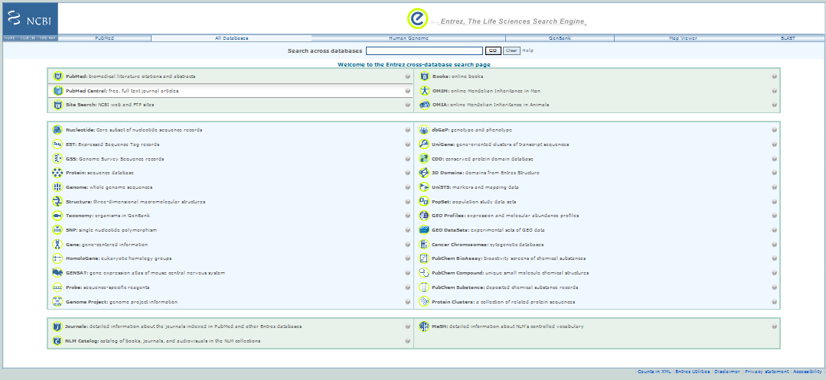
NCBI Entrez

Slide 21
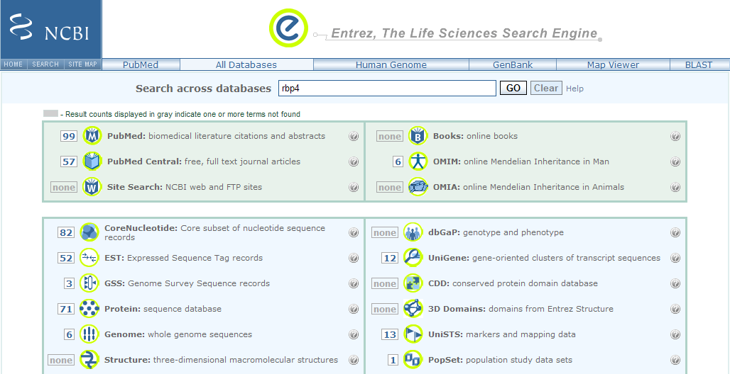
NCBI Entrez Results

Slide 22
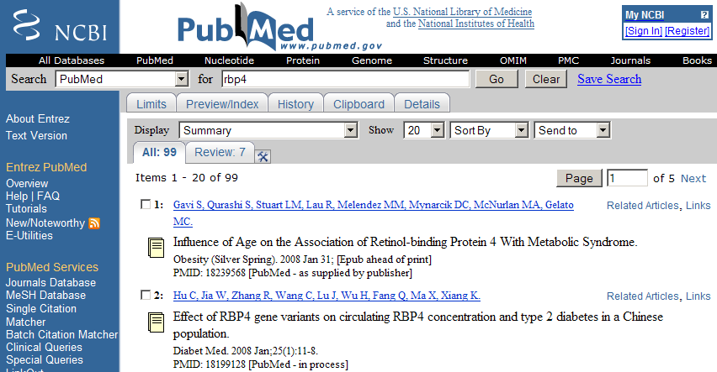
NCBI Entrez PubMed Results

Slide 23
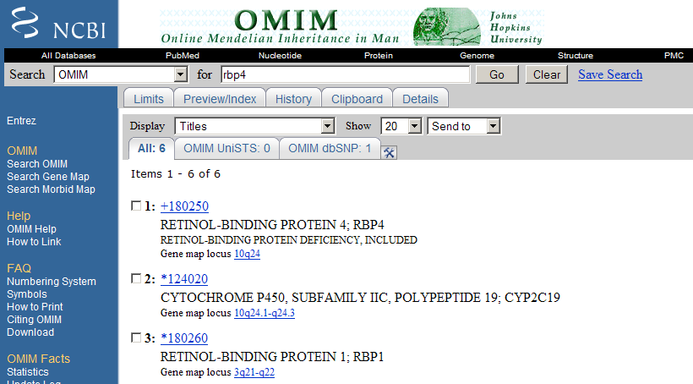
NCBI Entrez OMIM Results

Slide 24
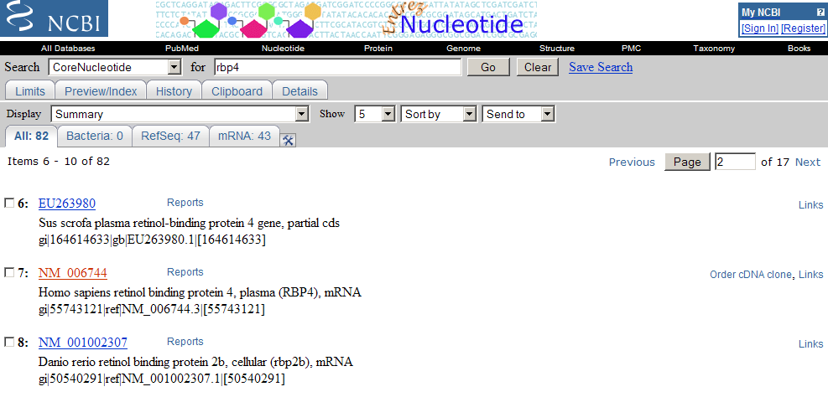
NCBI Entrez Core Nucleotide Results

Slide 25
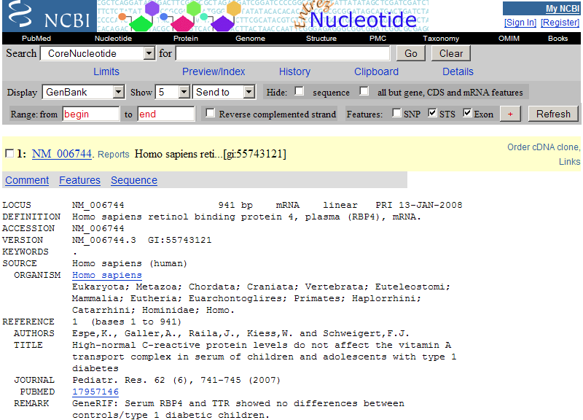
NCBI Entrez Core Nucleotide Results

Slide 26
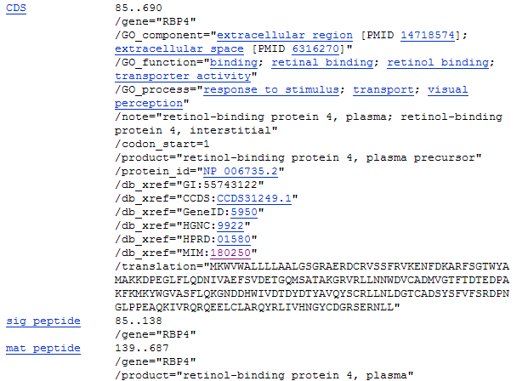
NCBI Entrez Core Nucleotide Results

Slide 27
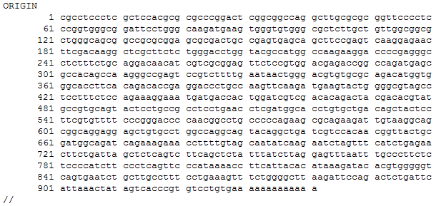
NCBI Entrez Core Nucleotide Results

Slide 28
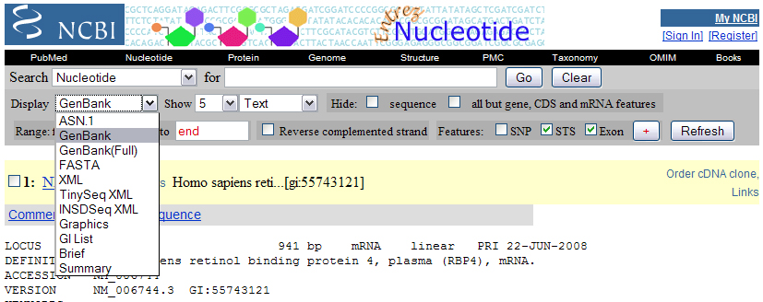
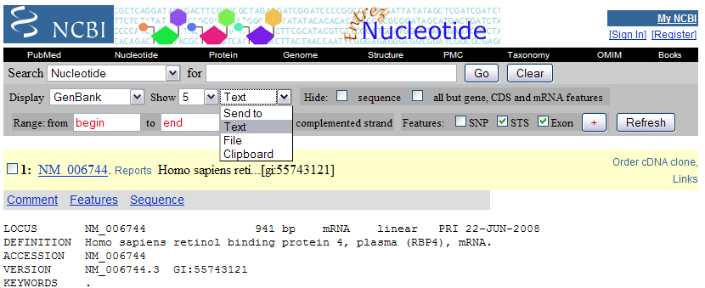
NCBI Entrez Saving Sequences

Slide 29
NCBI Sequence Identifiers
Accession Number: unique identifier given to a sequence when it is submitted to one of the DNA repositories (GenBank, EMBL, DDBJ). These identifiers follow an accession.version format. Updates increment the version, while the accession remains constant.
GI: GenInfo Identifier. If a sequence changes a new GI number will be assigned. A separate GI number is also assigned to each protein translation.

Slide 30
iProClass Protein Knowledgebase
Protein centric
Links to over 90 biological data libraries
Goal is to provide a comprehensive picture of protein properties that may lead to functional inference for previously uncharacterized "hypothetical" proteins and protein groups.
Uses both data warehousing in relational databases as well as hypertext links to outside data sources

Slide 31
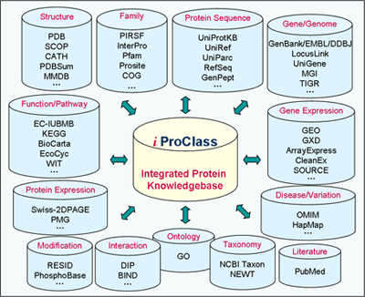
iProclass Integration

Slide 32
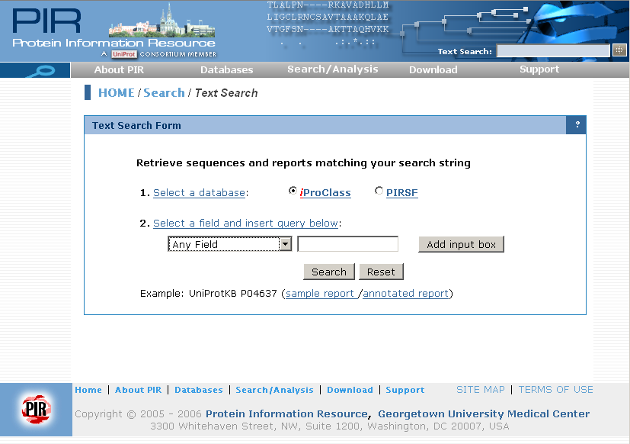
iProclass Search Form

Slide 33
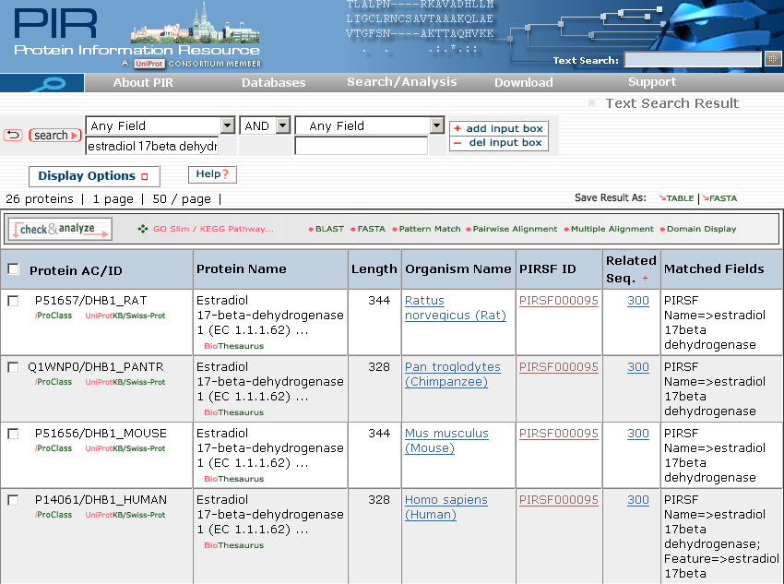
iProclass Results

Slide 34
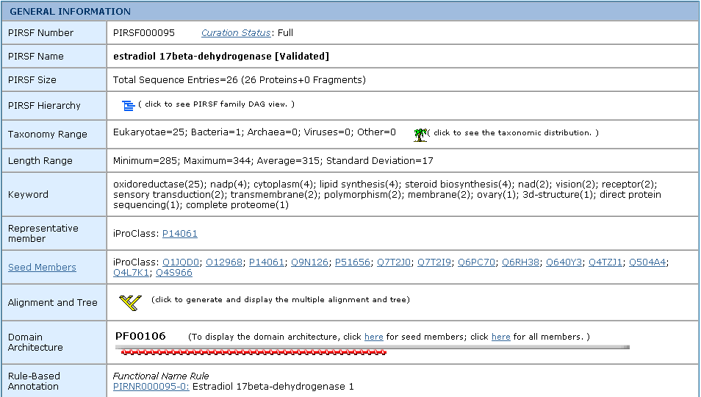
iProClass SuperFamily Summary

Slide 35
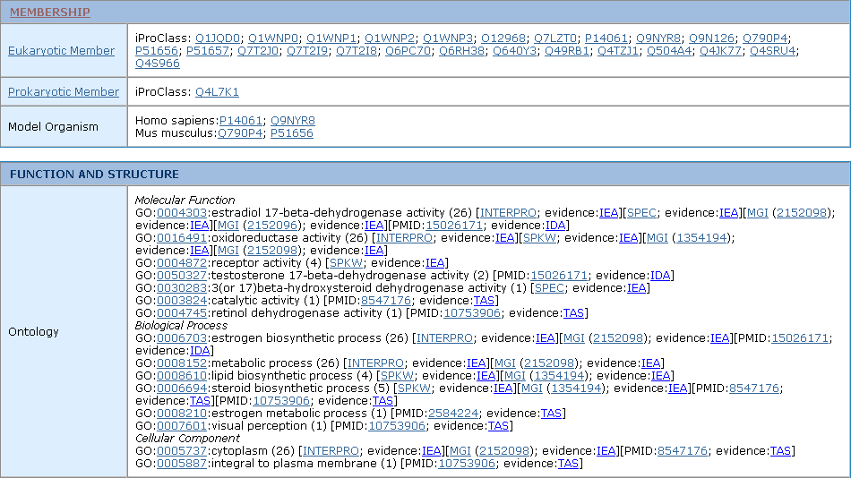
iProClass SuperFamily Summary

Slide 36
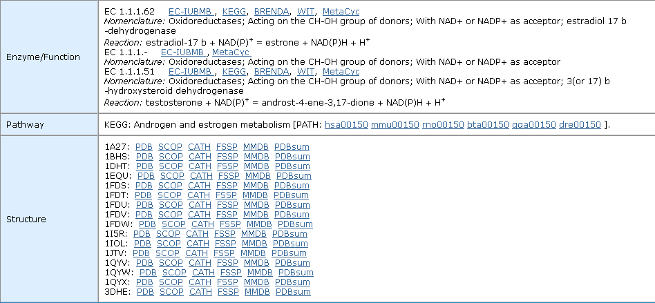
iProClass SuperFamily Summary

Slide 37
iProClass SuperFamily Summary

Slide 38
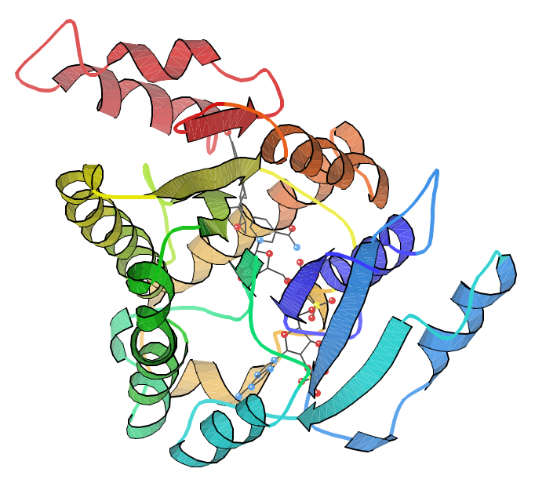
iProClass PDB Structure 1a27

Slide 39
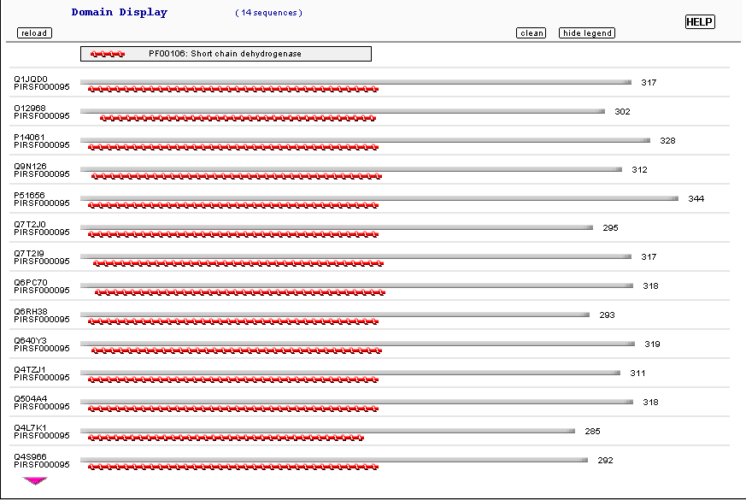
iProClass Domain Architecture

Slide 40
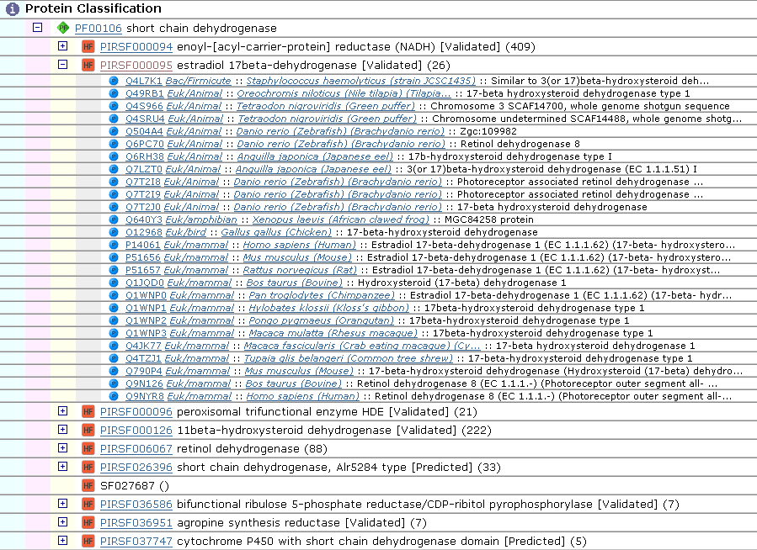
PIRSF Family Hierarchy

Slide 41
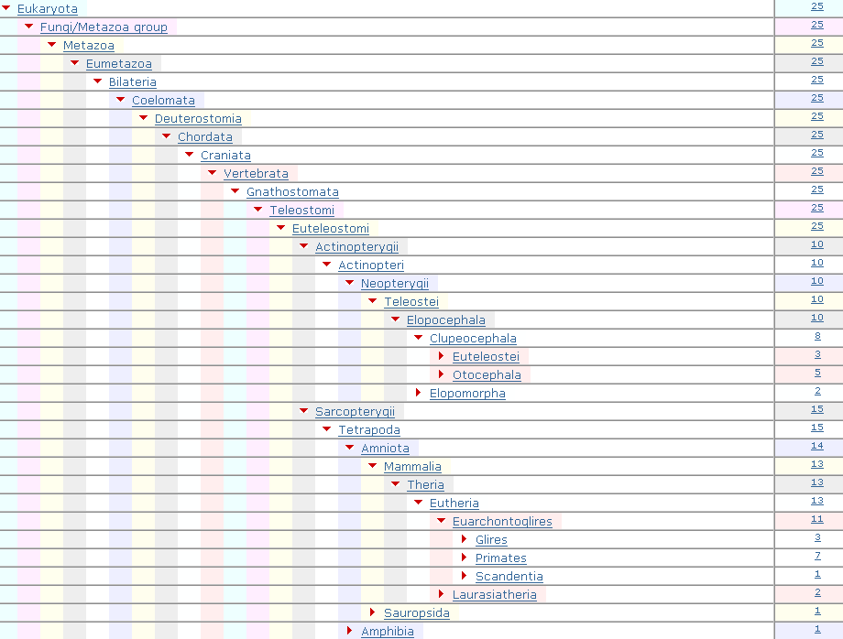
iProClass Taxonomy Nodes

Slide 42
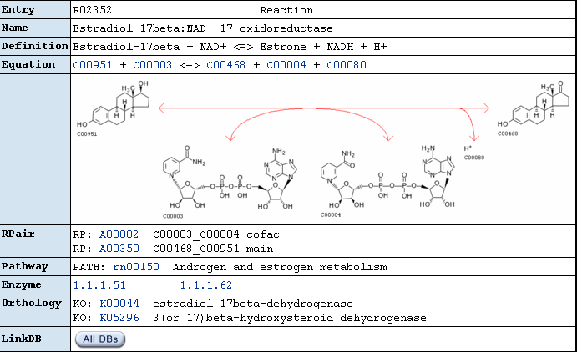
iProClass Enzyme Function: KEGG

Slide 43
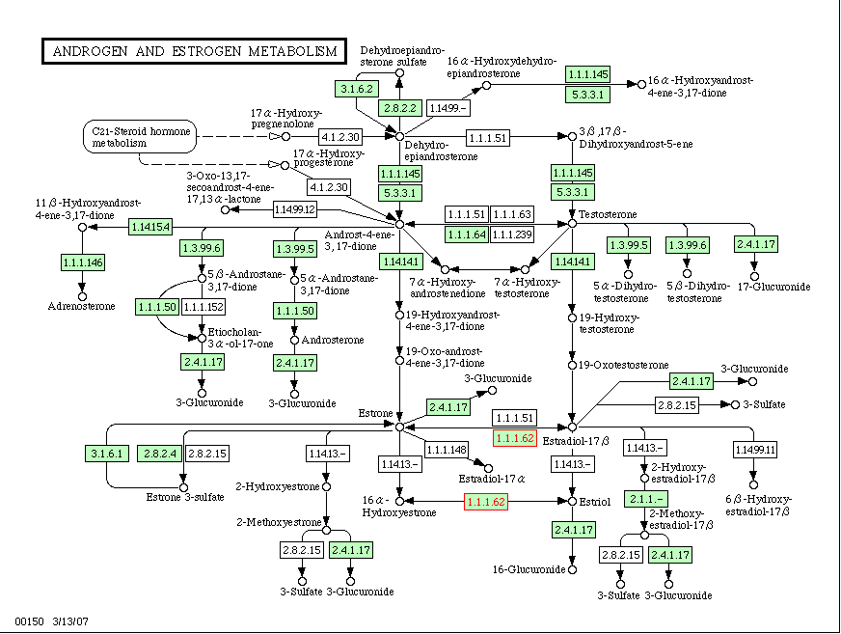
iProClass Pathway: KEGG

Slide 44
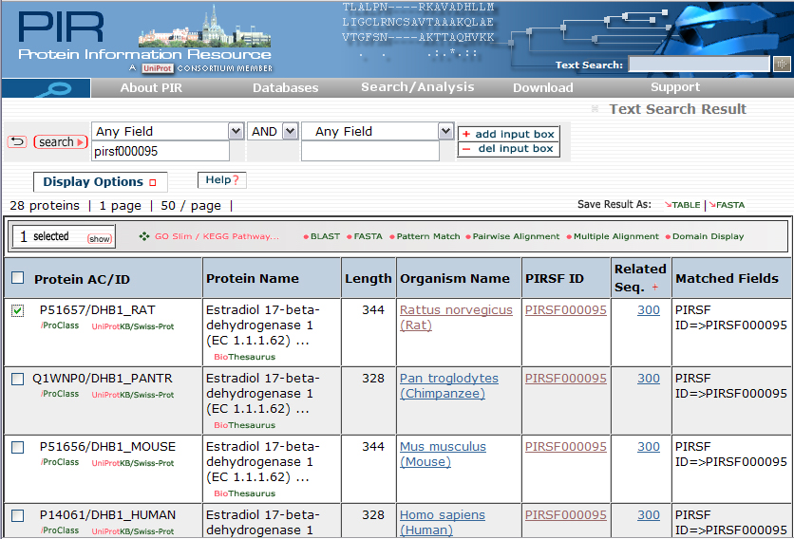
iProClass: Saving Sequences
Save
Format
Check
Entries

Slide 45
InterPro
Integrated resource of protein families, domains, repeats and sites from member databases (PROSITE, Pfam, Prints, ProDom, SMART and TIGRFAMs).
Member databases represent features in different ways: Some use hidden Markov models, some use position specific scoring meaticies, some use ambiguous consensus patterns.
Easy way to search several libraries at once with a query.

Slide 46
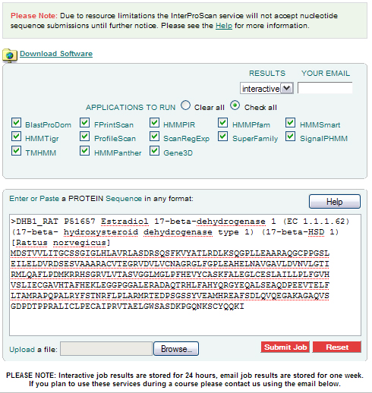
InterPro – Searching with InterProScan

Slide 47
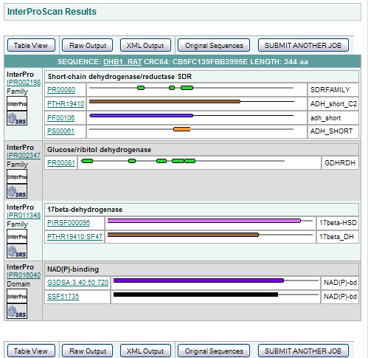
InterPro - InterProScan Results

Slide 48
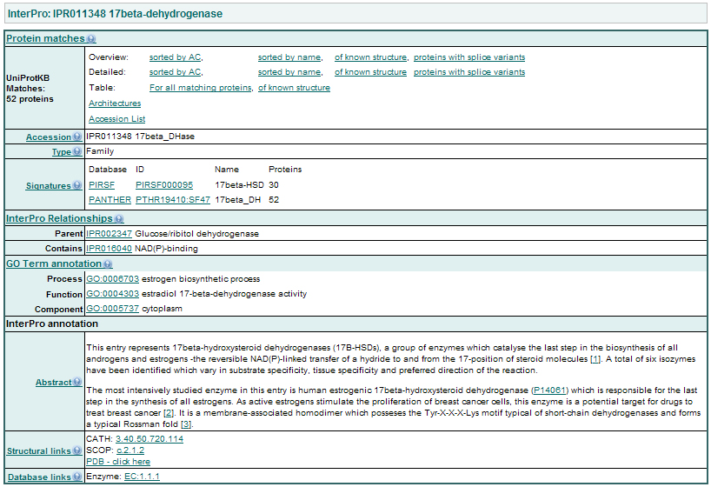
InterPro - InterProScan Results

Slide 49
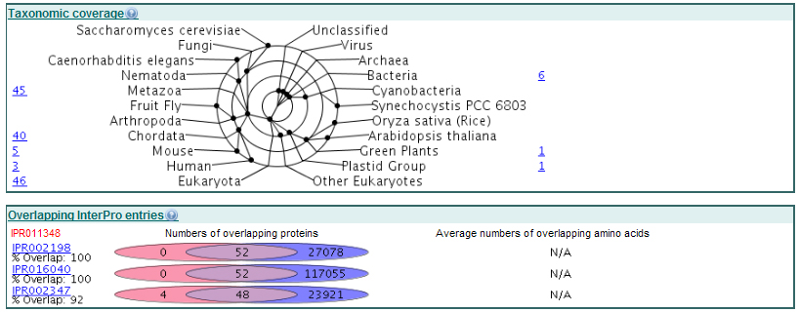
InterPro - InterProScan Results

Slide 50
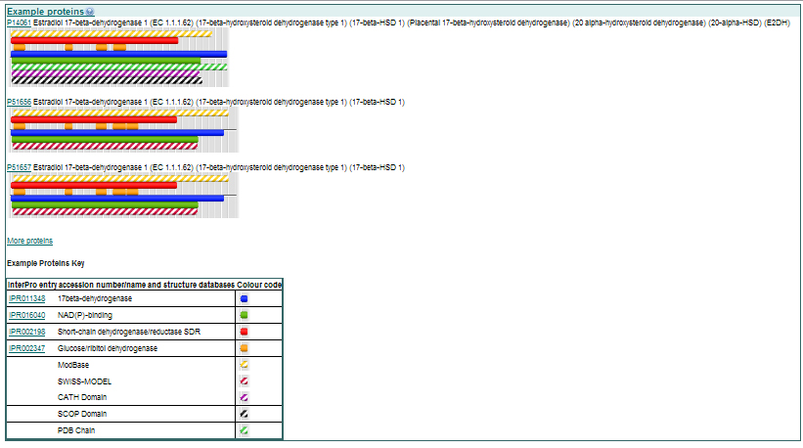
InterPro - InterProScan Results

Slide 51
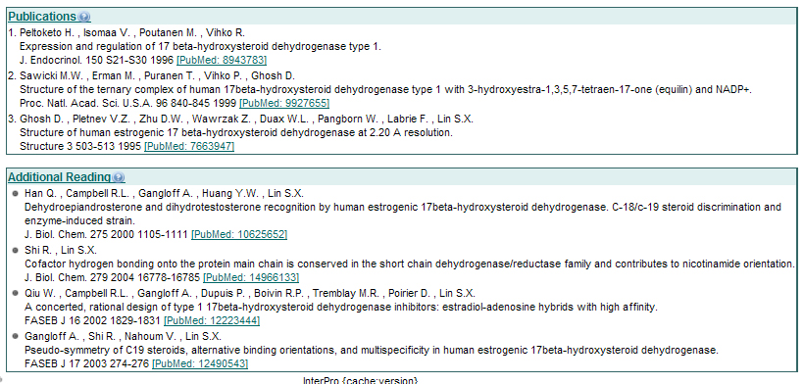
InterPro - InterProScan Results

Slide 52
A Vision: Computer Assisted Bioinformatics
Goal
The computer assists the scientist in the collection of all bioinformatics information relevant to the hypothesis at hand
A single software application that can:
Understand multiple data formats specifically devised to represent structure, function, metabolism, evolution, etc.
Assist scientists in creating and maintaining relationships among different types of information collected from multiple sources
Support simultaneous searches across multiple data sources of a similar nature (e.g. multiple sequence databases)
Remains an Open Research Problem

