Slide 1
Essential Computing for Bioinformatics
Lecture 2
High-level Programming with Python
Controlling the flow of your program
MARC: Developing Bioinformatics Programs
July 2009
Alex Ropelewski
PSC-NRBSC
Bienvenido Vélez
UPR Mayaguez
Reference: How to Think Like a Computer Scientist: Learning with Python

Slide 2
Essential Computing for Bioinformatics

Slide 3
Outline
Basics of Functions
Decision statements
Recursion
Iteration statements

Slide 4
Outline
Basics of Functions
Decision statements
Recursion
Iteration statements

Slide 5
Some Inaccurate Yet Popular Perceptions of Computing
Computing = Computers
Computing = Programming
Computing = Software

Slide 6
Computing = Computers
Computing is about solving problems using computers
A.K.A. The Computing Device View of Computing

Slide 7
Computing = Programming
Computing is about writing
programs for computers
A.K.A. The Programming Language view of Computing

Slide 8
Computing = Software
Computing is not concerned with
hardware design
A.K.A. The “Floppy Disk” view of Computing

Slide 9
Part I - Outline
What is Computing?
Computing Models and Computability
Interpretation and Universal Computers
Church’s Thesis

Slide 10
What is computing then?
Algorithmic
Computation
Function
Input
Information
Output
Information
Computing is the study of Computation:
the process of transforming information

Slide 11
The Computation Process
encode
compute
decode
011011001010100101…
011011001010100101…
Problem
Information
Information
Solution

Slide 12
Fundamental Questions Addressed by the Discipline of Computing
What is the nature of computation?
What can be computed?
What can be computed efficiently?
How can we build computing devices?

Slide 13
The Computation Process
encode
compute
decode
011011001010100101…
011011001010100101…
Problem
Solution
Integer
Integer
Function
Integer
Every Algorithm is in Essence an Integer Function

Slide 14
Computability
IF ≠ CF
IF ≟ CF
All Integer Functions
(IF)
Computable
Integer Functions
(CF)
Computable
Integer Functions
(CF)
Halting
Problem

Slide 15
The Halting Problem (Alan Turing 1936)
Given a program and an input to the program, determine if the program will eventually stop when it is given that input.
Compute
Want to describe
the set of computable
functions?
Program P
Cannot Build This
P Halts on I?
Input I

Slide 16
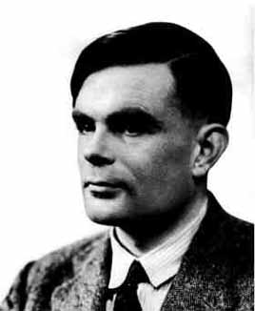
Mathematical Computers: The Turing Machine (1936)
0
1
Tape
Head
Infinite
I/O
TAPE
0/{1,0,R}
0
1
FSM
1/{0,1,L}
Alan Turing
Input
Symbol
Next
State
Head
Movement
Write
Symbol

Slide 17
Mathematical Computers: The Turing Machine (1936)
0
1
InfiniteTAPE
Tape
Head
Infinite
I/O
TAPE
0/{1,0,R}
0
1
FSM
FSM
1/{0,1,L}
Alan Turing
Turing demonstrated how to solve several
problems using his computing model

Slide 18
Ad-hoc Turing Machines
FSM
FSM
FSM
FSM
Sorting TM
Sorting TM
Sorting TM
Sorting TM
FSM
Searching TM
FSM
Integrating TM
Can we build a general purpose TM?

Slide 19
The Universal Turing Machine (UTM) The Paradigm for Modern General Purpose Computers
Coded TM M
Coded Tape for M
Software
(flexible)
Universal TM
Hardware
(fast)
Programming = Encoding Algorithms
Capable of Emulating Every other TM
Shown possible by Alan Turing (1936)
BIG IDEA: INTEPRETATION!!!

Slide 20
Other Familiar Models of Computation
Combinational Circuits
Sequential Circuits (FSM’s)
Pentium Instruction Set Architectures
Lambda Calculus
Recursive Functions
C++
Can you tell which ones are Turing Universal?
That is, which ones can emulate any other Turing Machine?

Slide 21
Computing in Perspective
All have
embedded PL’s
Excel
MatLab
PSpice
Build
Many
Pascal
C++
Fortran
Assembler 1
Assembler 2
Assembler 3
ISA
FSM
Build
One
Gate
CMOS
Interpreter Design Demands Programming Language Design

Slide 22
Why Abstraction Layers?
Resilience to change:
Each layer provides a level of indirection
Divide and Conquer Approach:
Can work on one small semantic gap at a time
Building Block Approach:
Can build many higher layer on same lower layer
Because we know of no other way of doing anything

Slide 23
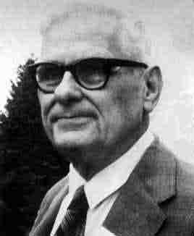
Church’s Thesis
“Any realizable computing device can be
simulated by a Turing machine”
“All the models of computation yet developed, and all those that may be developed in the future, are equivalent in power.”
Alonso Church
Issues not considered: Size, Programmability, Performance
But they must be considered if one is to build …

Slide 24
The (John) Von Neumann Architecture (late 40’s)
I/O
devices
Allow communication
with outside world
Central
Processing
Unit (CPU)
Interprets instructions
Stores both programs and data
Memory
After 60 years … most processors still look like this!

Slide 25
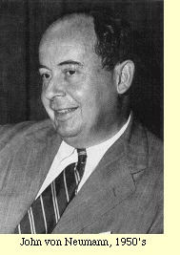
Practical Universal Computers (John) Von Neumann Architecture (1945)
Memory
CPU
DataPaths
Program
AC
ALU
This looks
just like a
TM Tape
PC
Data
ABR
status
control
Control Unit
(FSM)
CPU is a universal TM
An interpreter of some programming language (PL)

