Slide 1
Introduction to Python programming for Bioinformatics
BING 6004: Intro to Computational BioEngineering
Spring 2016
Lecture 2: Functions & Flow Control
Bienvenido Vélez
UPR Mayaguez
Reference: How to Think Like a Computer Scientist: Learning with Python

Slide 2
Essential Computing for Bioinformatics

Slide 3
Formatted Output using % operator
<format> % <values>
>>> '%s is %d years old' % ('John', 12)
'John is 12 years old'
>>>
<format> is a string
<values> is a list of values n parenthesis (a.k.a. a tuple)
% produces a string replacing each %x with a correding value from the tuple
For more details visit: http://docs.python.org/lib/typesseq-strings.html

Slide 4
Outline
Basics of Functions
Decision statements
Recursion
Iteration statements

Slide 5
Built-in Functions
>>> import math
>>> decibel = math.log10 (17.0)
>>> angle = 1.5
>>> height = math.sin(angle)
>>> degrees = 45
>>> angle = degrees * 2 * math.pi / 360.0
>>> math.sin(angle)
0.707106781187
To convert from degrees to radians,
divide by 360 and multiply by 2*pi
Can you avoid having to write the formula to
convert degrees to radians every time?
Notes:
Functions compute (return) values for a given set of parameters
Functions can be 'called' by other functions at any point where a value can appear in the program
Functions typically return values of the same type
The import statement makes all functions (and other stuff) defined inside a module (later) available to you program.

Slide 6
Defining Your Own Functions
def <NAME> ( <LIST OF PARAMETERS> ):
<STATEMENTS>
import math
def radians(degrees):
result = degrees * 2 * math.pi / 360.0
return(result)
>>> def radians(degrees):
... result=degrees * 2 * math.pi / 360.0
... return(result)
...
>>> radians(45)
0.78539816339744828
>>> radians(180)
3.1415926535897931
Notes:
A function has:
A 'signature' consisting of:
A name that should reflect the function's objective
A list of any number of 'formal parameters' that are sent to the function
A 'body' consisting of a sequence of statements that will produce the return value
The function's value is only computed at the time that it is called
Each function call can provide different parameters to the functions and yield a different result value
A function can be views as a parameterized sequence of statements that can be reused without duplicating the code each time it is needed.
Functions can call other functions.
The values sent in place of the parameters during a call are called 'arguments' of 'actual parameters'
Formal parameters are used in place of actual parameters in the specification of the body of the function
SYNTAX NOTE: The body of a function MUST be indented inside the header of the function. Indentation IS SIGNIFICANT in Python

Slide 7
Monolithic Code
cds = 'atgagtgaacgtctgagcattaccccgctggggccgtatatc'
gc = float(cds.count('g') + cds.count('c'))/ len(cds)
print gc
Notes:
Monolithic: Code is developed sequentially without creating much reusable components or “modules”

Slide 8
Step 1: Wrap Reusable Code in Function
def gcCount(s):
gc = float(s.count('g') + s.count('c'))/ len(s)
print(gc)
>>> gcCount('actgaccgggat')
0.583333333333

Slide 9
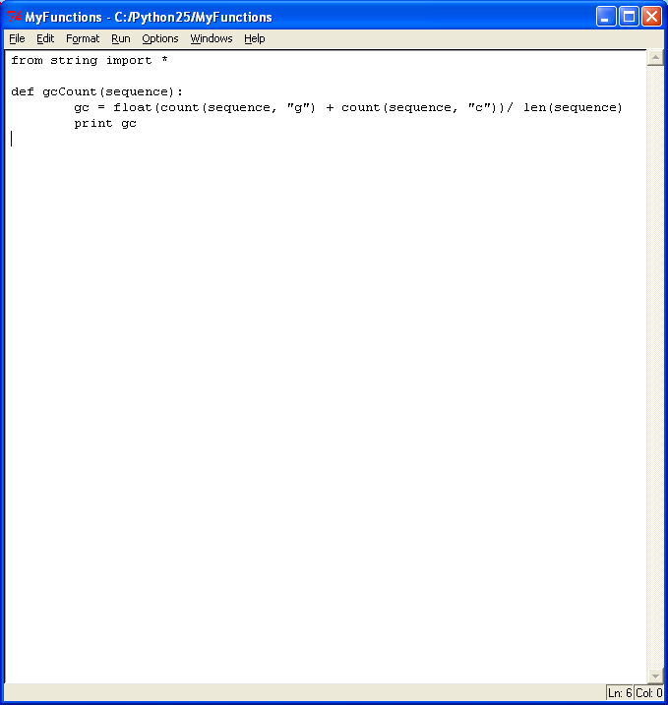
Step 2: Add function to script file
Save script in a file
Re-load when you want to use the functions
No need to retype your functions
Keep a single group of related functions and declarations in each file

Slide 10
Why Functions?
Powerful mechanism for creating building blocks
Code reuse
Modularity
Abstraction (i.e. hide (or forget) irrelevant detail)

Slide 11
Function Design Guidelines
Should have a single well defined 'contract'
E.g. Return the gc-value of a sequence
Contract should be easy to understand and remember
Should be as general as possible
Should be as efficient as possible
Should not mix calculations with I/O

Slide 12
Applying the Guidelines
def gcCount(s):
gc = float(s.count('g') + s.count('c'))/ len(s)
print (gc)
What can be improved?
def gcCount(s):
gc = float(s.count('g') + s.count('c'))/ len(s)
return gc
Why is this better?
More reusable function
Can call it to get the gcCount and then decide what to do with the value
May not have to print the value
Function has ONE well-defined objective or CONTRACT

Slide 13
Outline
Basics of Functions
Decision statements
Recursion
Iteration statements

Slide 14
Decision statements
if <be₁> :
<block₁>
elif <be₂>:
<block₂>
…
…
else:
<block_{n+1}>
Indentation has meaning
in Python
Each <be_{i>} is a BOOLEAN expressions
Each <block_{i}>is a sequence of statements
Level of indentation determines what's inside each block

Slide 15
Compute the complement of a DNA base
def complementBase(base):
if (base == 'a'):
return 't'
elif (base == 't'):
return 'a'
elif (base == 'c'):
return 'g'
elif (base == 'g'):
return 'c'
How can we improve this function?
Notes:
Potential improvement:
Function only recognizes upper-case bases
Function computes the complement of ANYTHING that is not ATGC as X. Reasonable?
Class room exercise:
Try to write the contract for this function considering its limitations
Think about an IDEAL contract for this function without considering how to implement it
Then implement that IDEAL contract
Can you venture to draw some generalization about the relationship between the simplicity of a contract and the difficulty of its implementation?

Slide 16
Boolean Expressions
Expressions that yield True of False values
Ways to yield a Boolean value
Boolean constants: True and False
Comparison operators (>, <, ==, >=, <=)
Logical Operators (and, or, not)
Boolean functions
0 (means False)
Empty string '' (means False)
Notes:
Exercises:
Write an example of each type of boolean expression and try it in your favorite Python intepreter

Slide 17
Some Useful Boolean Laws
Lets assume that b,a are Boolean values:
(b and True) = b
(b or True) = True
(b and False) = False
(b or False) = b
not (a and b) = (not a) or (not b)
not (a or b) = (not a) and (not b)
De Morgan's Laws
Notes:
Another way to state De Morgan's laws is:
If a conjunction (and) is false then one of the operands must be false
If a disjunction (or) is false then both operands must be false
De Morgan's laws are very useful to find the negation of complex Boolean expressions

Slide 18
A strange Boolean function
def test(x):
if x:
return True
else:
return False
What can you use this function for?
What types of values can it accept?
Notes:
The test function above is an example of a polymorphic function:
Polymorphic functions can take in several types of values
How is this function different from the function:
def test(x):
return x

Slide 19
Outline
Basics of Functions
Decision statements
Recursion
Iteration statements

Slide 20
Recursive Functions
A classic!
def fact(n):
if (n==0):
return 1
else:
return n * fact(n - 1)
>>> fact(5)
120
>>> fact(10)
3628800
>>> fact(100)
93326215443944152681699238856266700490715968264381621468592963895217599993229915608941463976156518286253697920827223758251185210916864000000000000000000000000L
>>>
Notes:
Big Integers: Python automatically adjusts the size of its integer numbers

Slide 21
Recursion Basics
def fact(n):
if (n==0):
return 1
else:
return n * fact(n - 1)
n = 0
n = 1
fact(3)
n = 2
n = 3
fact(2)
n = 3
3 * 2 = 6
n = 2
fact(1)
2 * 1 = 2
Interpreter keeps a
stack of activation records
n = 1
fact(0)
1 * 1 = 1
n = 0
1
Notes:
If we call fact(5.5), n will never become equal to 1 and the recursion will go on forever.
Could this error happen in Java or C++?
No because both Java and C++ make sure that the argument is an integer at compile time
One possible fix is to stop when n gets to be less or equal to 1
Don't forget to try fact(5.5) in your interpreter since it will show yu how to recognize an infinite recursion

Slide 22
Beware of Infinite Recursions!
def fact(n):
if (n==0):
return 1
else:
return n * fact(n - 1)
What if you call fact 5.5? Explain
When using recursion always think about how will it stop or converge
Notes:
If we call fact(5.5), n will never become equal to 1 and the recursion will go on forever.
Could this error happen in Java or C++?
No because both Java and C++ make sure that the argument is an integer at compile time
One possible fix is to stop when n gets to be less or equal to 1
Don't forget to try fact(5.5) in your interpreter since it will show yu how to recognize an infinite recursion

Slide 23
Practice Exercises on Functions
Write recursive Python functions to satisfy the following specifications:
Compute the reverse of a sequence
Compute the molecular mass of a sequence
Compute the reverse complement of a sequence
Determine if two sequences are complement of each other
Compute the number of stop codons in a sequence
Determine if a sequence has a subsequence of length greater than n surrounded by start/stop codons
Return the starting position of the subsequence identified in exercise 6
Notes:
I recommend the following classroom exercise:
Divide the students in extreme programming (http://en.wikipedia.org/wiki/Extreme_Programming) teams of two
Assign one problem to each team
Give the team some time (30 min) to work on each problem
Each team presents its solution to the rest of the class
Under the guidance of the professor, everybody provides constructive criticism on how to improve the solution
Don't stop until NO ONE can come up with an improvement that a majority agrees on
This exercise is very time consuming, yet in my opinion, worth every second

Slide 24
Reversing a sequence recursively
def reverse(sequence):
'Returns the reverse string of the argument sequence'
if (len(sequence)>1):
return reverse(sequence[1:])+sequence[0]
else:
return sequence

Slide 25
Runtime Complexity - 'Big O' Notation
def fact(n):
if (n==0):
return 1
else:
return n * fact(n - 1)
How 'fast' is this function?
Can we come up with a more efficient version?
How can we measure 'efficiency'
Can we compare algorithms independently from a specific implementation, software or hardware?

Slide 26
Runtime Complexity - 'Big O' Notation
Big Idea
Measure the number of steps taken by the
algorithm as an asymptotic function of the size of its input
What is a step?
How can we measure the size of an input?
Answer in both cases: YOU CAN DEFINE THESE!

Slide 27
'Big O' Notation - Factorial Example
A 'step' is a function call to fact
The size of an input value n is n itself
def fact(n):
if (n==0):
return 1
else:
return n * fact(n - 1)
Step 1: Count the number of steps for input n
T(0) = 0
T(n) = T(n-1) + 1 = (T(n-2) + 1) + 1 = … = T(n-n) + n = T(0) + n = 0 + n = n
Step 2: Find the asymptotic function
A.K.A Linear Function
T(n) = O(n)

Slide 28
Outline
Basics of Functions
Decision statements
Recursion
Iteration statements

Slide 29
Iteration
while <be>:
<block>
SYNTAX
Repeat the execution of <block> as long as expression <be>
remains true
SEMANTICS
SYNTAX = FORMAT
SEMANTICS = MEANING

Slide 30
Iterative Factorial
def iterFact(n):
result = 1
while(n>0):
result = result * n
n = n - 1
return result
Work out the runtime complexity:
whiteboard
Notes:
This is an example of an iterative version of the factorial function
In this case, the runtime complexity is the same as the recursive version
This will not be the case in the case of the Fibonacci function on the next slide

Slide 31
The For Loop: Another Iteration Statement
for <var> in <sequence>:
<block>
SYNTAX
Repeat the execution of the <block> binding variable <var> to each element of the sequence
SEMANTICS

Slide 32
For Loop Example
def iterFact2(n):
result = 1
for i in xrange(1,n+1):
result = result * i
return result
xrange(start,end,step) generates a sequence of values :
start = first value
end = value right after last one
step = increment
Notes:
The for loop is a somewhat less general iterative construct
Every for can be written as a while, yet for loops tend to be easier to read and understand.
For loops are recommended when we have an a priori list of values that we want to iterate over
Examples of such lists of values are:
Python lists or tuples
Discrete ranges of integer numbers

Slide 33
Revisiting code from Lecture 1
seq="ACTGTCGTAT"
print (seq)
Acount= seq.count('A')
Ccount= seq.count('C')
Gcount= seq.count('G')
Tcount= seq.count('T')
Total = float(len(seq))
APct = int((Acount/Total) * 100)
print ('A percent = %d ' % Apct)
CPct = int((Ccount/Total) * 100)
print ('C percent = %d ' % CPct)
GPct = int((Gcount/Total) * 100)
print ('G percent = %d ' % GPct)
TPct = int((Tcount/Total) * 100)
print ('T percent = %d ' % TPct)
Can we reduce the amount of repetitive code?

Slide 34
Approach: Use For Loop
bases = ['A', 'C', 'T', 'G']
sequence = "ACTGTCGTAT"
for base in bases:
nextPercent = 100 * sequence.count(base)/float(len(sequence))
print 'Percent %s: %d' % (base, nextPercent)
How many functions would you refactor this code into?

Slide 35
Exercises on Functions
Write iterative Python functions to satisfy the following specifications:
Compute the reverse of a sequence
Compute the molecular mass of a sequence
Compute the reverse complement of a sequence
Determine if two sequences are complement of each other
Compute the number of stop codons in a sequence
Determine if a sequence has a subsequence of length greater than n surrounded by start/stop codons
Return the starting position of the subsequence identified in exercise 6

Slide 36
Finding Patterns Within Sequences
from string import *
def searchPattern(dna, pattern):
'print all start positions of a pattern string inside a target string'
site = find (dna, pattern)
while site != -1:
print 'pattern %s found at position %d' % (pattern, site)
site = find (dna, pattern, site + 1)
>>> searchPattern("acgctaggct","gc")
pattern gc at position 2
pattern gc at position 7
>>>
Example from: Pasteur Institute Bioinformatics Using Python

Slide 37
Homework
Extend searchPattern to handle unknown residues

