Slide 1
Diminished Radii Complement and codes
INEL 4205

Slide 2
Definition
Given a number N in base r having n digits, the (r - l)'s complement of N is defined as:
(r" - 1) - N.
For Decimal numbers
r = 10 and r - 1 = 9, so the 9's complement
of N is (10^{n} - 1) - N.
Now, 10^{n} represents a number that consists of a single 1
followed by n O's.
10" - I is a number represented by n 9's.

Slide 3
Example for decimal numbers
For example, if n = 4,
we have 10⁴ = 10,000 and
10000- 1 = 09999.
It follows that the 9's complement of a decimal number is obtained by subtracting each digit from 9.
The 9's complement of 546700 is 999999 - 546700 = 453299.
The 9's complement of 012398 is 999999 - 012398 = 987601.

Slide 4
Example for binary numbers (r=2)
For example, if n = 4,
we have 10⁴ = 10000
10000- 1 = 01111.
It follows that the 1'st complement of a binary number is obtained by subtracting each digit from 1.
The 1'st complement of 101010 is
111111 - 101010 = 010101.
The 1'st complement of 001 is 111 - 001 = 110.

Slide 5
Two’s Complement of Binary Number
Invert every number
Example: N=11001100
ones complement =00110011
two’s complement = one’s complement +1=00110100

Slide 6
Subtracting using twos complement
Using 10's complement, subtract 72532 - 3250.
M= 72532
10' s complemen t of N = + 96750
Sum = 169282
Discard end carry 10⁵ = -100000
Answer = 69282
•Note that M has 5 digits and N has only 4 digits. Both numbers must have the same number of digits; so we can write N as 03250.
Taking the lO's complement of N produces a 9 in the most significant position. The occurrence of the end carry signifies that
M >=N and the result is positive.

Slide 7
Subtraction using 2’s complement with binary numbers
X-Y
Y-X
X = 1010100 and Y = 1000011,
X= 1010100
2's compY = + 0111101
Sum = 10010001
Discard end carry 2' = - 10000000
Answer: X - Y = 0010001
Y= 1000011
2's comp of X = + 0101100
Sum = 1101111
There is no end carry.
Answer:
Y - X = (2's comp of 1101111)
= -0010001 •

Slide 8
ASCII Code
The ASCII code contains 94 graphic characters that
can be printed and 34 nonprinting characters used for various control functions. The graphic characters consist of the 26 uppercase letters (A through Z), the 26 lowercase letters (a through z), the 10 numerals (0 through 9), and 32 special printable characterssuch as %, *, and $.

Slide 9
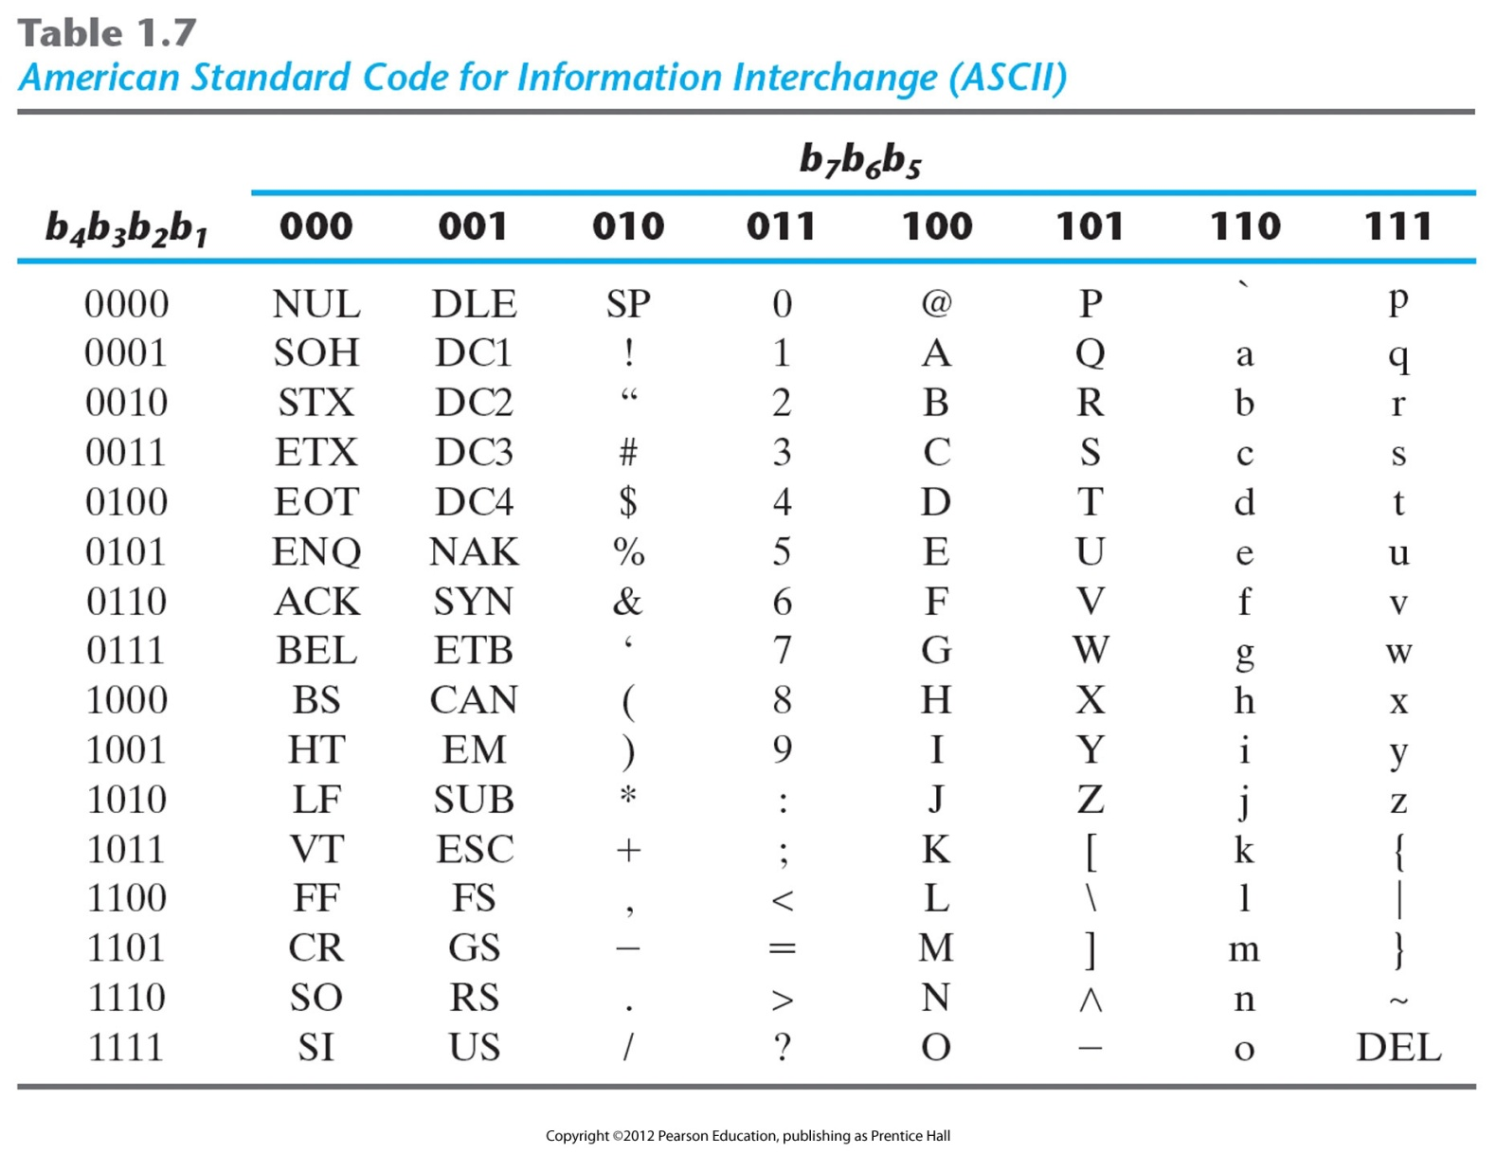
American Standard Code for Information Interchange (ASCII)

Slide 10
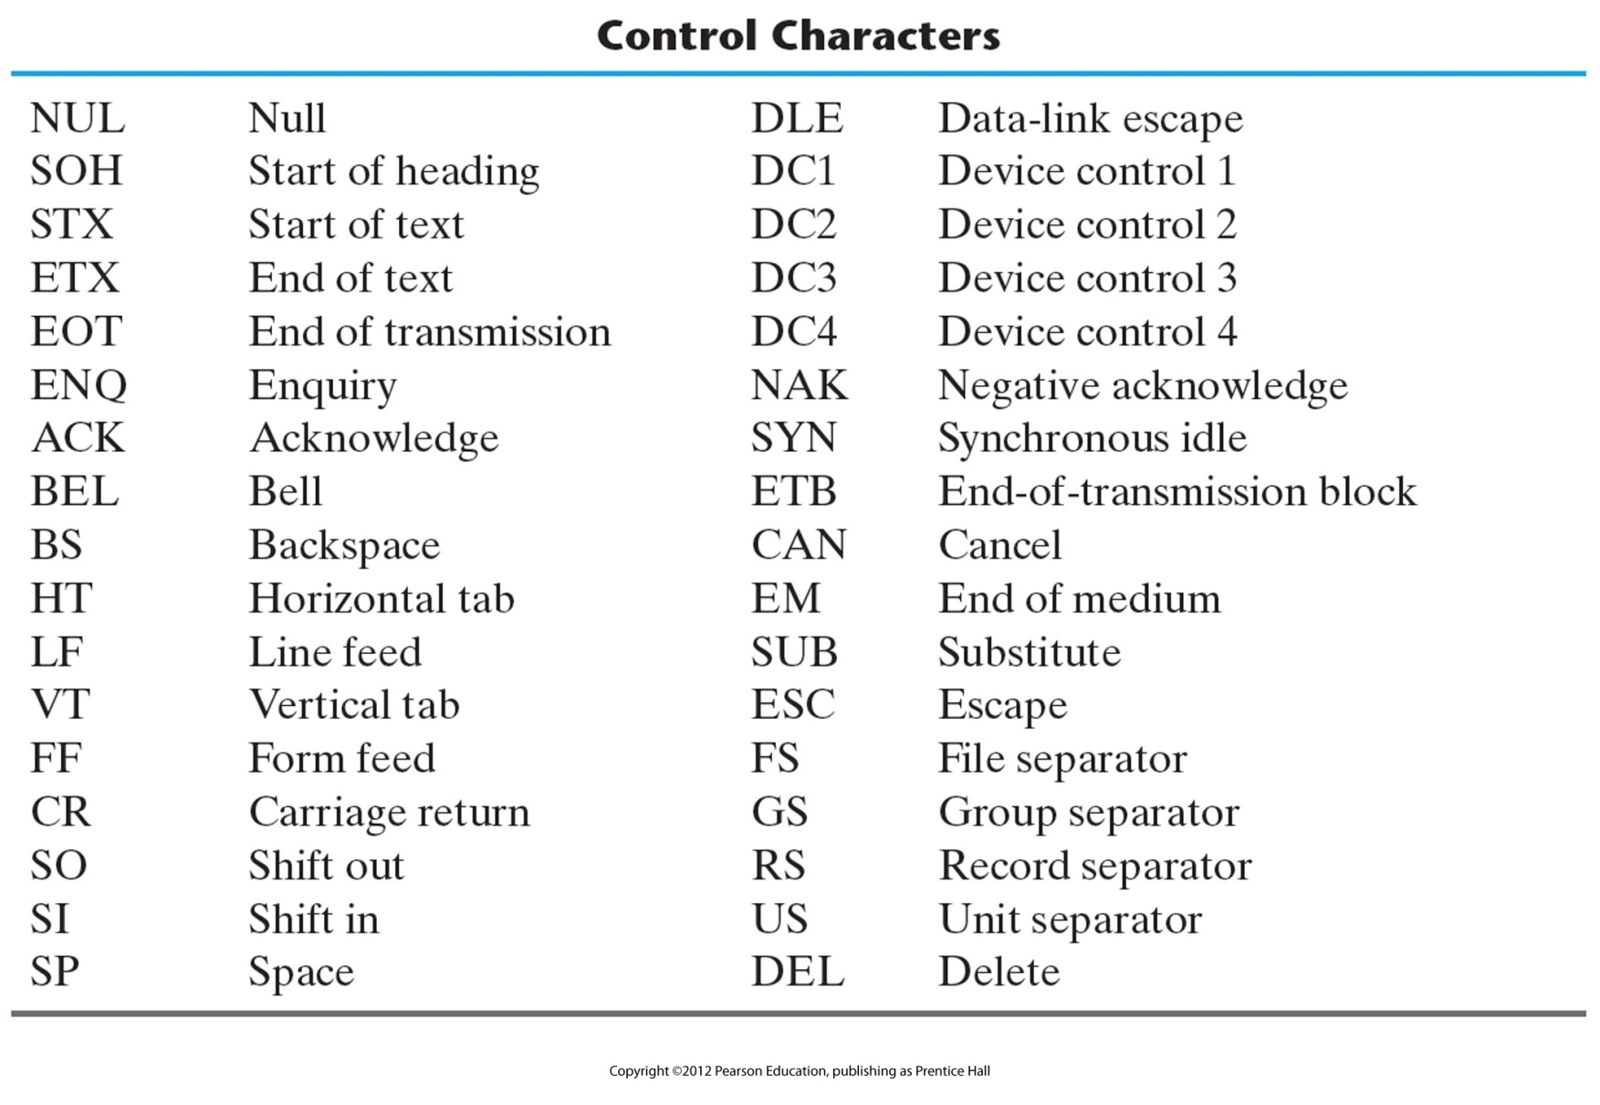
American Standard Code for Information Interchange (ASCII)

Slide 11
Registers
Group of binary cells
A cell stores one bit of information.
Register contains n cells therefore can store n bits of information.
The State of the register is an n-tuple number of 1’s and 0’s.
The content of a register is a function of the interpretation given to the information stored in it

Slide 12
Register information
An interregister transfer operation – transfer of information from one register to another.
Information from keyboard if ASCII enters in the memory as an 8 bit register.
The eighth bit is a parity bit.
The 8 bits are stored in the LSBits of the register and later are shifted

Slide 13
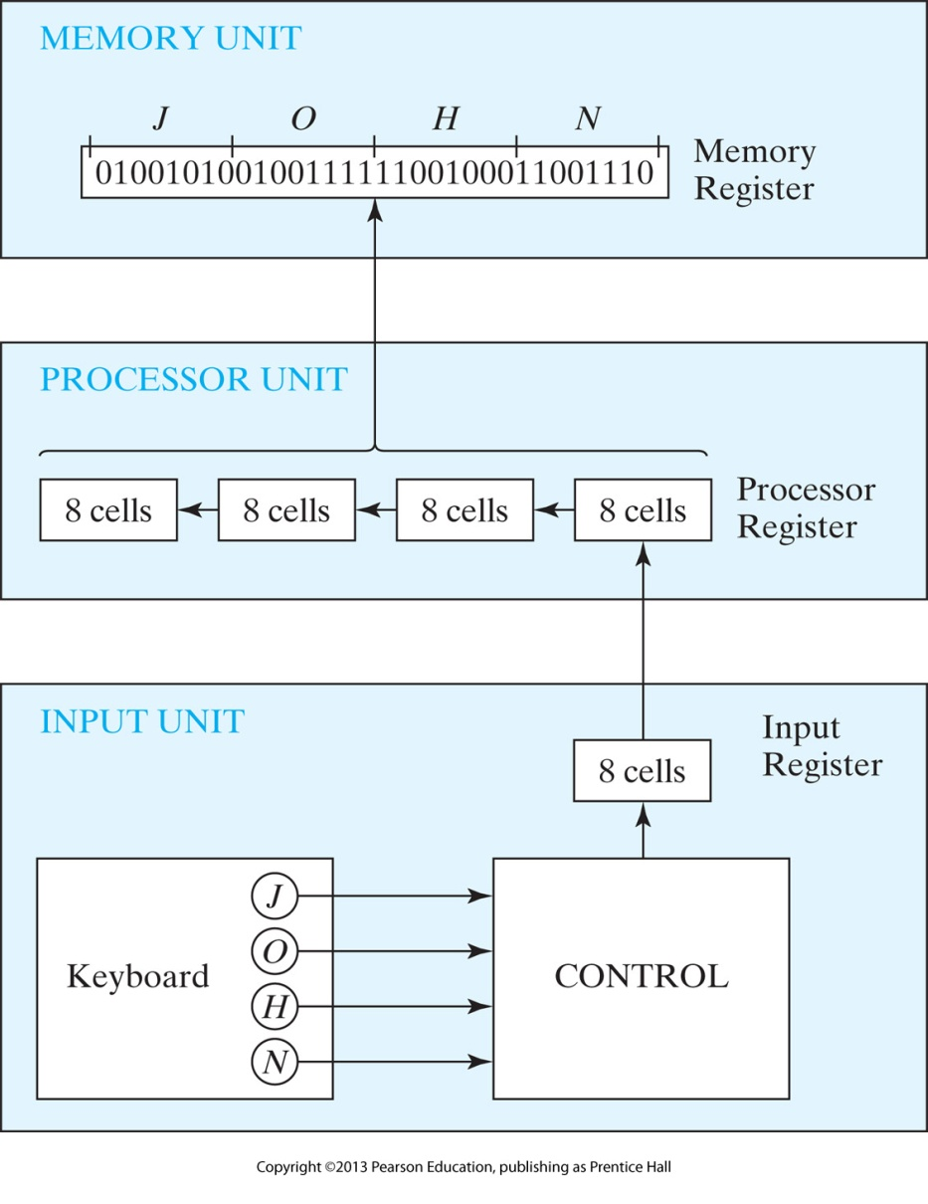
Transfer of information among registers

Slide 14
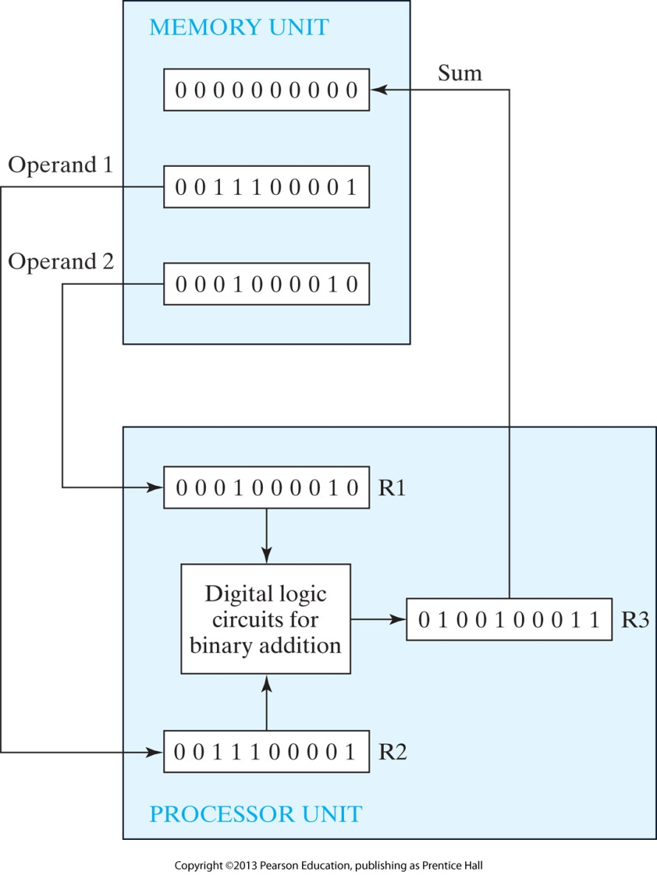
FIGURE 1.2 Example of binary information processing

Slide 15
Table 1.8 Truth Tables of Logical Operations

Slide 16
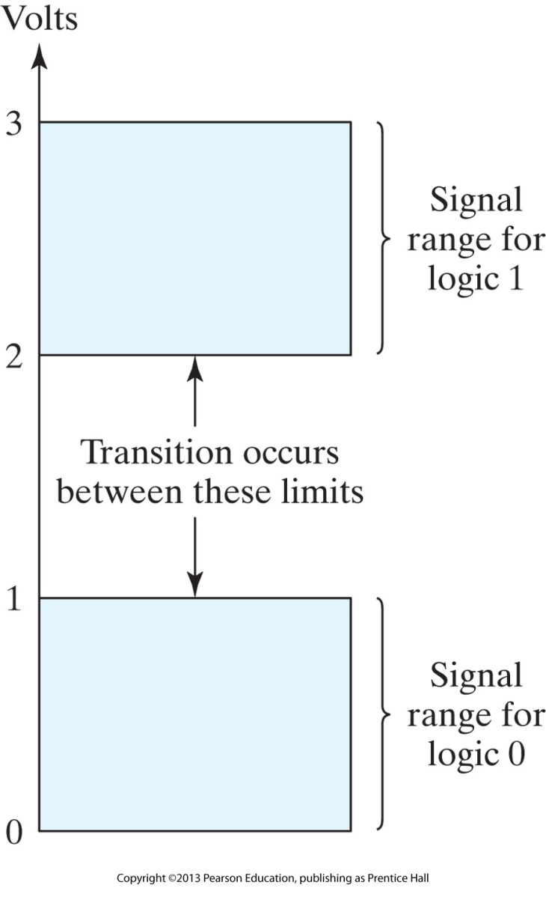
FIGURE 1.3 Signal levels for binary logic values

Slide 17
FIGURE 1.4 Symbols for digital logic circuits

Slide 18
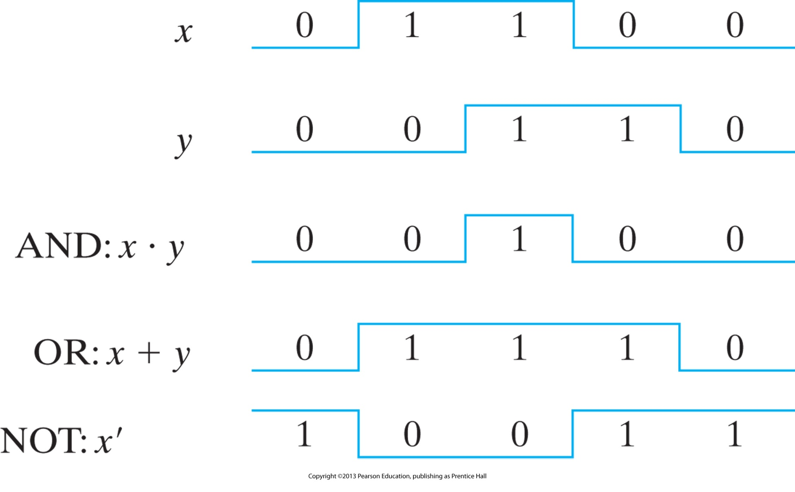
FIGURE 1.5 Input–output signals for gates

Slide 19
FIGURE 1.6 Gates with multiple inputs

