Slide 1
Emitter-Coupled Logic
INEL 4207

Slide 2
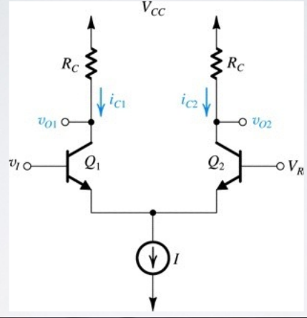
Differential Pair as basic element of ECL

Slide 3
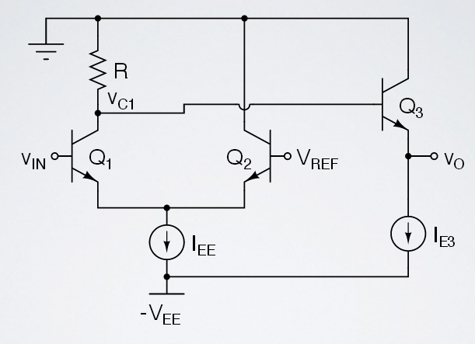
Simplified ECL Inverter
Example: Select R so that Vo= -1.5V. Use I_{EE}= 0.1mA.

Slide 4
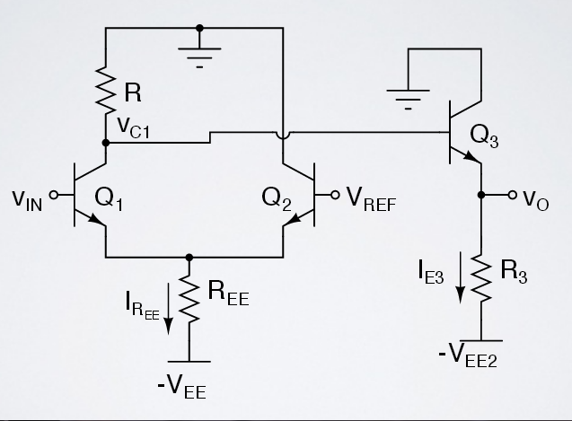
ECL with Resistor Biasing
Example: Find R and R₃ if V_{EE}= V_{EE2}=−5.2V, V_{L}=−1.3V, I_{EE}= 300μA and I_{EE2}= 100μA.

Slide 5
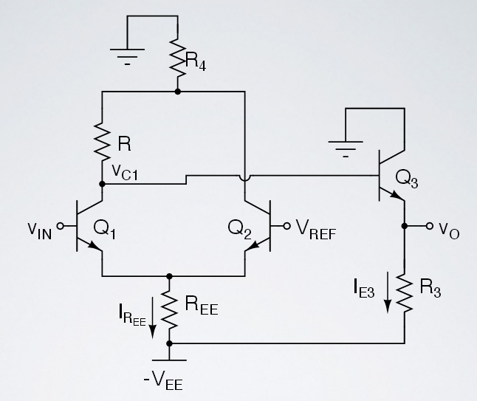
Example: Use the above circuit design an ECL gate for which V_{H}=−1.7V and
V_{L}=−2.3V . The average power dissipation should be less that 2mW. The supply voltage is −5.2V . Neglect the base currents.

Slide 6
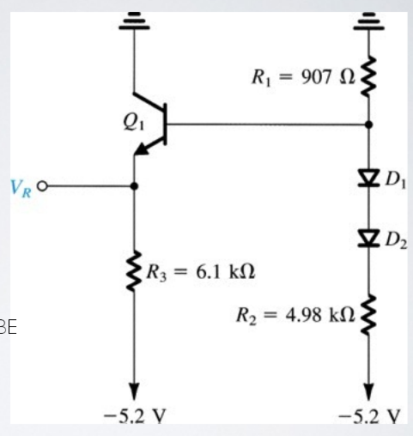
Find V_{R} if v_{D1}= v_{D2}
v_{D2}= v_{BE}= 0.75V.
Neglect i_{B}

Slide 7
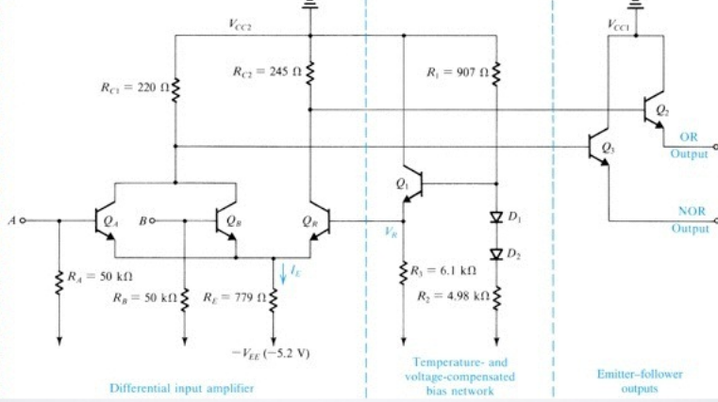
Figure 14.26 Basic circuit of the ECL 10K logic-gate family t_{p}≈1ns, the time it takes light to travel 1 foot.

Slide 8
Practice Problem
For previous circuit, find
I_{E} through R_{E} if A and B are left open.
Also find v_{C}, Q_{R} and v_{CA,B}.
Use V_{R}= -1.32V, V_{BE}=0.75V and a very large β.

Slide 9
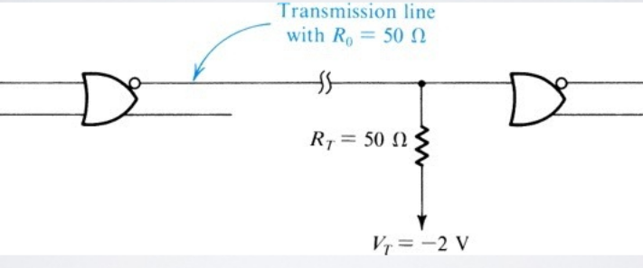
Figure 14.27 The proper way to connect high-speed logic gates such as ECL. Properly terminating the transmission line connecting the two gates eliminates the “ringing” that would otherwise corrupt the logic signals. (See Section 14.4.6)

Slide 10
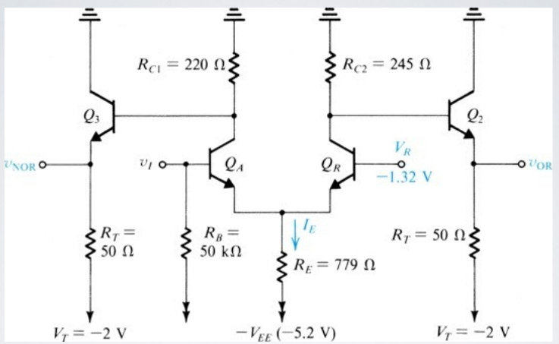
Figure 14.28 Simplified version of the ECL gate for the purpose of finding transfer characteristics.

Slide 11
Practice Problems
Find VOL and VOH (neglect iC of QR) if β=100. Then find NMH and NML if V_{IL} and V_{IH} are defined as the conditions for which I_{E}, I_{EQA}= 99% of I_{E} when V_{I}=V_{IH} and I_{EQA}=1% when V_{I}=V_{IL}

Slide 12
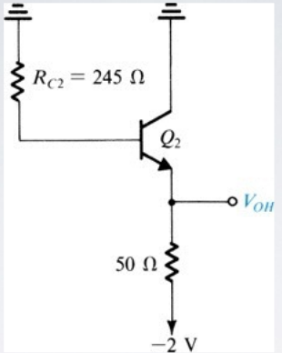
V_{OH}= -0.88V. Take into account base current and variations in v_{BE}. Assume that at i_{C}= 1mA, v_{BE}= 0.75V
Figure 14.30 Circuit for determining VOH

Slide 13
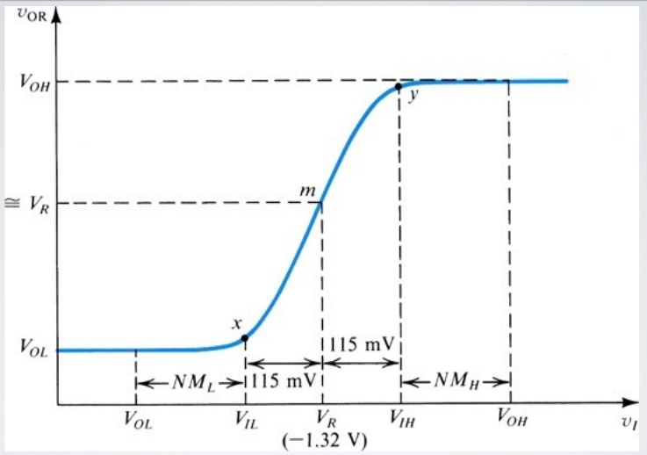
Figure 14.29 The OR Transfer Characteristic v_{OR} vs v_{I}, for the circuit in fig. 14.28

Slide 14
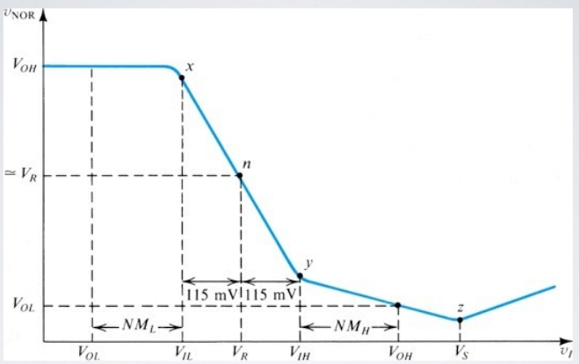
Figure 14.31 The NOR Transfer Characteristic

Slide 15
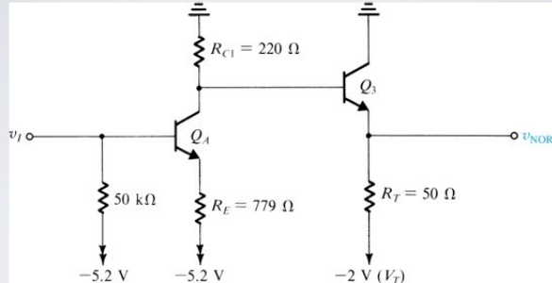
Circuit for finding v_{NOR} vs v_{I} for the range v_{I}>V_{IH}

Slide 16
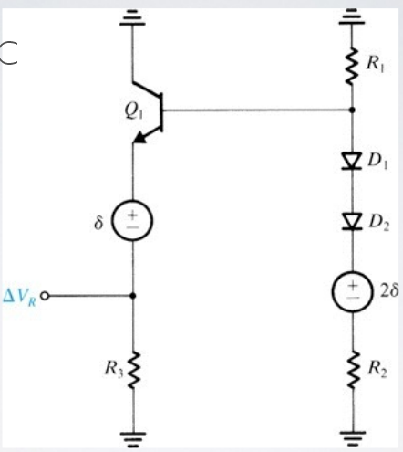
Figure 14.33 Equivalent circuit for determining the temperature coefficient of the reference voltage VR
δ=-2mV/C

Slide 17
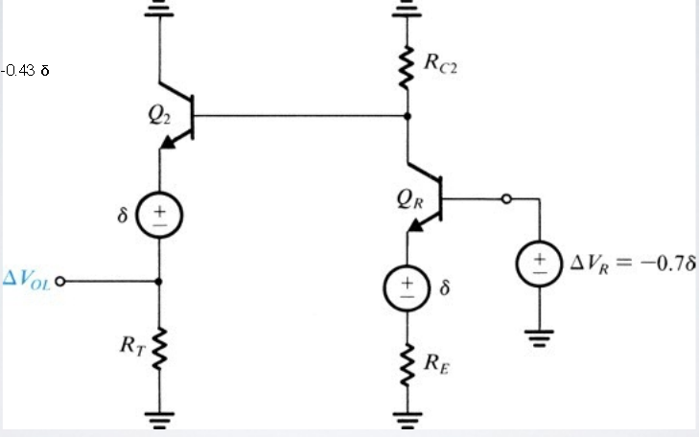
∆V_{OL}= -0.43δ
Figure 14.34 Equivalent circuit for determining the temperature coefficient of V_{OL}

Slide 18
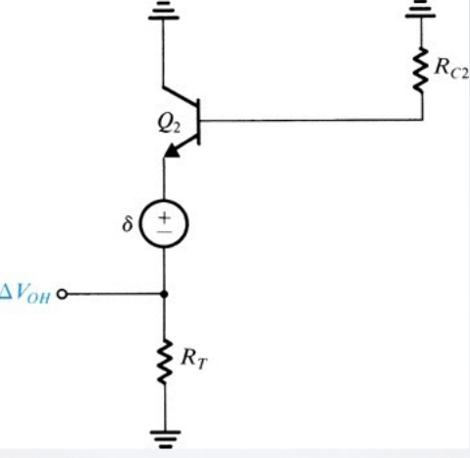
Figure 14.35 Equivalent circuit for determining the temperature coefficient of V_{OH}.

Slide 19
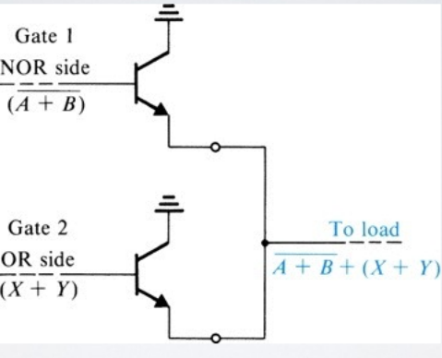
Figure 14.36 The wired-OR capability of ECL

Slide 20
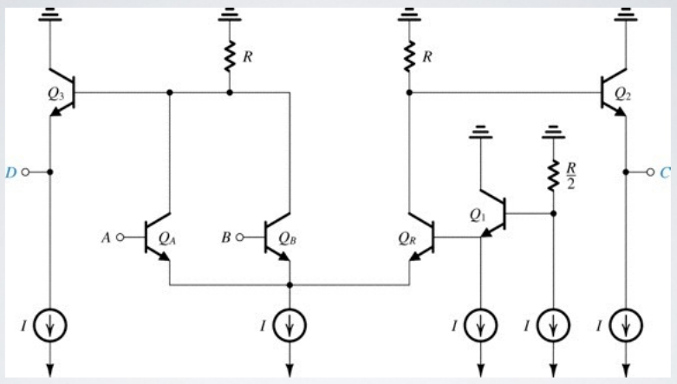
Figure P14.30

Slide 21
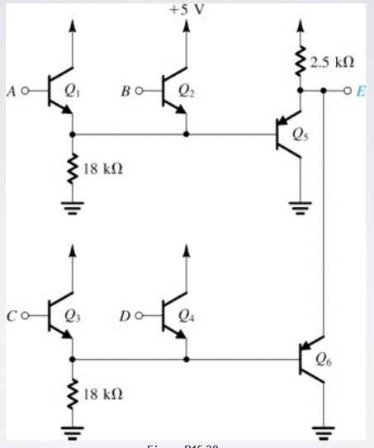
Figure P14.39

Slide 22
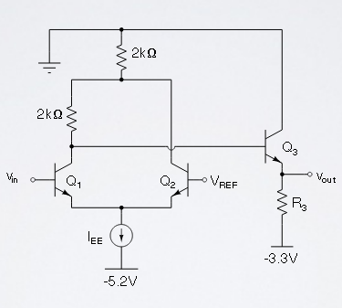
For the ECL inverter shown in the following sketch, the high voltage level is V_{H} = −1.7V and the average power dissipated when the input is high 50% of the time is P =5mW.
Determine the source’s current I_{EE}, the low voltage level V_{L}, the reference voltage level V_{REF} and the value of resistance R₃

Slide 23
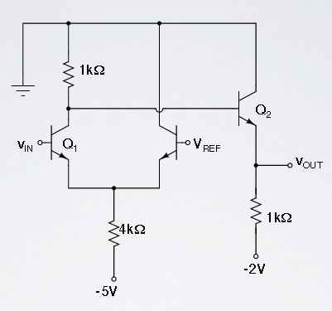
Find VL, VH and VREF for the following circuit. Neglect base currents and assume VBE=0.7V if a transistor is ON.

