Slide 1
Flip Flops INEL 4207
Gladys O. Ducoudray
Material for test 4

Slide 2
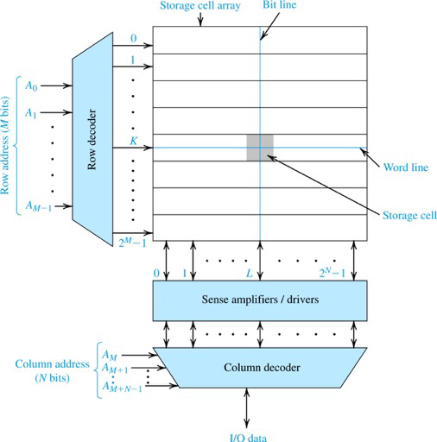
Flip Flops are the basis for memory
For memory we need
FlipFlops
Sense amplifiers
Decoders
Figure 15.11 A 2M+N -bit memory chip organized as an array of 2M rows × 2N columns.

Slide 3
Basic Latch
Figure 16.1 (a) Basic latch. (b) The latch with the feedback loop opened.
(c) Determining the operating point(s) of the latch.

Slide 4
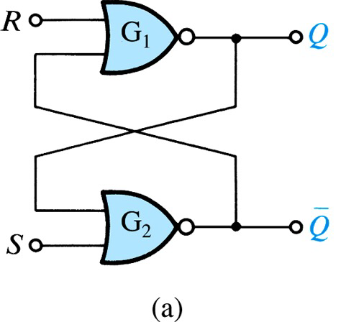
RS Latch
R | S | Q_{n+1}
0 | 0 | Q_{n}
0 | 1 | 1
1 | 0 | 0
1 | 1 | Not used

Slide 5
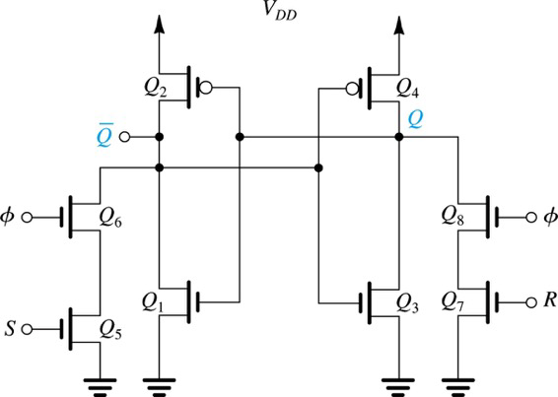
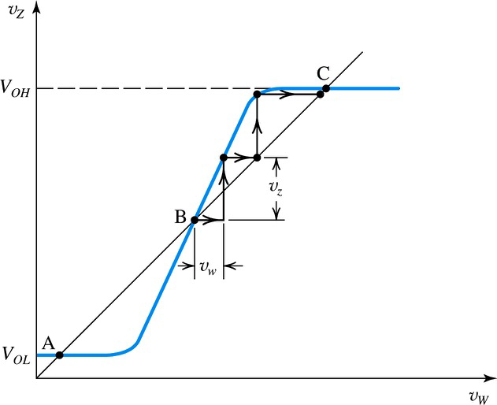
Implementation of Clocked SR FlipFlop

Slide 6
Function of Flip Flop
Assume
Q=0, Q’ =1
Clock and S toggles high
Q’ is pulled down
voltage at Q increases
0
1
⦁
1
0
1
Fig. 16.4 CMOS implementation of a clocked SR flip-flop. The clock signal is denoted by ϕ.

Slide 7
Function of Flip Flop
Q’ reaches critical point
Q reaches critical point
Vdd/2
Vdd/2
⦁
1
0
0
1
Fig. 16.4 CMOS implementation of a clocked SR flip-flop. The clock signal is denoted by ϕ.

Slide 8
Function of Flip Flop
S toggles Low
Regenerative action restore levels
1
0
Vdd/2+ΔV
Vdd/2-ΔV
⦁
1
0
0
1
Fig. 16.4 CMOS implementation of a clocked SR flip-flop. The clock signal is denoted by ϕ.

Slide 9
Widescreen Pictures
Pictures can also be presented more dramatically in widescreen.

Slide 10
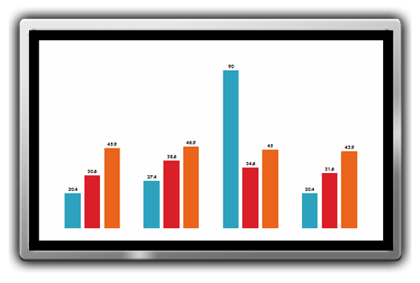
Slide Show Tips
To present in true widescreen, you’ll need a computer and, optionally, a projector or flat panel that can output widescreen resolutions.
Common computer widescreen resolutions are 1280 x 800 and 1440 x 900. (These are 16:10 aspect ratio, but will work well with 16:9 projectors and screens.)
Standard high definition televisions resolutions are1280 x 720 and 1920 x 1080.
Use the Test Pattern on the next slide to verify your slide show settings.

Slide 11
Widescreen Test Pattern (16:9)
Aspect Ratio Test
(Should appear circular)
4x3
16x9

