Slide 1
Frequency Analysis
Determining capacitance and resistance for pole and zero

Slide 2
Frequency Response of Amplifiers
Midband:
The frequency range of interest for amplifiers
Large capacitors can be treated as short circuit and small capacitors can be treated as open circuit
Gain is constant and can be obtained by small-signal analysis

Slide 3
Frequency Response of Amplifiers
Low-frequency band:
Gain drops at frequencies lower than fL
Large capacitors can no longer be treated as short circuit
The gain roll-off is mainly due to coupling and by-pass capacitors

Slide 4
Frequency Response of Amplifiers
High-frequency band:
Gain drops at frequencies higher than fH
Small capacitors can no longer treated as open circuit
The gain roll-off is mainly due to parasitic capacitances of the MOSFETs

Slide 5
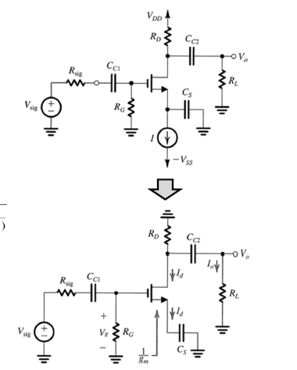
Low Frequency Response for Common Source Amplifiers
Small Signal Analysis
First pole derivation
Where

Slide 6
Low Frequency Response for Common Source Amplifiers
Second Pole Derivation (KCL)
Small signal Analysis Diagram

Slide 7
Low Frequency Response for Common Source Amplifiers
Third Pole derivation

Slide 8
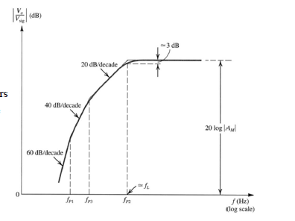
Low Frequency Response

Slide 9
Determining Lower 3dB Frequency
Coupling and by-pass capacitors result in a high-pass frequency response with three poles
If the poles are sufficiently separated
Bode plot can be used to evaluate the response for simplicity
The lower 3-dB frequency is the highest-frequency pole
ω_{P2} is typically the highest-frequency pole due to small resistance of 1/gm
If the poles are located closely
The lower 3-dB frequency has to be evaluated by the transfer function which is more complicated.

Slide 10
Determining the pole frequency by inspection
Reduce V_{sig} to zero
Consider each capacitor separately
(treat the other capacitors as short circuit)
Find the total resistance between the terminals

Slide 11
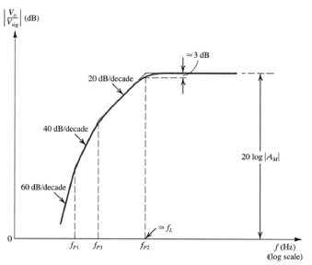
Selecting values for the coupling and by-pass capacitors
These capacitors are typically required for discrete amplifier designs
C_{S} is first determined to satisfy needed f_{L}
C_{C1} and C_{C2} are chosen such that poles are 5 to 10 times lower than f_{L}

Slide 12
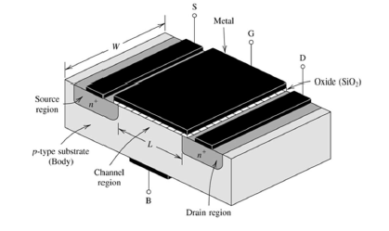
Internal Capacitive Effects and the High-Frequency Model
Parasitic Capacitances in the MOSFETs transistor

Slide 13
Capacitance in the MOSFET
There are basically two types of internal capacitance in the MOSFET
Gate capacitance effect: the gate electrode forms a parallel-plate capacitor with gate oxide in the middle
Junction capacitance effect: the source/body and drain/body are pn-junctions at reverse bias The gate capacitive effects

Slide 14
Gate capacitance effect
MOSFET in triode region:
MOSFET in saturation region:
MOSFET in cutoff region:

Slide 15
Cov is the Overlap Capacitance
Overlap capacitance:
L overlap is the length of the drain/source under the gate

Slide 16
Junction Capacitance
Junction capacitance includes components from the bottom side and from the side walls
The simplified expression are given by:

Slide 17
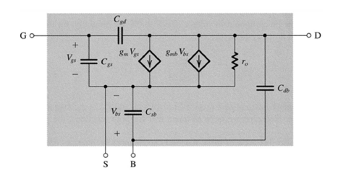
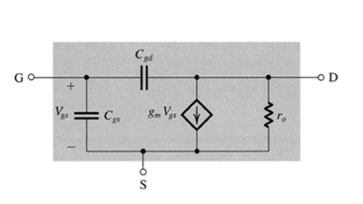
MOSFET High Frequency Model
Simplified high-frequency MOSFET model
Source and body terminals are shorted
Cgd plays an important role in the amplifier frequency response
Cdb is neglected to simplify the analysis

Slide 18
Unity Gain Frequency
The frequency at which the current gain becomes unity
f_{T} Is typically used as an indicator to evaluate the high-frequency capability
Smaller parasitic capacitances C_{gs} and C_{gd} are desirable for higher unity-gain frequency

Slide 19
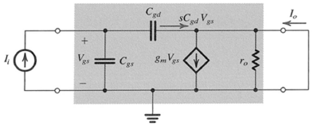
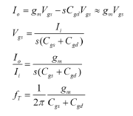
Analysis for unity frequency

Slide 20
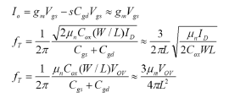
Analysis for unity frequency
The unity-gain frequency can also be expressed as
The unity-gain frequency is strongly influenced by the channel length
Higher unity-gain frequency can be achieved for a given MOSFET by increasing the bias current or the overdrive voltage

Slide 21
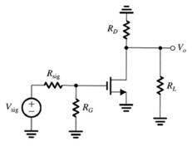
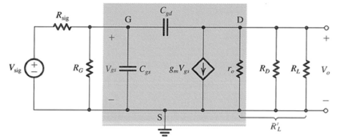
Common Source Amplifier
Midband gain:
Frequency response

Slide 22
Common Source Amplifier
The common-source amplifier has one zero and two poles at higher frequencies
The amplifier gain falls off at frequencies beyond midband
The amplifier bandwidth is defined by the 3-dB frequency which is typically evaluated by the dominant pole (the lowest-frequency pole) in the transfer function

Slide 23
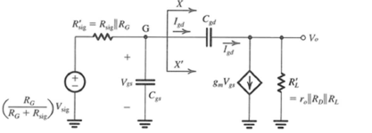
Simplified Analysis Technique
Assuming the gain is nearly constant (≅ -g_{m}R’_{L})
Find the equivalent capacitance of C_{gd} at the input (with identical I_{gd})
This is the Miller effect

Slide 24
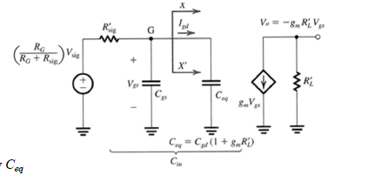
Simplified Analysis Technique
Neglect the small current I_{gd} at the output
The dominant pole is normally determined by C_{eq}
The frequency response of the common-source amplifier is approximated by a STC

Slide 25
Widescreen Test Pattern (16:9)
Aspect Ratio Test
(Should appear circular)
4x3
16x9

