Slide 1
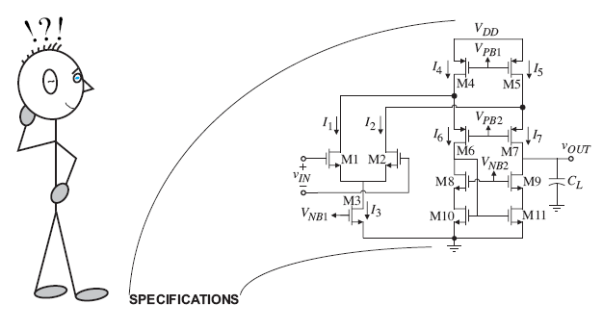
Course Objectives
This course teaches analog integrated design using CMOS Technology

Slide 2
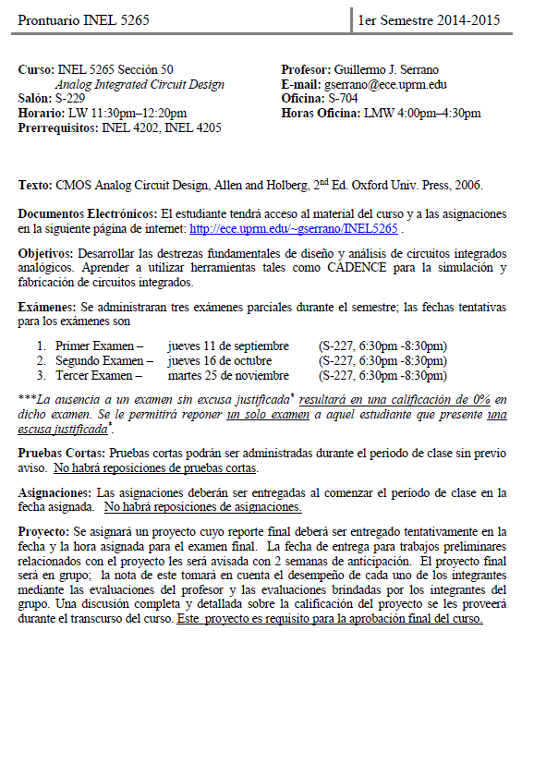
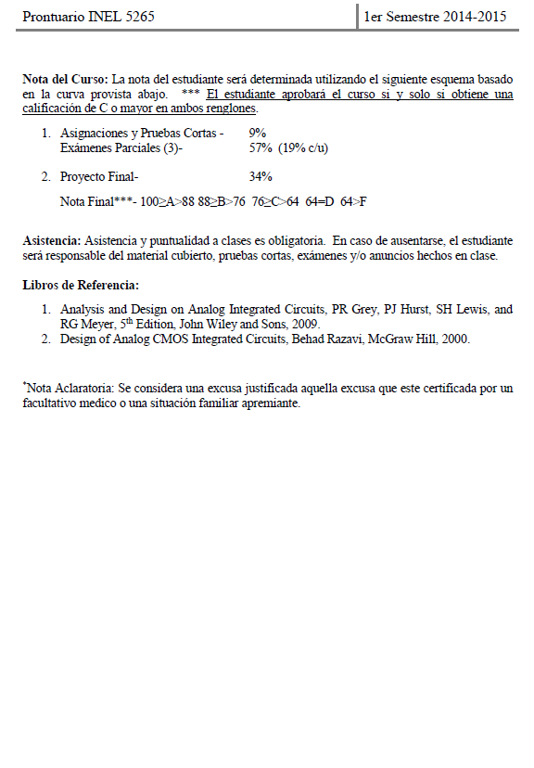

Slide 3
Course Prerequisites
Circuit Analysis Techniques
Mesh and loop equations
Superposition, Thevenin and Norton’s equivalent Circuit
Basic understanding of electronics
Active and passive components
Large and small signal models
Frequency response
Integrated Circuit Technology
Active and passive components
Large and small signal models
Frequency response
Circuitos I,II
Electrónica I,II

Slide 4
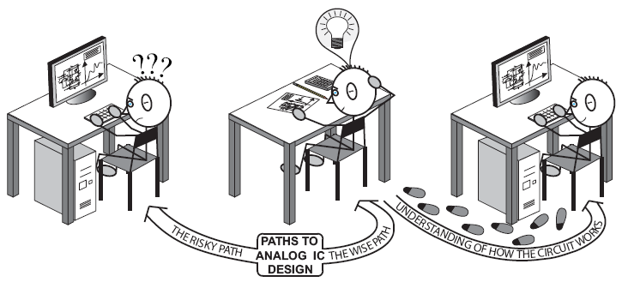
Course Philosophy
Think before design!

Slide 5
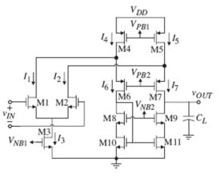
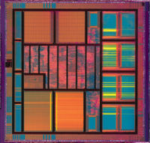
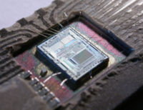
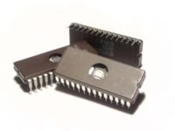
The Analog IC Design Process
Electrical Design
Simulation
Physical Design
Fabrication
Testing
Product
Development

Slide 6
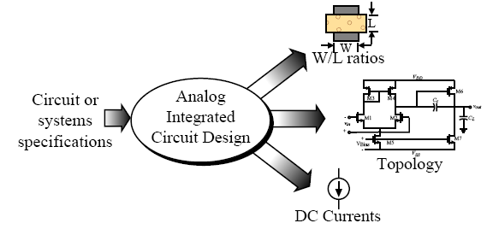
What is Electrical Design?
Electrical design is the process of going from the specifications to a solution.

Slide 7
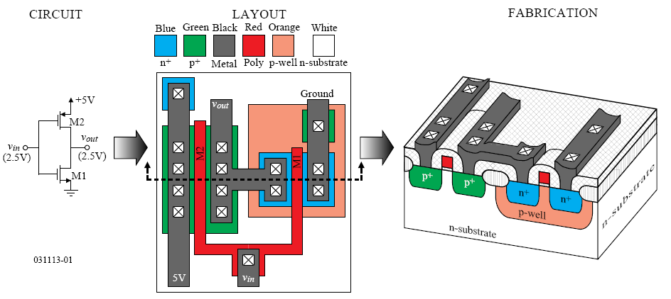
What is Physical Design?
Physical design is the process of representing the electrical design in a layout. The layout is then used to create the actual three dimensional circuit through fabrication.

Slide 8
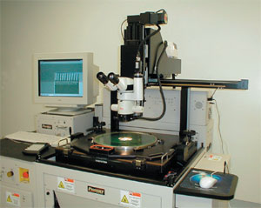
Packaging?
Packaging provides the electrical and mechanical connection between the integrated circuit and the outside world.
What is Test Design?
Test design is the process of coordinating, planning and implementing the measurement of the analog integrated circuit performance.
Objective: To compare experimental performance with specifications and/or simulations results.

Slide 9
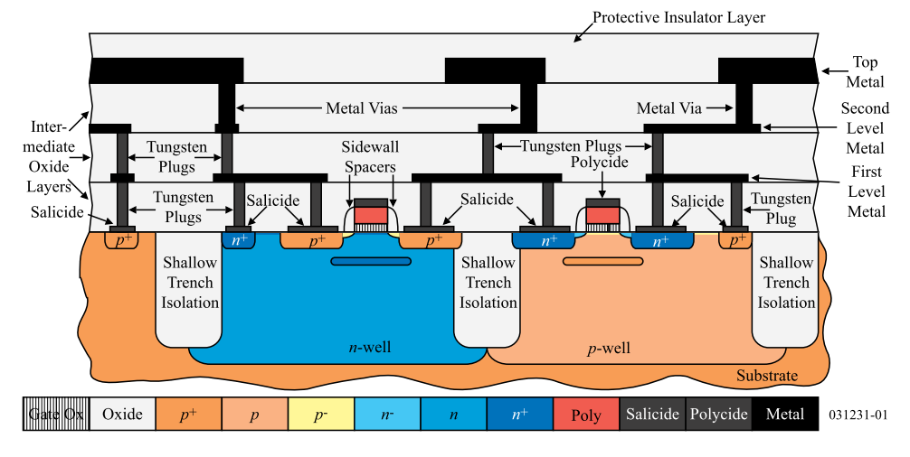
Modern CMOS Technology
* For this course we will be using an n-well process, hence the bulk terminals of all nMOS transistors are connected to the lowest potential..

Slide 10
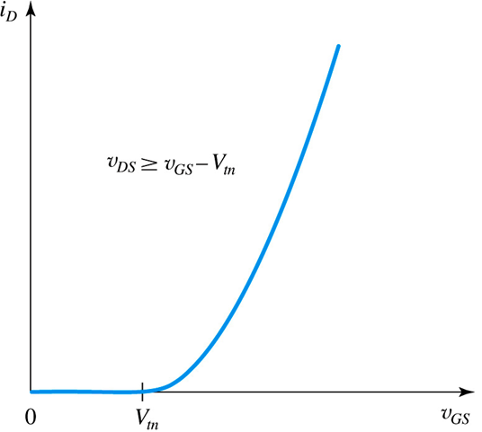
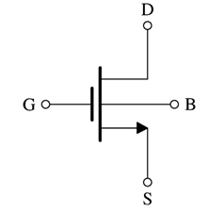
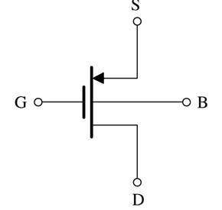
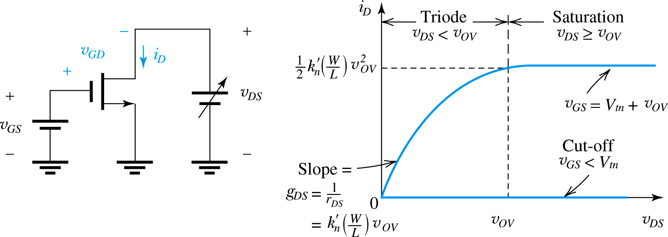
Metal Oxide Semiconductor FET (MOSFET)
Symbol
i_{D} vs v_{GS}
Behavior
i_{D} vs v_{DS} Behavior

Slide 11
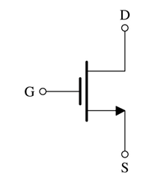
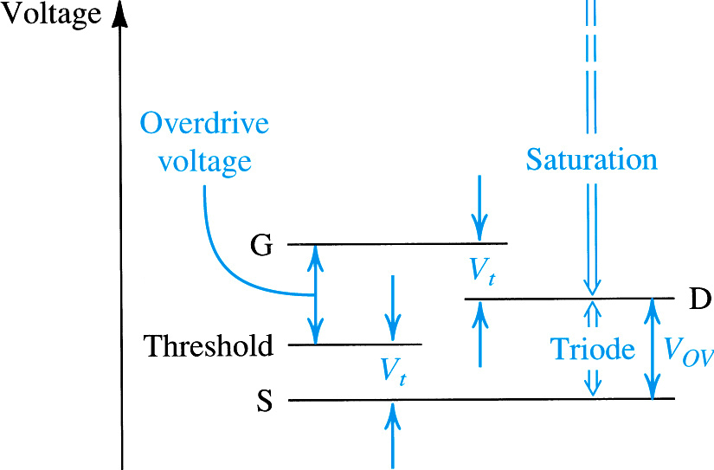
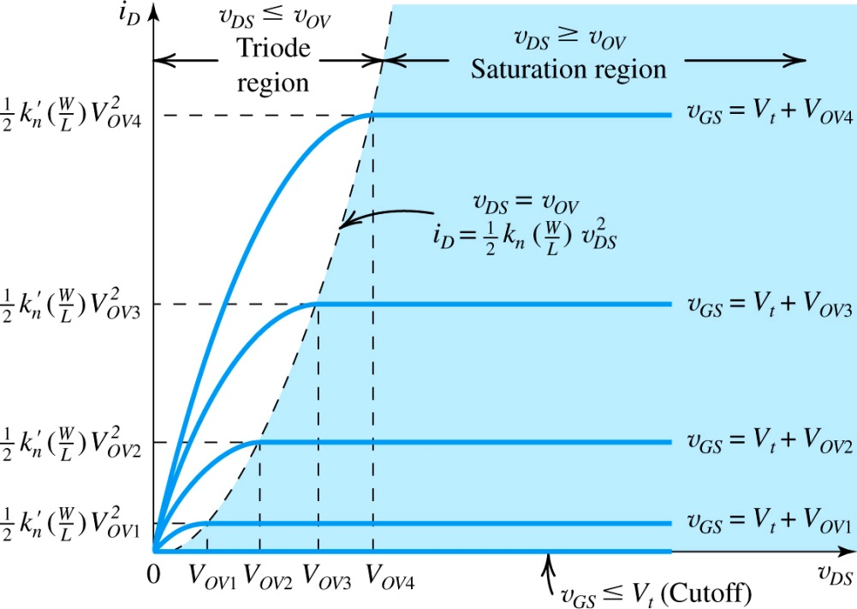
MOS Transistor
Regions of Operation
Saturation
Ohmic
Subthreshold
$V_{OV}=V_{GS}$-$V_{th}$

Slide 12
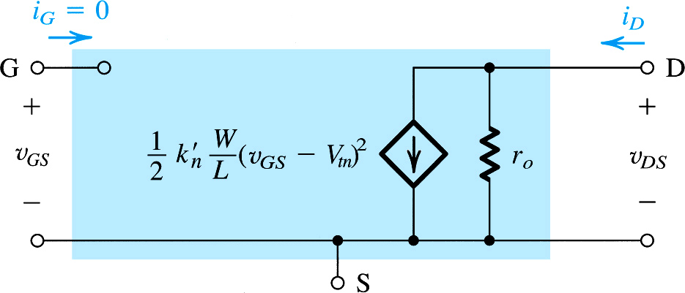
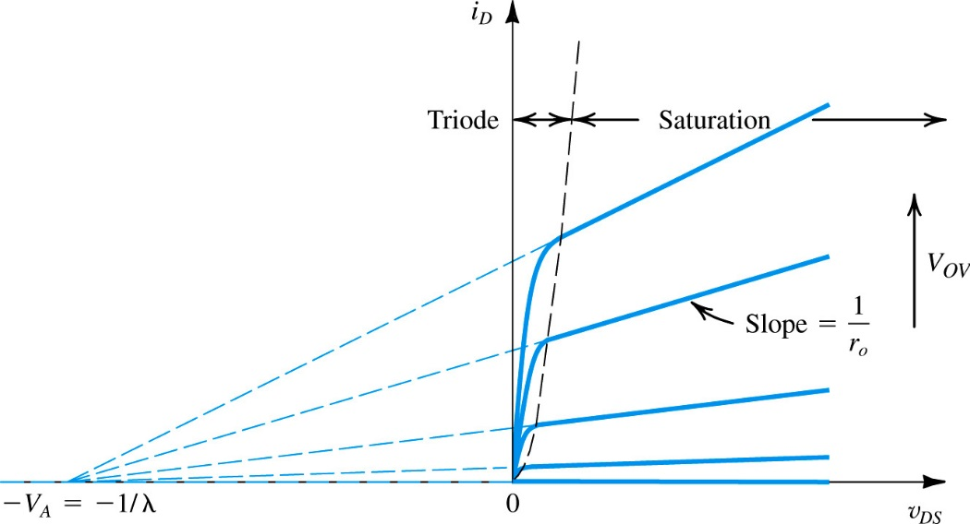
MOS Transistor
Large Signal Equivalent Circuit: Saturation Region

Slide 13
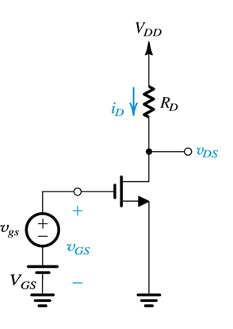
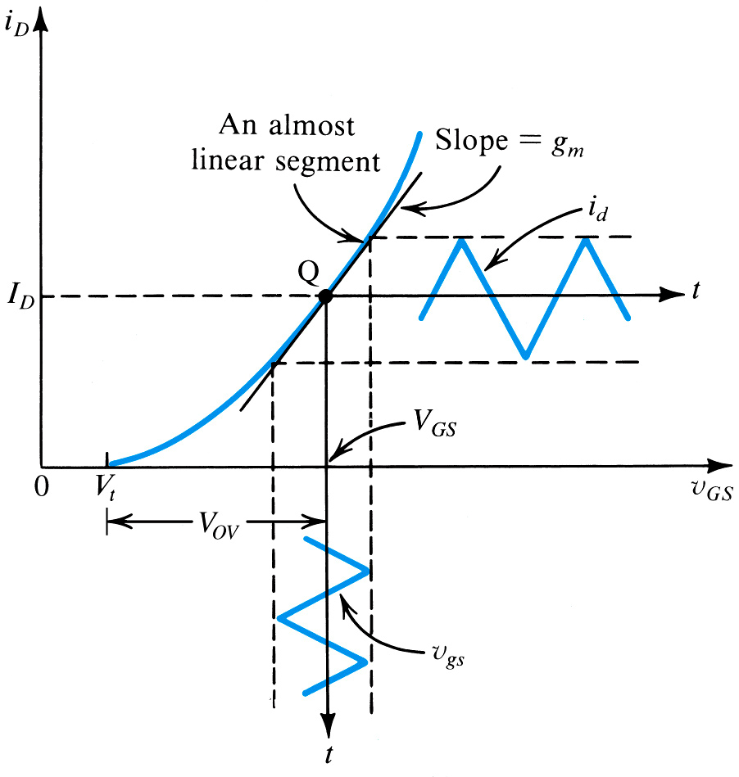
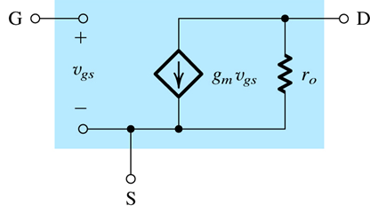
MOS Transistor
Small Signal Behavior
Small-Signal Behavior
Bias Point
Small-Signal Equivalent Circuit

