Slide 1
Last Lecture – MOS Transistor Review (Chap. #3)
Transistor Operation Regions & Large Signal Behavior
saturation - V_{gs}>V_{th} & V_{ds}>V_{ds}(sat)
ohmic - V_{gs}>V_{th} & V_{ds}<V_{ds}(sat)
subthreshold - V_{gs}<V_{th} & V_{ds}> 0.2V
Small Signal Model
low-frequency model

Slide 2
Regions of Operation
Saturation –
Ohmic –
Subthreshold –
* For p-channel MOSFET, use n-channel equations with p-channel parameters and invert the current

Slide 3
Large Signal MOSFET Model
where:
V_{DS}(sat) = V_{ov} =
µ_{o} = zero field mobility (cm²/V·s)
C_{ox}=gate oxide capacitance per unit area (F/cm²)
λ = channel-length modulation parameter (V⁻¹)
V_{t} =
V_{t0} = zero bias threshold voltage
γ = bulk threshold parameter (1/V^{0.5})
2|φ_{f} |= strong inversion surface potential (V)
I_{D0} = process dependant parameter (A)
n = subthreshold slope factor

Slide 4
MOSFET Small-Signal Model
Complete Schematic Model
Simplified Schematic Model

Slide 5
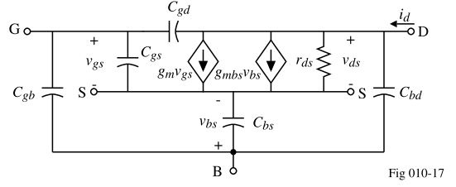
Small-Signal Frequency Dependent Model
Complete Model
* The capacitor size varies with the region of operation and the transistor size
* The parasitic capacitors are constant for a specific region of operation

Slide 6
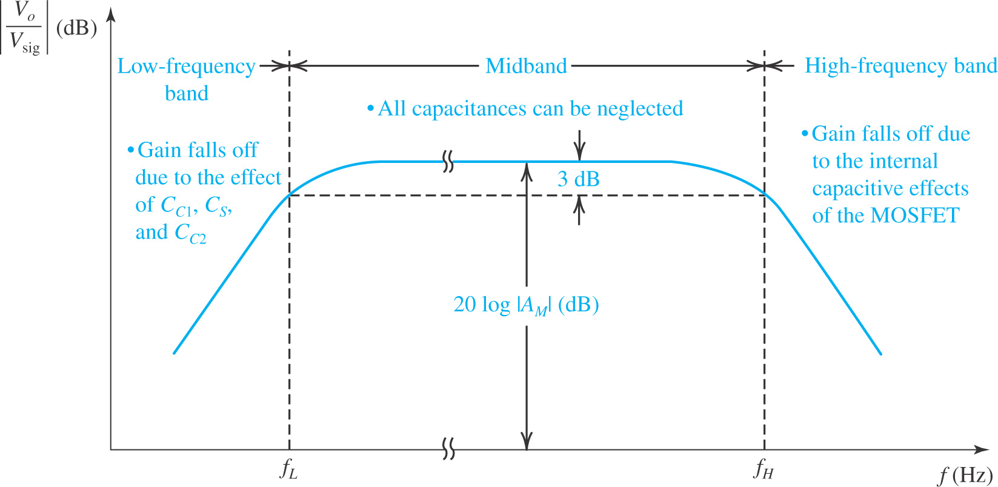
Frequency Response

Slide 7
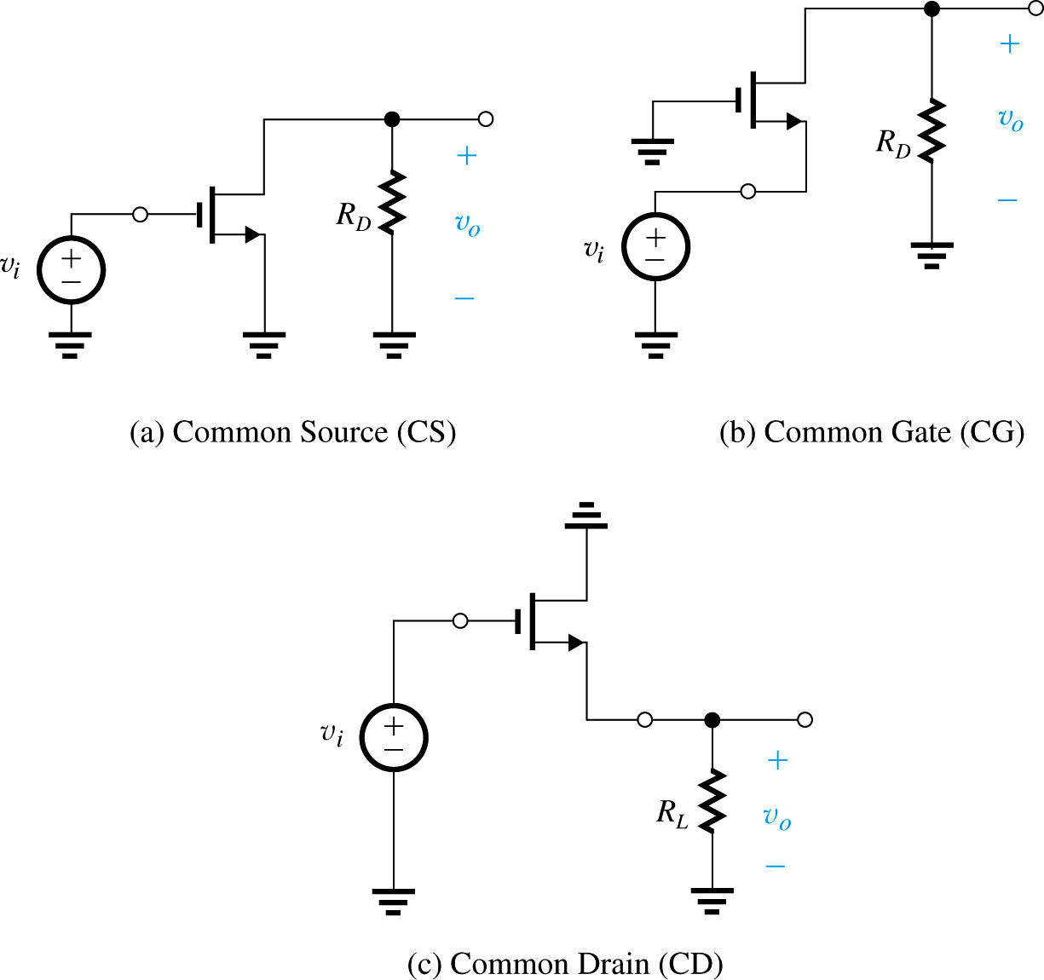
Single Stage Amplifiers

Slide 8
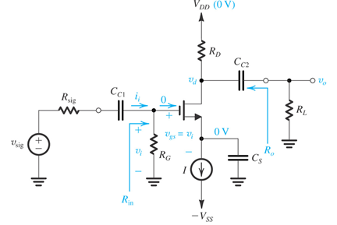
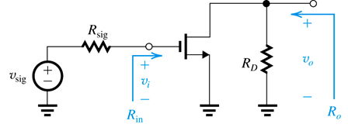
Common Source Amplifier

Slide 9
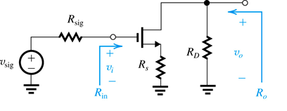
Common Source Amplifier with Degeneration

Slide 10
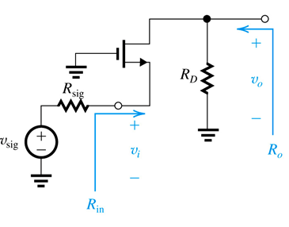
Common Gate Amplifier

Slide 11
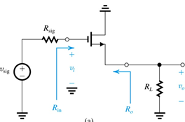
Common Drain Amplifier or Voltage Follower

