Slide 1
Last Lecture – MOS Transistor Review (Chap. #3)
Transistor Operation Regions & Large Signal Behavior
saturation - V_{ds}>V_{ds}(sat)
ohmic - V_{ds}<V_{ds}(sat)
subthreshold - V_{ds}> 0.2V
Small Signal Model
low-frequency model
frequency dependent model (parasitic capacitances)
Single Stage Amplifiers
voltage gain
terminal impedances
V_{sb} effect!
Basic Design Exercises

Slide 2
Single Stage Amplifiers

Slide 3
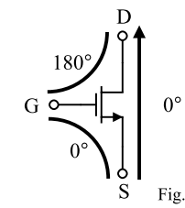
Single Flow in Transistors
It is important to recognize that ac signals can only flow into and out of certain transistor terminals.
Rules:
The drain can never be an input terminal.
The gate can never be an output terminal.

Slide 4
Transistor Design #1
Design the transistor’s W/L such that it operates in the saturation region for I_{D}=10µA
I_{D}
V_{G}
Si V_{DSSAT}=0.2V entonces W/L=5
where
K_{n}=100µA/V²

Slide 5
Transistor Design #2
Design the transistor’s W/L such that it operates in the saturation region for I_{D}=10µA and V_{D} = [0.5 - 3.1] V.
V_{DD}
V_{G}
I_{D}
V_{D}
Si V_{DSSAT min}=3.3-3.1=0.2V
Entonces W/L=5
where
K_{p}=100µA/V²
V_{DD}=3.3V

Slide 6
Transistor Design #3
Design the transistor’s W/L such that it operates in the saturation region for I_{D}=[0.1 – 10] µA and V_{X}(max)=1.2V.
This connection is a diode connection and ensures saturation
I_{D}
V_{X}
where
K_{n}=100µA/V²
V_{t0}=0.7V

Slide 7
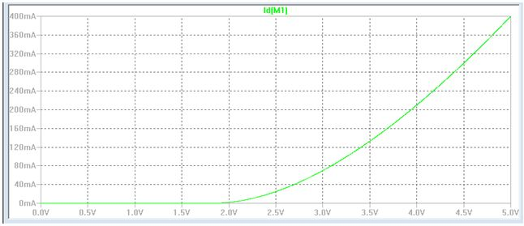
Common Source Amplifier
V_{DD}
V_{DD}
V_{B}
I_{D}
I_{bias}
M₂
V_{out}
V_{out}
V_{in}
M₁
V_{in}
M₁
Simplified
Schematic
Implementation
V_{GS}

Slide 8
Common Source Amplifier
Typical design approach:
I_{d} set by power constraints
V_{ds1}(sat) & V_{ds2}(sat) set by output voltage range constraints if any
hence (W/L)₁ & (W/L)₂
3. (W/L)₁ set by gain constraints (there might be a need for redesign M1)
V_{DD}
Large Signal Behavior
V_{out}(min) – V_{DSSAT} Typically V_{DSSAT}≅0.2V
V_{ou}t(max) –V_{DD}-V_{SDSAT} Typically V_{SDSAT}≅0.2V
V_{B}
M₂
V_{out}
Small Signal Behavior
A_{v} – -g_{m}R_{out} : where R_{out}=r_{o2}||r_{o1}
V_{in}
M₁

Slide 9
Common Source Amplifier
Design the following CS amplifier for the following specifications:
V_{out} = [0.15 – 2.7] V
P_{supply} < 90μW
|A_{v}| > 30 V/V
where
V_{T0n}=|V_{T0p}|=1.0V
K’_{n}=100µA/V²
K’_{p}=25µA/V²
λ_{n}= λ_{p} =0.2V⁻¹
V_{DD}=3.0V
V_{DD}
V_{DD}
V_{in}
M₁
I_{ref}
=10µA
V_{out}
M₃
M₂

