Slide 1
Last Lecture
Current Source Amplifier → Chp. - 5.1
large signal behavior
small signal behavior
design excercise
Cascode Transistor → Chp. - 5.3
large signal effect
small signal effect
V_{DD}
V_{b}
M₃
V_{out}
V_{cn}
M₂
The specifications of the circuit have a direct impact on the transistor sizing!
V_{in}
M₁

Slide 2
Common Drain Amplifier
V_{DD}
V_{DD}
I_{D}
V_{in}
M₁
V_{in}
M₁
V_{out}
V_{out}
V_{b}
M₂
I_{bias}
Simplified
Schematic
Implementation
V_{GS}

Slide 3
Common Drain Amplifier as an Output Stage
Maximum source and sink capabilities?
nMOS
pMOS
V_{DD}
V_{DD}
V_{b}
M₂
V_{in}
M₁
V_{out}
V_{out}
V_{in}
M₁
V_{b}
M₂
R_{L}
R_{L}
V_{SS}
V_{SS}

Slide 4
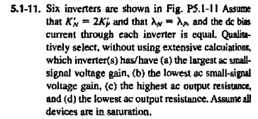
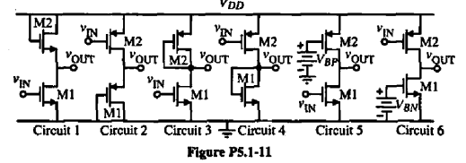
Problem 5.1-11

Slide 5
Current Mirrors Chap. #4.4
V_{DD}
Circuits used to replicates, amplify or minimize an given input current.
I_{out}
I_{in}
+
Current Mirror
+
V_{in}
V_{out}
Ideal Behavior
Linear Gain
Low Input Impedance
High Output Impedance
_
_
I_{out}
A_{i}
I_{in}
I_{in}
1/R_{in}
V_{in}
I_{out}
1/R_{out}
V_{out}

Slide 6
Basic Current Mirror
DC Analysis
AC Analysis
Parameter Mismatch Effects
V_{DD}
I_{out}
i_{in}
i_{out}
R_{in}
R_{out}
I_{ref}
M₁
M₂
M₁
M₂

