Slide 1
Clasificacion de Circuitos y frecuencia maxima
Digital Logic Inverter

Slide 2
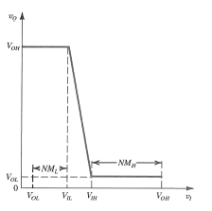
The Voltage-Transfer Characteristic (VTC)
The function of the inverter is to invert the logic value of its input signal
The voltage-transfer characteristic is used to evaluate the quality of inverter operation
VTC parameters
V_{OH}: output high level
V_{OL}: output low level
V_{IH}: the minimum value of input interpreted by the inverter as a logic 1
V_{IL}: the maximum value of input interpreted by the inverter as a logic 0
Transition region: input level between V_{IL} and V_{IH}

Slide 3
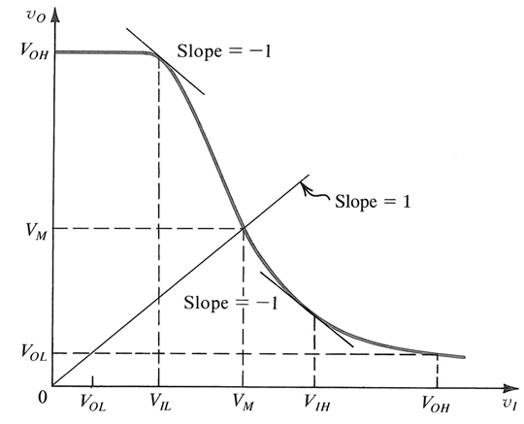
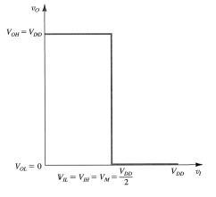
Noise Margins
The VTC is generally non-linear
VIH and VIL are defined as the points at which the slope of the VTC is =-1
Robustness (noise margin at a high level): NMH = VOH - VIH
Robustness (noise margin at a low level): NML = VIL - VOL
Static inverter characteristics for ideal VTC:
VOH = VDD
VOL = 0
VIH = VIL = VDD/2
NMH = NML = VDD/2

Slide 4
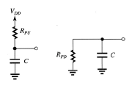
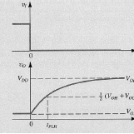
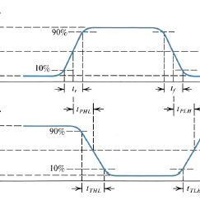
Power Dissipation
Static power dissipation: power dissipated when the inverter stays in logic 0 or logic 1
Dynamic power dissipation: power dissipated as the output is switching

Slide 5
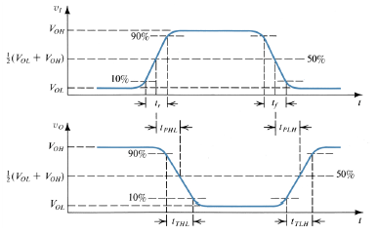
Propagation Delay
t_{PHL} : high-to-low propagation delay
t_{PLH} : low-to-high propagation delay
t_{P} (propagation delay) = (t_{PLH} + t_{PHL})/2
Maximum switching frequency f_{max} = 1/(2t_{P})
The transient of the inverter can be characterized by a RC charge/discharge model

