Slide 1

Intro to Testing

Slide 2
Testing
Hardware
Software
Test is a module based process
Earlier in the assembly process the cheaper the cost
TIME=MONEY
Software
2/3 of the time/budget is spent in debugging

Slide 3
Approach to testing
Shoot from the hip
Well planned into design
Is a manner of leaving test from the end
Fast in assembly
If lucky will work
Measures only final performance
Takes time
May slow the assembly process
Speeds up debugging process
Takes into account controllability and observability

Slide 4
Generating the Test Plan
To Plan or Not to Plan?
Shoot From the Hip Approach
Non-optimized
May cause a device to be Non-testable
Planned Testing
Allows early interaction between design and test engineers
Identification of non-testable functions
Synchronization of clocking schemes
Tester hardware identification
identify tester hardware deficiencies

Slide 5
Definition
Controllability-
Ability to control the signal (Voltage or Current) on each node)
Accessability
Access for measuring every node
Metrology
Method used to test by selecting what to measure, how to measure and when to measure

Slide 6
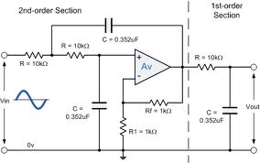
Sometime ago……
Every node was accessible and thus we could control and measure
Notes:
Habla de la perdida de medidas en ciorriente y voltage en nodos intermedios

Slide 7
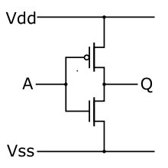
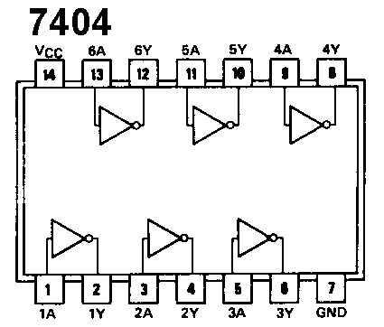
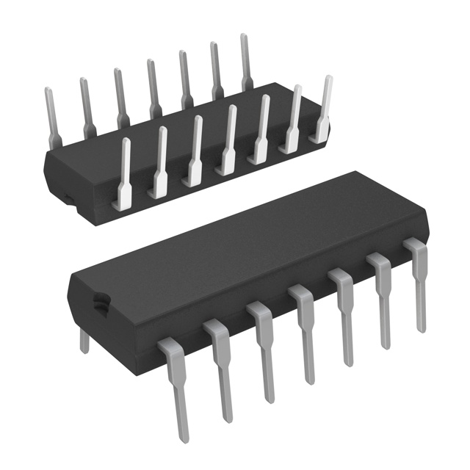
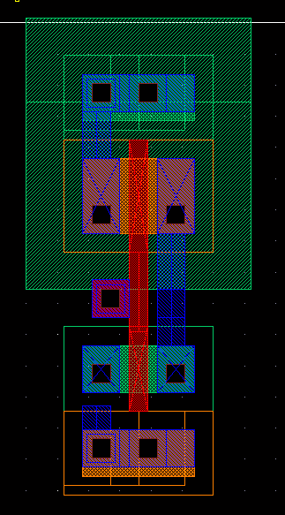
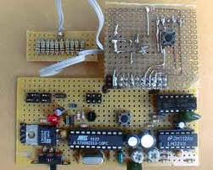
Integration
Non integrated System
Integrated

Slide 8
Cost of detection
Earlier
Transistor cents
Chip or device dollars
Module 10’s of dollars
Board 100’s
System 1,000’s
Major equipment can go up to millions
LATER
Notes:
Habla en terminos del tiempo si hacen prueba final de funcionalidad

Slide 9
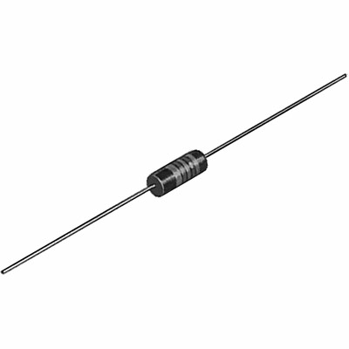
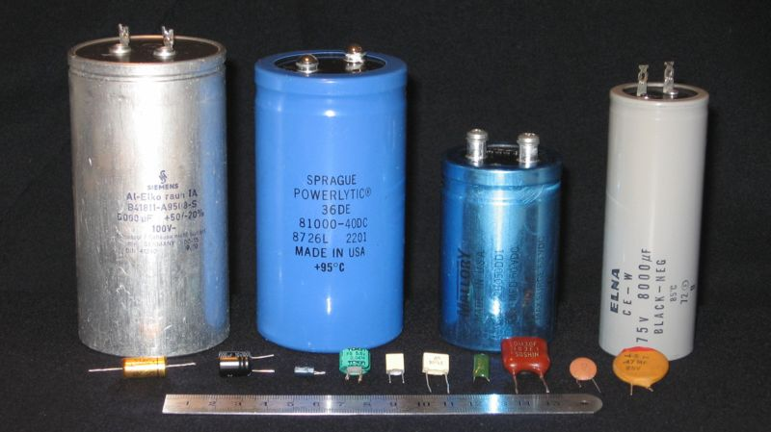
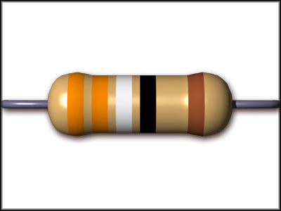
System Test= Module Testing=many Device tests
Considerations
What inputs the signal to the device
What is the Load on the device?
Resistor Capacitor and Inductor testing
Multimeter 1-10 pieces
If testing hundreds of pieces use ATE
Automatic Test Equipment
ELVIS
Labview
VLCT

Slide 10
Chip Testing A Step by Step approach
Download and Read the Data sheet
View picture of pin layout
Input Output, analog or digital…..NC (no connection)
Current or Voltage
Continuous signal or discrete
Clocking Signals
Read Brief description
Read AbsMax Section!!
Notes:
Aprieta el link

Slide 11
Device Specification Sheet
Purpose
Design Specification
Determine functionality of design
Test List Generation
Insure device lives up to spec sheet claims
Communication
Verify that device is appropriate for the end application
Flexible Document
Ownership - catalog or custom?
Allows changes to specifications
Avoid ambiguities
Late Changes in Specification Sheet Indicates Poor Organization

Slide 12
Device Specification Sheet
Structure
Feature Summary
Quick look at functionality of chip
Principles of Operation
Detailed device function
guaranteed by functional or parametric test program
Absolute Maximum Ratings
Failure limits of chip
not critical to a test engineer
Electrical Specifications
Core of parametric tests
Test conditions are listed as notes
MAX, MIN, TYP, guaranteed by design

Slide 13
Device Specification Sheet
Structure
Timing Diagrams
Critical to test program development
Manually generated for frequency synchronization
Application Information
Aids customer in designing end application
Functional block diagram
shows top level representation of device function
Characterization Data
Data collected during testing i.e. parameter histograms
Circuit Schematics / Die Layout
Device functional pin representation and layout

Slide 14
ABS MAX
NEVER TEST FOR THIS

Slide 15
Parametric test
Industry characterizes a lot
Various measurements appear in the table
For Digital
VDD max and min
VOH VOL VIH VOL
IDDQ IL etc…..
What should we test first???

Slide 16
What we should test first?
Continuity
Of chip to Silicon
Chip to module
Modules to board
Board to slots
Slots to system
Power supply
May require ID or Flags on your wires
Notes:
First test each chip then the rest
Include integration of loading and feed

Slide 17
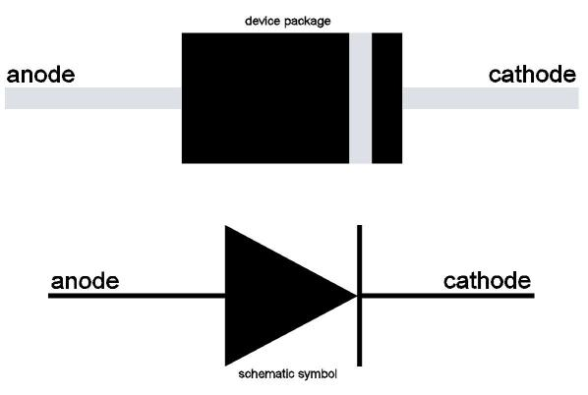
Continuity
Testing Continuity of Chip to Silicon???
ESD = Electrostatic Protection Diode
Not shown in Data sheet!!!

Slide 18
Purpose of Continuity Testing
Electromechanical relays
Wiper
Contact
Coil
Sinlge Pole,
Single Throw
(SPST)
Sinlge Pole,
Double Throw
(SPDT)
Double Pole,
Double Throw
(DPDT)

Slide 19
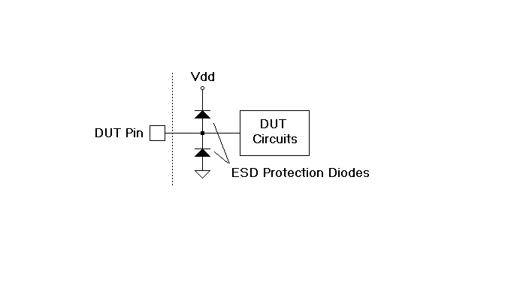
Continuity
Continuity Test Technique
On chip protection diodes
Protect input and output from Electrostatic Discharge (ESD) and other overvoltage
Pins have either one or two reverse biased diodes

Slide 20
Continuity
Continuity Test Technique
Force current - measure voltage
DUT power supplies are grounded
Current level is usually between 100uA and 1mA
Diodes connected to the positive supply - current forced in
Diodes connected to the negative supply - current forced out
Output diode voltage drop usually is between 550mV and 750mV
If tester does not see diode voltage drop or the current reaches its voltage clamp, the test fails

Slide 21
Continuity
Serial vs. Parallel Continuity Testing
Serial is one pin at a time
Test time intensive
Parallel can not see pin to pin shorts
Alternating odd and even pin parallel test
Analog parallel per-pin measurement is not available in some testers
Single current source and volt meter can be used one pin at a time
Digital per-pin measurement is available, but may introduce noise into sensitive analog circuit

Slide 22
Leakage Currents
Purpose of Leakage Testing
Good design should have leakage current of less than 1uA
Detects poorly processed integrated circuits
Improper operation in customer end application
Detect weak devices
Initially function but eventually fail after unacceptably short lifetime (Infant mortality)

Slide 23
Leakage Currents
Leakage Test Technique
Force DC voltage - measure small current
Typically measured twice
input voltage equal to positive supply
input voltage set to ground or negative supply
Input current high (IIH) and input current low (IIL)
Digital and analog inputs
Output leakage current (IOZ)
Measured same as IIH & IIL
output pin must be placed in a high impedance (HIZ) state using test modes

Slide 24
Leakage Currents
Serial vs. Parallel Leakage Testing
Serial is one pin at a time
Test time intensive
Less possibility of errors
Leakage currents can flow from pin to pin
Alternating odd and even pin parallel test is recommended
Again, analog parallel per-pin measurement is not available in some testers
Single voltage source and current meter can be used one pin at a time
Again, digital per-pin measurement is available, but may introduce noise into sensitive analog circuit

Slide 25
Power Supply Currents
Importance of Supply Current Tests
Fast method for determining catastrophic failure
Large current draw from power supplies
Tests are run early in test protocol to weed out defective chips without wasting valuable test time
Customer specific application characteristic
Battery operated instruments like a cellular phone require minimal current draw by electronics

Slide 26
Power Supply Currents
Test Techniques
Basic test is simple
Testers have the ability to measure current draw from power supplies (Idd and Icc)
Actual test is never basic
Test conditions
must be clearly identified in test plan
power up mode, standby mode, normal operational mode
digital supply (Iddd and Iccd) and analog supply (Idda and Icca) measured separately
Worst case
requires complete characterization

Slide 27
Test Techniques - cont.
Multiple power supply pins
designers may need to know the current flow into each pin
Settling time
5 to 10 milliseconds in active mode
hundreds of milliseconds to stabilize to within 1mA

Slide 28
DC References and Regulators
Voltage Regulators
High voltage input - regulated lower voltage output
Output voltage
simple voltmeter reading
Output voltage regulation
ability of regulator to maintain specific output under load
Dropout voltage
minimum input voltage before output drops below specified level
Input regulation
ability of regulator to maintain steady output with a range of input voltages

Slide 29
DC References and Regulators
Voltage References
Low power voltage regulators
Not always accessible from external pin
test engineer may need to request test modes to test references
May not have a separate specification in the data sheet
DC reference test modes allow the program to trim the DC references for more precise device operation

Slide 30
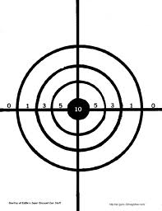
Measurement Accuracy
Terminology
Definitions of Accuracy
Closeness with which an instrument reading approaches the true value of the variable being measured.
The maximum error in the measurement of a physical quantity in terms of the output of an instrument when referred to the individual instrument calibrations.
The degree of conformance of a test instrument to absolute standards.
The ability to produce an average measured value which agrees with the true value or standard being used.

Slide 31

Measurement Accuracy
Terminology
Precision
A measure of the reproducibility of the measurements.
Given a fixed value of a variable, precision is a measure of the degree to which successive measurements differ from one another.
The degree to which repeated measurements of a given quantity agree when obtained by the same method and under the same conditions.
Also called repeatability or reproducibility.
The ability to repeatedly measure the same product or service and obtain the same results.

Slide 32
Measurement Accuracy
Book Terminology
Accuracy - to refers to the overall closeness of an averaged measurement to the true value.
Repeatability - the consistency with which that measurement can be made.
The word precision will be avoided.
Accuracy takes all error sources into account
Systematic Errors
Random Errors
Resolution (Quantization Errors)

Slide 33
Measurement Accuracy
Terminology
Systematic Errors
Errors that appear consistently from measurement to measurement
Ideal Value = 100mV
Measurements : 101mV, 103mV, 102mV, 101mV, 102mV, 103mV, 103mV, 101mV, 102mV
Average Error : 2mV
Caused by DC offsets, gain errors, non-linearities in the DVM
Systematic errors can often be reduced through calibrations.

Slide 34
Measurement Accuracy
Terminology
Random Errors
Notice that the list of numbers in the last slide vary from 101mV to 103mV.
All measurement tools have random errors even $2 Million Automated test instruments
Random Errors are perfectly normal in analog and mixed-signal measurements.
Big challenge is in determining whether the random error is caused by a bad DIB design, bad DUT design or by the tester itself.

Slide 35
Measurement Accuracy
Terminology
Resolution (Quantization Errors)
Notice that in the previous list of numbers, the measurement was always rounded off to the nearest milivolt.
Limited resolution results from the fact that continuous analog signals must be converted to digital format (using ADC’s) before a computer can evaluate the test results.
The inherent error in ADCs and measurement instrumentation is called Quantization Error.
Quantization error is a result of the conversion from an infinitely variable input voltage to a finite set of possible outputs from the ADC.

Slide 36


Testing Matches
If the match has all the elements
If conditions are the predetermine ones
Then the match should light up when stroke against the side of the Box
Match box factories do NOT test each Match by striking it!!!!!
Notes:
Talk about if test of chip with load is made then performance is unnecessary

Slide 37
Feed and Load
Notes:
Talk about if it can cope with the load
If the internal resistance at the input lowers the expected Vin.
Introduce the problems with Multimeters in terms of internal resistance

Slide 38
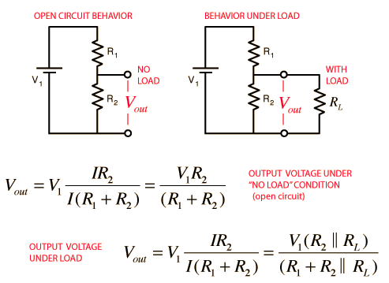
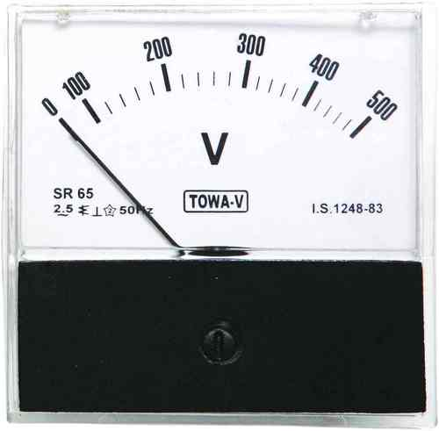
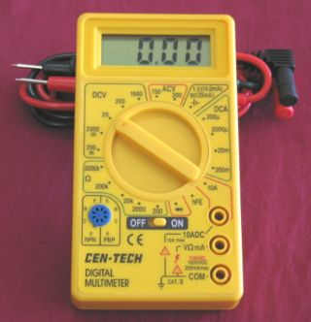
Measuring Voltage

Slide 39
Measuring Voltage
If R_{L}>>R₂ then V_{out}=R₂/(R₁+R₂)

Slide 40

Measuring Current
Current is measured in series
The Circuit must Be Broken to measure the signal

Slide 41
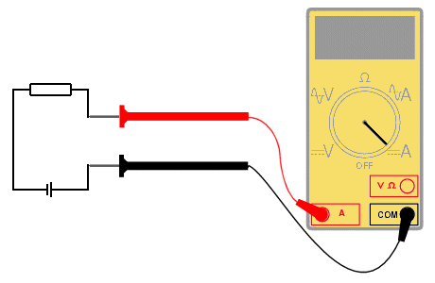
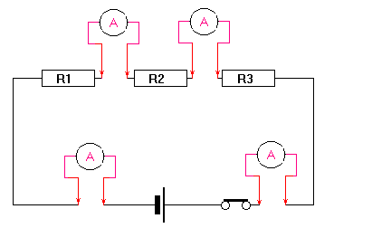
Measuring Current
It Loads the circuit thus each measurement affects the function in analog.
Digital signals are mostly measured in Volts and are impervious to minute changes, however the problems can be analog.
Slew Rate, Frequency, Transition Curve etc….

Slide 42
Testing Modules and Systems
Ideal or real Input signals
Ideal Voltage or Current Signals indicates proper functionality at the input.
Real Inputs have,
Noise
Load tolerance
Variations
Maximum frequency

Slide 43
Real Input
Possible Problems
Fan Out
Slew rate
Exceeds Load Regulations
Frequency incompatibility
Ground Bouncing
Poorly defined States

Slide 44
Fan Out
CUT 1
CUT 2
Input
CUT 3
CUT 4
CUT 5
The Input signal is exceeding its signal capabilities!!!!
CUT 6

Slide 45
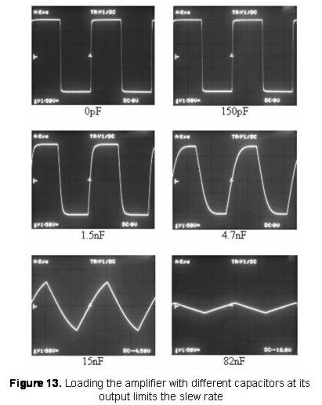
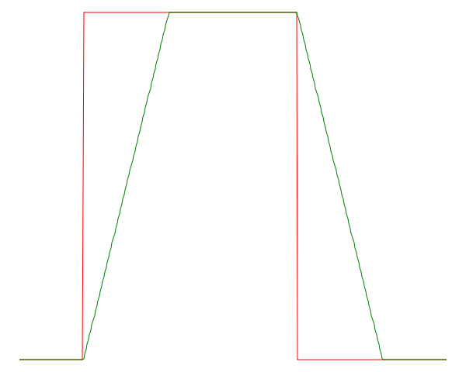
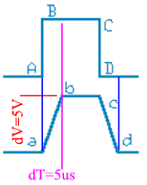
Slew Rate

Slide 46
Slew Rate

Slide 47
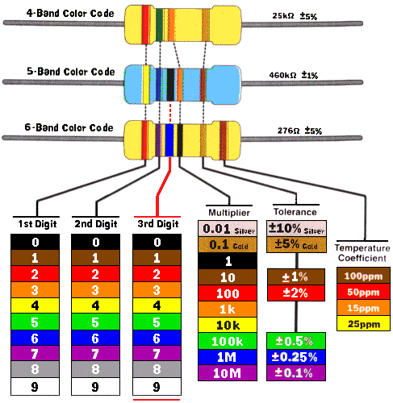
Load Regulation
More Current
Current needed By the circuit can not be provided by the source so it gives maximum current.
In case of a voltage signal the signal magnitude is considerably diminished!!
Less Current

Slide 48
Frequency problems
The input signal varies at a higher rate than the maximum frequency response of the circuit
The input signal is much slower that the circuit and the output may be processing the transition region
False zeroes or ones if the signal is a clock signal that is not sinchronize

Slide 49

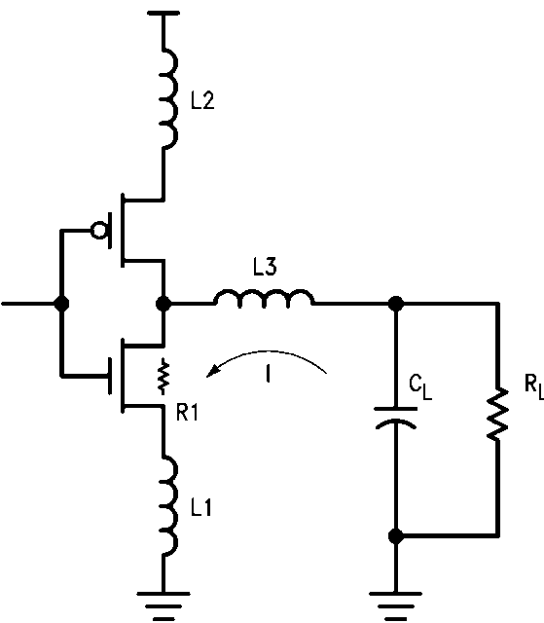
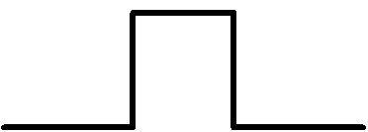
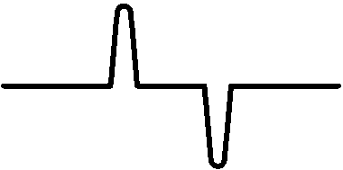
Ground Bouncing
Output Voltage
I=-C_{L}dV/dt
V_{GB}=L ΔI/Δt
Notes:
Ground bounce is usually seen on high density VLSI where insufficient precautions have been taken to supply a logic gate with a sufficiently low resistance connection (or sufficiently high capacitance) to ground. In this phenomenon, when the gate is turned on, enough current flows through the emitter-collector circuit that the silicon in the immediate vicinity of the emitter is pulled high, sometimes by several volts, thus raising the local ground, as perceived by the transistor, to a value significantly above true ground. Relative to this local ground, the BASE voltage can go negative, thus shutting off the transistor. As the excess local charge dissipates, the transistor turns back on, possibly causing a repeat of the phenomenon, sometimes up to a half-dozen bounces.

Slide 50
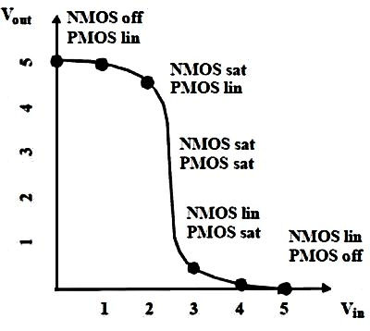
Poorly defined states
States are defined as the High or Low in digital.
The transition region is an unknown
The bigger transition region determines the transition region of the system

Slide 51
Load Problems
The Impedance of the load is too small
Load regulations are exceeded
Current will give the maximum current but it will not be enough to achieve the desire voltage or current magnitude
Load Capacitance is too large
The maximum current charges the Capacitor
The rate of charge is determined by the maximum Current creating slew rate problems.

Slide 52
Module and system testing
If each device is measured according to its specifications with the load and real input
Then; The sum of the parts will work.
Interaction with the other modules should be synchronize if needed.
Board Specs and electrical characteristics should be taken into consideration as load.

Slide 53
Performance test
Inputs N
Amount of testing Vectors 2N
If 10 inputs----1024 possible vectors!!!
Performance should be run only after full assembly is done. Should attempt the high end of specs
Should not be soldered unless all possible module test are run!!!

Slide 54
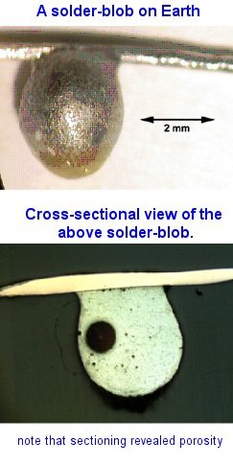
Soldering
Soldering is good for connection
It can heat your devices to failing temperatures and cause catastrophic effects.
All soldered devices should be retested
Soldering can cause no connection

Slide 55
Use of Jumpers
As part of the test that aid in determining faults and their diagnosis
When knowing the current aids in determining possible flaw use a jumper in a board (allows for current test)

Slide 56
Faults and defects
Defect is a physical problem
Short circuit
Open
Wrong value of device
Incorrect conection
Fault is the electrical manifestation of a defect
Stuck at one, Stuck at zero
Voltage drift, Offset, attenuation

Slide 57
Specs of system
Speed is determined by the slowest of your modules.
Heat sinks might be needed (specially for heavily integrated or high speed or power hungry devices.
Output signal determined by the module at the end.
Loading for testing should be considered

Slide 58
Steps to more efficient testing
Determine input and output specs of every device you will use.
If Interface boards are used, design should considered points fro testing
A document among the whole team should circulate early on to integrate the test from the beginning
Connectors should be used for soldering

Slide 59
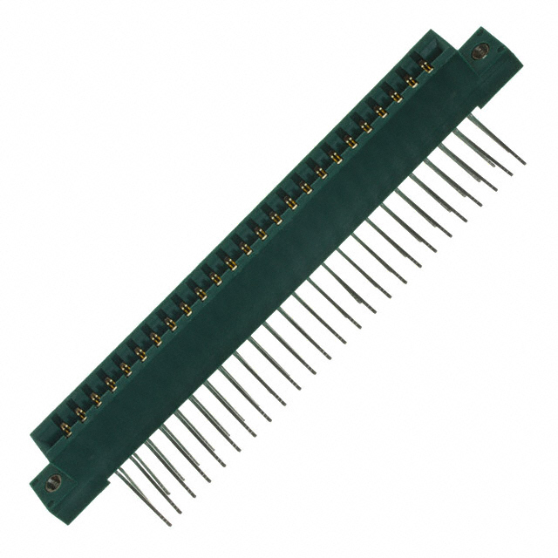
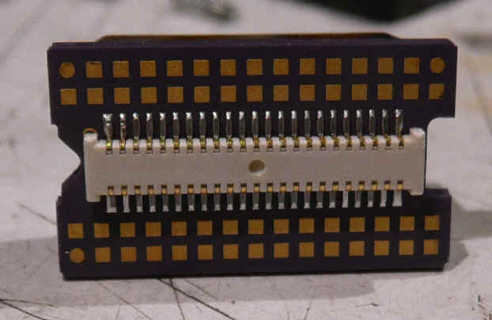
Chip Connectors
Avoid burning of parts due to soldering

Slide 60

If software interacts
Debug
Simulate
Debug
Simulate
And then debug some more ;)

Slide 61
Questions
?

