Slide 1


Software Engineering in Puerto Rico
Rock Solid Technologies, Inc.
Eng. Ángel L. Pérez
Vice President

Slide 2

Rock Solid Technologies www.rocksolid.com
Software development and implementation firm
About 40 Colegiales
Offices
San Juan, Caguas R&D Center
Austin, TX
St. Michael, Barbados
World-wide Award – Microsoft 2010 & 2011

Slide 3

What is software?
Programs
Documentation
Manuals
Help files
Licenses

Slide 4
Software engineering definition
… is concerned with software systems which are built by teams rather than individual programmers, uses engineering principles in the development of these systems, and is made up of both technical and non-technical aspects…

Slide 5

Trade-offs Triangle

Slide 6
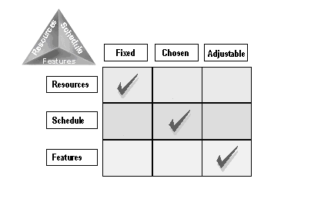
Tradeoff Matrix

Slide 7
What is software engineering – my version?
Marketing
Proposals
Economic Analysis
ROI
TCO
Sales
Legal – Contracts
Licensing
Requirement Definition
Prototype
Risk Management
Design
Coding
Testing
More testing
Training
Implement
On-site Support
Help Desk
Maintenance
Enhancements
Re-negotiate

Slide 8
Well engineered software
Functional
Maintainable
Reliable
Efficient
Appropriate user interface
User-friendly
Expert-friendly

Slide 9

Software Models
Waterfall model
Iterative waterfall model
Prototyping
Works well for us in government
Others

Slide 10
MSF Process Model

Slide 11

Software Engineering here?

Slide 12

Or here?

Slide 13
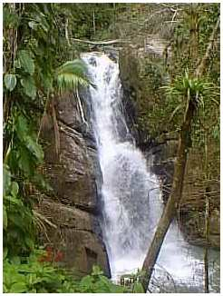
I prefer here!

Slide 14
Puerto Rico Software Development Map
Multiple local companies doing Software Development
Rock Solid – government and private sector
Softek, Invid
CRG, Infotech, Evertec, Nagnoi
USA based aerospace companies – Axon, Infotech, Honeywell
Your Company – Become an entrepreneur!
Multinationals
SAP
ORACLE
Microsoft
Others
Insurance
Banking

Slide 15
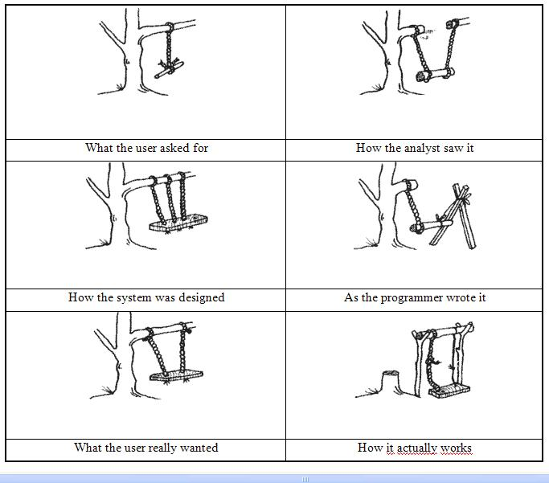
The key to good Software Engineering – Knowing what the customer wants!

Slide 16

How to improve your chances?
Learn to write
Not just software code
Spanish and English
Learn to listen
Learn to speak
Networking: Student and Business Orgs
Focus on learning the business
Become a well rounded professional
Give back to your community, $chool, etc.

Slide 17

Q&A
Contact Info
Angel L. Pérez
aperez@rocksolid.com
787-447-6090

