Slide 1
Writing Formal Reports
Nayda G. Santiago
ICOM 5047
September 14, 2012

Slide 2
Design Process
Define Problem
Gather Information
Concept Generation
Evaluate & Select Concept
Conceptual Design
Product Architecture
Configuration Design
Parametric Design
Detail Design
Embodiment Design

Slide 3
Why?
Flow of information.
  Management is impossible without flow of information.
  Make decisions.
    Need relevant facts.
Constructed in an useful way.

Slide 4
Report Components
Abstract or Summary
  Executive Summary
Introduction
Discussion or Body of the Report
Conclusions
Future Work or Recommendations
Appendix
References or Bibliography

Slide 5
Contents (More)
Cover
Title page
Table of contents
List of figures
List of tables
Glossary

Slide 6
Cover and Title page
Cover
  Nice
Title page
  Title of report
  Name of organization
  Name of people who wrote the report
  Date
  Report number
  (Section, course)
  Dignified

Slide 7
Example
University of PR, Mayaguez Campus
Electrical and Computer
Engineering Department
Title here
By
Nayda G. Santiago
For: Fernando Vega
Course: ICOM 5047, section 030 (031)
Date: Sept 20, 2008
Logo

Slide 8
Abstract or Summary
Purpose – contain the substance of the report
  Busy reader can grasp the contents
  Author – grasp of central idea
Summary of purpose, main results, and findings
Written at the end
Types
  Indicative
  Informative
  Indicative-informative

Slide 9
Types of abstracts
Indicative
  Main subject of the document
  Qualitative description
  Simple vocabulary
Informative
  Point out discoveries
  Quantitative description
  Technical
Informative-indicative
  Combination

Slide 10
Executive Summary
Readers of the report are busy people.
  Do not have time to go through the report page after page to find what is valuable for them.
Purpose
  Set out the substance of the report briefly in such way that busy readers can see at glance whether the report is relevant to them.
Should not exceed one page.

Slide 11
Table of contents
How to find information
How material has been organized
Important
  Headings exactly as they appeared in text
  Appendixes must be included
  If too many headings
    Include only main ones
List of figures and List of Tables
  If necessary

Slide 12
Introduction
Prepares the reader
Main components
  Background
  Purpose
  Scope
Other components
  Problem Statement
  Main contribution
  Reference to technical contents

Slide 13
Body of the report
Theoretical Background
Discussion
Detailed account of the work or research performed
Organized
Consider the audience for vocabulary
  Over or under estimate reader
Divided in sections
  Appropriate title
    No Discussion as title
Include tables, charts, figures

Slide 14
System Description
Composition Structure and Block Diagram
  In hardware: Block diagram
    Describe components and their interconnection
  In software: Structure diagram
    UML
    Class diagram
      Component
      Object
      Structure

Slide 15
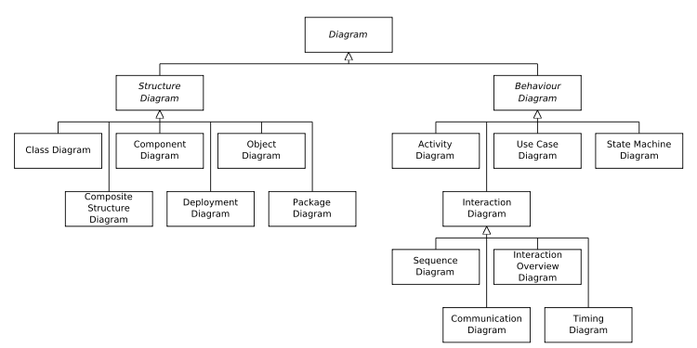
UML (From Wikipedia)

Slide 16
System description
Dynamic structure
  Changing behavior of the system
    Time
UML
  Sequence Diagram
    Displays the time sequence of the objects participating in the interaction.
    This consists of the vertical dimension (time) and horizontal dimension (different objects)
1

Slide 17
System description
Entity relationship diagrams
  Visualize different sets of entities, each being of a certain type
    Defined by a set of attributes
    Arrows represent relations
  UML
    Component Diagram
    Displays the high level packaged structure of the code itself.
    Dependencies among components are shown, including source code components, binary code components, and executable components.
    Some components exist at compile time, at link time, at run times well as at more than one time

Slide 18
Tables and Figures
Illustrations
  Must serve a purpose
  Supplement not duplicate information
  Referred to in the text
  Clear and simple to understand
  Caption and figure or table number
  Smaller than page
    If full page, read from right
  Don’t scan tables or figures or copy from web page. Draw them.

Slide 19
Conclusions
Analyze
Provide suggestions
Future work
Summarize (don’t overdo it)
Reasoning

Slide 20
Appendix
Detailed descriptions
Derivations
Lengthy tables
Data
  Manufacturer data
  Data sheets
Complex analysis
Information that might interrupt the flow of the report.
Must appear in the order cited in the document
Assign a letter to appendix and a title

Slide 21
References or Bibliography
References
  Where did we get the information for the report
    Please, no web pages if possible
    Cited within
Bibliography
  Reading material
    Might not have been used to prepare the report

Slide 22
References
Essential
  Author
  Title
  Publisher, publication
  Year, date, month
Style
  Use the same style as the people in your field
  Read and you will learn the style

Slide 23
Plagiarism
Written material must be original
  Do NOT copy material (cut and paste) from any source
  If so, use quotes and reference the material
PLAGIARISM!
Plagiarism is a form of academic
dishonesty punishable by expulsion.

Slide 24
Comparison and Contrast
Ascending order
  Most likely to adopt, last
Descending order
  Most likely to adopt, first

Slide 25
Cognitive Mapping / Mind Maps
Definition: The representation of a person’s reality as a "cognitive map" consisting of nodes and edges (linkages). Nodes are used to represent the person’s concepts, including events, actions and values, and the edges are used to represent perceived causal relationships. Using a cognitive map, one can identify idea chains or explanatory paths.

Slide 26
Construction of Cognitive Maps
Code the text by identifying the concepts and the explicit or implicit causal linkages between them.
Construct a concept dictionary.
List relationships between concepts.
Draw the cognitive map.

Slide 27
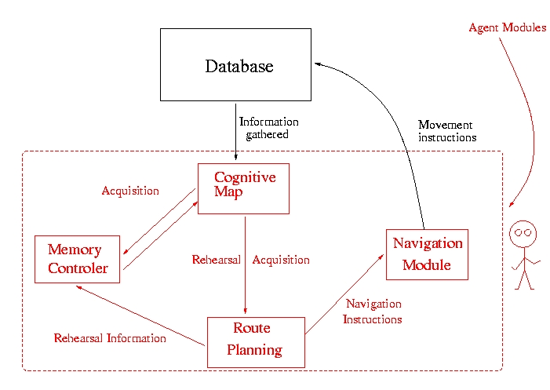
Example

Slide 28
Hints
Use diagrams
Have one person read the report at the end and oversee the overall structure
Enumerate pages and create table of contents
Write when you have something to write
Write body first, abstract last

Slide 29
References
Blicq, Ron S., Writing Reports to Get Results: Guideline for the Computer Age, IEEE Press, 1987.
Lloréns, Baldomero, Class notes ELEG 4165, Univ. of Puerto Rico at Mayagüez, 1991.
Michaelson, Herbert B., How to Write & Publish Engineering Papers and Reports, 3rd Edition, Oryx Press, 1990.
Pringle, Alan S., O’Keefe Sarah S., Burns, Bill, Technical Writing 101 : A Real-World Guide to Planning and Writing Technical Documentation, Scriptorium Press, 2000
Dieter and Schmidt, Engineering Design, Fourth Edition, Mc Graw Hill, 2007

Slide 30
Questions?
?????????????
http://www.ece.uprm.edu/~nayda/Report_Format.pdf

