Slide 1
Intro to Testing
A hardware perspective
Gladys O. Ducoudray

Slide 2
Testing
Hardware
Software
Test is a module based process
Earlier in the assembly process the cheaper the cost
TIME=MONEY
Software
  2/3 of the time/budget is spent in debugging

Slide 3
Approach to testing
Shoot from the hip
Well planned into design
Is a manner of leaving test for the end
Fast in assembly
If lucky will work
Measures only final performance
Takes time
May slow the assembly process
Speeds up debugging process
Takes into account controllability and observability

Slide 4
Generating the Test Plan
  To Plan or Not to Plan?
    Shoot From the Hip Approach
      Non-optimized
      May cause a device to be Non-testable
    Planned Testing
      Allows early interaction between design and test engineers
      Identification of non-testable functions
      Synchronization of clocking schemes
      Tester hardware identification
        identify tester hardware deficiencies

Slide 5
Definition
Controllability-
  Ability to control the signal (Voltage or Current) on each node
Accessability
  Access for measuring every node
Metrology
  Method used to test by selecting what to measure, how to measure and when to measure

Slide 6
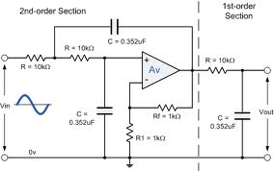

Sometime ago……
Every node was accessible and thus we could control and measure
Notes:
Habla de la perdida de medidas en ciorriente y voltage en nodos intermedios

Slide 7
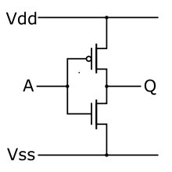
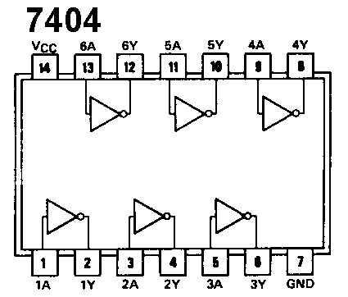
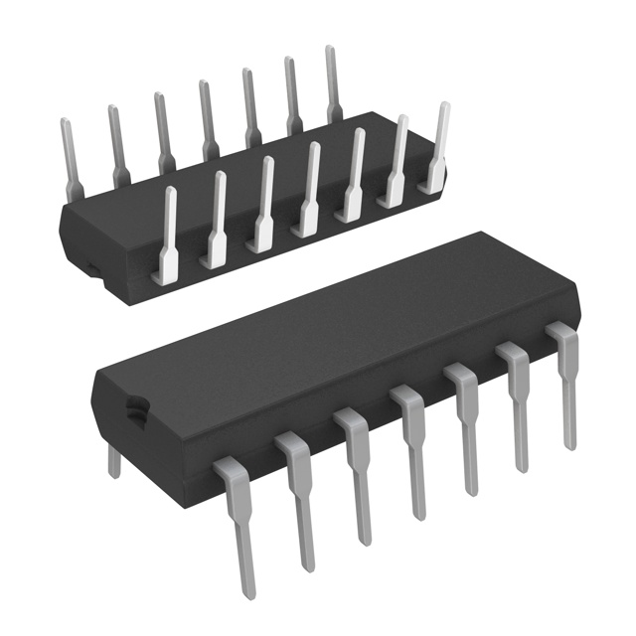
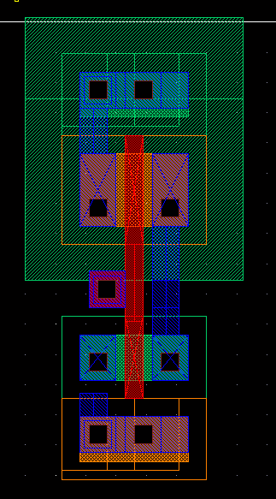
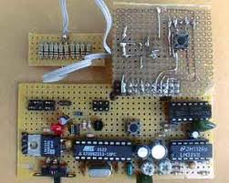
Integration
Non integrated System
Integrated

Slide 8
Cost of detection
Earlier
Transistor cents
Chip or device dollars
Module 10’s of dollars
Board 100’s
System 1,000’s
Major equipment can go up to millions
LATER
Notes:
Habla en terminos del tiempo si hacen prueba final de funcionalidad

Slide 9
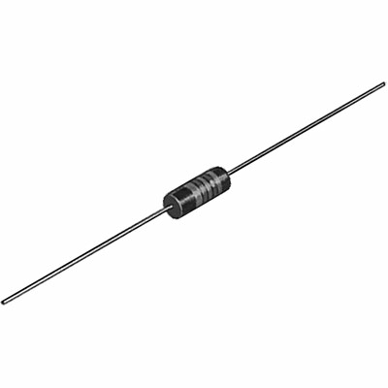
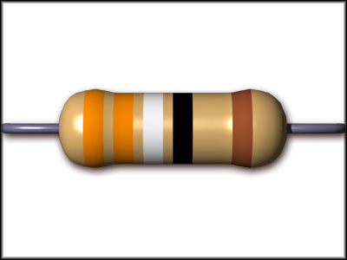
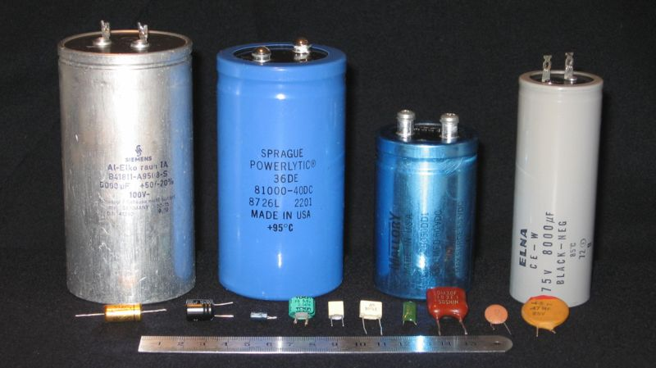
System Test= Module Testing=Many Device Tests
Considerations
  What inputs the signal to the device
  What is the Load on the device?
Resistor Capacitor and Inductor testing
  Multimeter 1-10 pieces
  If testing hundreds of pieces use ATE
    Automatic Test Equipment
      ELVIS
      Labview
      VLCT

Slide 10
Chip Testing
A Step by Step approach
Download and Read the Data sheet
  View picture of pin layout
    Input Output, analog or digital…..NC (no connection)
    Current or Voltage
    Continuous signal or discrete
    Clocking Signals
  Read Brief description
  Read AbsMax Section!!
Notes:
Aprieta el link

Slide 11
Device Specification Sheet
  Purpose
    Design Specification
      Determine functionality of design
    Test List Generation
      Ensure device lives up to spec sheet claims
    Communication
      Verify that device is appropriate for the end application
    Flexible Document
      Ownership - catalog or custom?
      Allows changes to specifications
      Avoid ambiguities
    Late Changes in Specification Sheet Indicates Poor Organization

Slide 12
Device Specification Sheet
  Structure
    Feature Summary
      Quick look at functionality of chip
    Principles of Operation
      Detailed device function
        guaranteed by functional or parametric test program
    Absolute Maximum Ratings
      Failure limits of chip
        not critical to a test engineer
    Electrical Specifications
      Core of parametric tests
      Test conditions are listed as notes
      MAX, MIN, TYP, guaranteed by design

Slide 13
Device Specification Sheet
  Structure
    Timing Diagrams
      Critical to test program development
      Manually generated for frequency synchronization
    Application Information
      Aids customer in designing end application
      Functional block diagram
        shows top level representation of device function
    Characterization Data
      Data collected during testing i.e. parameter histograms
    Circuit Schematics / Die Layout
      Device functional pin representation and layout

Slide 14
ABS MAX
NEVER TEST FOR THIS!!!

Slide 15
Parametric test
Industry characterizes a lot
Various measurements appear in the table
For Digital
  V_{DD} max and min
  V_{OH} ,V_{OL}, V_{IH}, V_{OL}
  I_{DDQ} I_{L} etc…..
What should we test first???

Slide 16
What we should test first?
Continuity
  Of chip to Silicon
  Chip to module
  Modules to board
  Board to slots
  Slots to system
  Power supply
May require ID or Flags on your wires
Notes:
First test each chip then the rest
Include integration of loading and feed

Slide 17
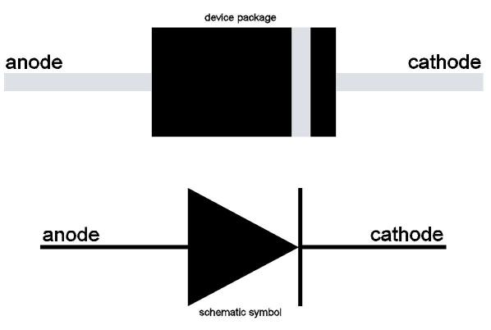
Continuity
Testing Continuity of Chip to Silicon???
ESD = Electrostatic Protection Diode
Not shown in Data sheet!!!

Slide 18
Purpose of Continuity Testing
  Determine connection on chip from leads to mission circuit
  Determine connection from chip-chip, or chip-board
  Determine connection Board-System

Slide 19
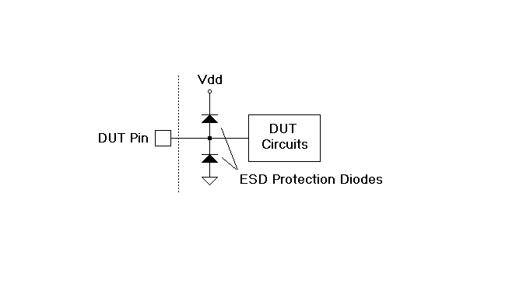
Continuity
  Continuity Test Technique
    On chip protection diodes
      Protect input and output from Electrostatic Discharge (ESD) and other overvoltage
      Pins have either one or two reverse biased diodes

Slide 20
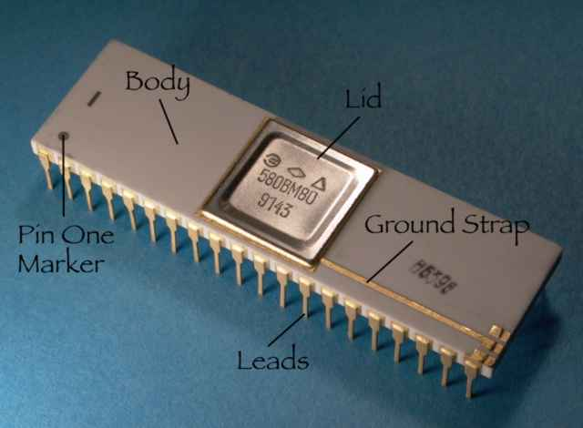
Continuity
  Continuity Test Technique
    Force current - measure voltage
      DUT power supplies are grounded
      Current level is usually between 100uA and 1mA
      Diodes connected to the positive supply - current forced in
      Diodes connected to the negative supply - current forced out
      Output diode voltage drop usually is between 550mV and 750mV It can be positive or negative.
      If tester does not see diode voltage drop or the current reaches its voltage clamp, the test fails

Slide 21

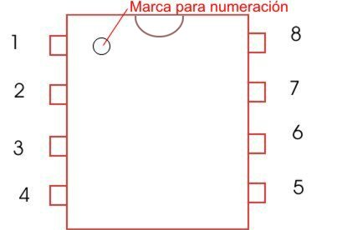
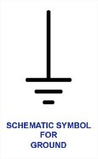
Continuity
  Serial vs. Parallel Continuity Testing
    Serial is one pin at a time
      Test time intensive
Measured Voltage

Slide 22
Continuity
  Serial vs. Parallel Continuity Testing
    Serial is one pin at a time
      Test time intensive
    Parallel can not see pin to pin shorts
      Alternating odd and even pin parallel test

Slide 23
Continuity
  Serial vs. Parallel Continuity Testing
    Serial is one pin at a time
      Test time intensive
    Parallel can not see pin to pin shorts
      Alternating odd and even pin parallel test
    Analog parallel per-pin measurement is not available in some testers
      Single current source and volt meter can be used one pin at a time
    Digital per-pin measurement is available, but may introduce noise into sensitive analog circuit

Slide 24
Leakage Currents
  Purpose of Leakage Testing
    Good design should have leakage current of less than 1uA
    Detects poorly processed integrated circuits
      Improper operation in customer end application
    Detect weak devices
      Initially function but eventually fail after unacceptably short lifetime (Infant mortality)

Slide 25
Leakage Currents
  Leakage Test Technique
    Force DC voltage - measure small current
      Typically measured twice
        input voltage equal to positive supply
        input voltage set to ground or negative supply
      Input current high (I_{IH}) and input current low (I_{IL})
      Digital and analog inputs
    Output leakage current (I_{OZ})
      Measured same as I_{IH} & I_{IL}
        output pin must be placed in a high impedance (HIZ) state using test modes

Slide 26
Leakage Currents
  Serial vs. Parallel Leakage Testing
    Serial is one pin at a time
      Test time intensive
      Less possibility of errors
    Leakage currents can flow from pin to pin
      Alternating odd and even pin parallel test is recommended
    Again, analog parallel per-pin measurement is not available in some testers
      Single voltage source and current meter can be used one pin at a time
    Again, digital per-pin measurement is available, but may introduce noise into sensitive analog circuit

Slide 27
Power Supply Currents (I_{DDQ} i_{DD})
  Importance of Supply Current Tests
    Fast method for determining catastrophic failure
      Large current draw from power supplies
      Tests are run early in test protocol to weed out defective chips without wasting valuable test time
    Customer specific application characteristic
      Battery operated instruments like a cellular phone require minimal current draw by electronics

Slide 28
Power Supply Currents
  Test Techniques
    Basic test is simple
      Testers have the ability to measure current draw from power supplies (Idd and Icc)
    Actual test is never basic
      Test conditions
        must be clearly identified in test plan
        power up mode, standby mode, normal operational mode
        digital supply (Iddd and Iccd) and analog supply (Idda and Icca) measured separately
      Worst case
        requires complete characterization

Slide 29
  Test Techniques - cont.
      Multiple power supply pins
        designers may need to know the current flow into each pin
      Settling time
        5 to 10 milliseconds in active mode
        hundreds of milliseconds to stabilize to within 1mA

Slide 30
DC References and Regulators
  Voltage Regulators
    High voltage input - regulated lower voltage output
      Output voltage
        simple voltmeter reading
      Output voltage regulation
        ability of regulator to maintain specific output under load
      Dropout voltage
        minimum input voltage before output drops below specified level
      Input regulation
        ability of regulator to maintain steady output with a range of input voltages

Slide 31
DC References and Regulators
  Voltage References
    Low power voltage regulators
      Not always accessible from external pin
        test engineer may need to request test modes to test references
      May not have a separate specification in the data sheet
      DC reference test modes allow the program to trim the DC references for more precise device operation

Slide 32
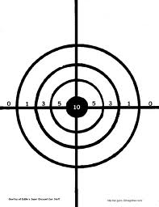
Measurement Accuracy
  Terminology
    Definitions of Accuracy
      Closeness with which an instrument reading approaches the true value of the variable being measured.
      The maximum error in the measurement of a physical quantity in terms of the output of an instrument when referred to the individual instrument calibrations.
      The degree of conformance of a test instrument to absolute standards.
      The ability to produce an average measured value which agrees with the true value or standard being used.

Slide 33

Measurement Accuracy
  Terminology
    Precision
      A measure of the reproducibility of the measurements.
        Given a fixed value of a variable, precision is a measure of the degree to which successive measurements differ from one another.
      The degree to which repeated measurements of a given quantity agree when obtained by the same method and under the same conditions.
      Also called repeatability or reproducibility.
      The ability to repeatedly measure the same product or service and obtain the same results.

Slide 34
Measurement Accuracy
  Book Terminology
    Accuracy - to refers to the overall closeness of an averaged measurement to the true value.
    Repeatability - the consistency with which that measurement can be made.
      The word precision will be avoided.
    Accuracy takes all error sources into account
      Systematic Errors
      Random Errors
      Resolution (Quantization Errors)

Slide 35
Measurement Accuracy
  Terminology
    Systematic Errors
      Errors that appear consistently from measurement to measurement
        Ideal Value = 100mV
        Measurements : 101mV, 103mV, 102mV, 101mV, 102mV, 103mV, 103mV, 101mV, 102mV
        Average Error : 2mV
        Caused by DC offsets, gain errors, non-linearities in the DVM
        Systematic errors can often be reduced through calibrations.

Slide 36
Measurement Accuracy
  Terminology
    Random Errors
      Notice that the list of numbers in the last slide vary from 101mV to 103mV.
      All measurement tools have random errors even $2 Million Automated test instruments
      Random Errors are perfectly normal in analog and mixed-signal measurements.
      Big challenge is in determining whether the random error is caused by a bad DIB design, bad DUT design or by the tester itself.

Slide 37
Measurement Accuracy
  Terminology
    Resolution (Quantization Errors)
      Notice that in the previous list of numbers, the measurement was always rounded off to the nearest milivolt.
      Limited resolution results from the fact that continuous analog signals must be converted to digital format (using ADC’s) before a computer can evaluate the test results.
      The inherent error in ADCs and measurement instrumentation is called Quantization Error.
      Quantization error is a result of the conversion from an infinitely variable input voltage to a finite set of possible outputs from the ADC.

Slide 38


Testing Matches
If the match has all the elements and If conditions are the predetermine ones
  Then the match should light up when stroke against the side of the Box
Match box factories do NOT test each Match by striking it!!!!!
Notes:
Talk about if test of chip with load is made then performance is unnecessary

Slide 39
Feed and Load
Notes:
Talk about if it can cope with the load
If the internal resistance at the input lowers the expected Vin.
Introduce the problems with Multimeters in terms of internal resistance

Slide 40
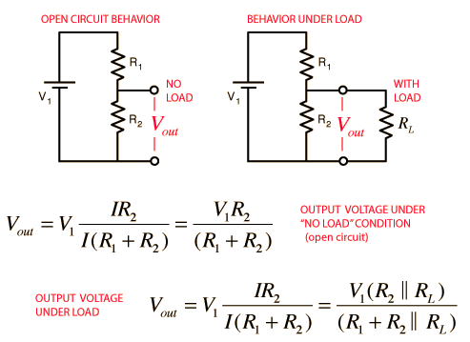
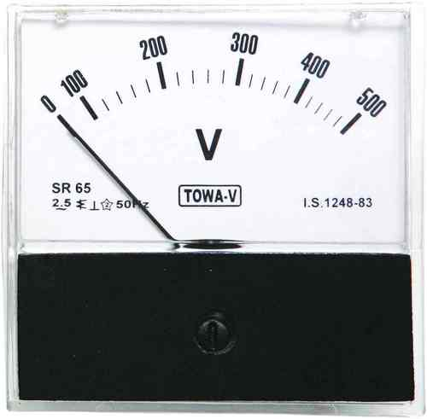
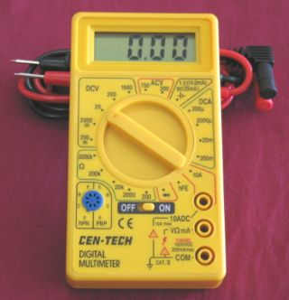
Measuring Voltage

Slide 41
Measuring Voltage
If R_{L}>>R₂ then V_{out}=R₂/(R₁+R₂)

Slide 42

Measuring Current
Current is measured in series
The Circuit must Be Broken to measure the signal

Slide 43
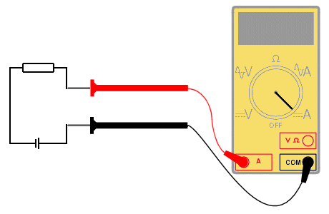
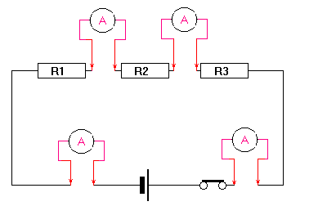
Measuring Current
It Loads the circuit thus each measurement affects the function in analog.
Digital signals are mostly measured in Volts and are impervious to minute changes, however the problems can be analog.
Slew Rate, Frequency, Transition Curve etc….

Slide 44
Testing Modules and Systems
Ideal or real Input signals
Ideal Voltage or Current Signals indicates proper functionality at the input.
Real Inputs have,
  Noise
  Load tolerance
  Variations
  Maximum frequency

Slide 45
Real Input
Possible Problems
  Fan Out
  Slew rate
  Exceeds Load Regulations
  Frequency incompatibility
  Ground Bouncing
  Poorly defined States

Slide 46
Fan Out
CUT 1
Input
CUT 2
CUT 3
CUT 4
CUT 5
The Input signal is exceeding its signal capabilities!!!!
CUT 6

Slide 47
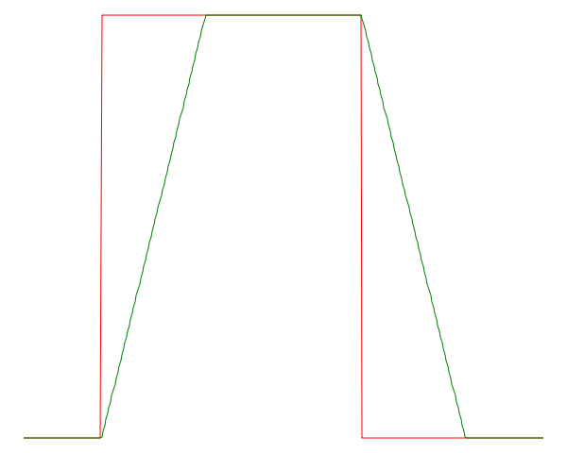
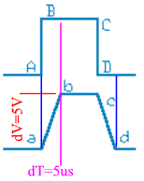
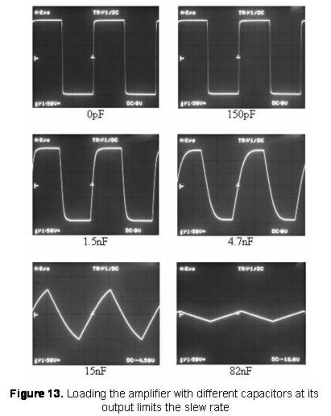
Slew Rate

Slide 48
Slew Rate

Slide 49
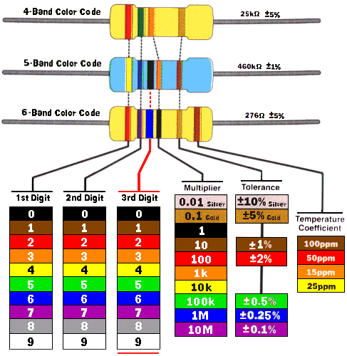
Load Regulation
More Current
Current needed By the circuit can not be provided by the source so it gives maximum current.
In case of a voltage signal the signal magnitude is considerably diminished!!
Less Current

Slide 50
Frequency problems
The input signal varies at a higher rate than the maximum frequency response of the circuit
The input signal is much slower that the circuit and the output may be processing the transition region
False zeroes or ones if the signal is a clock signal and it is not synchronized

Slide 51

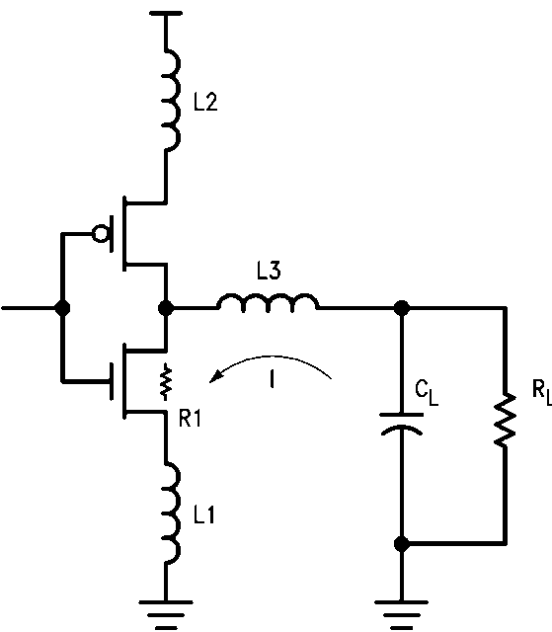
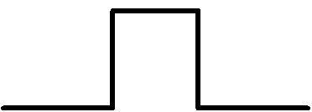
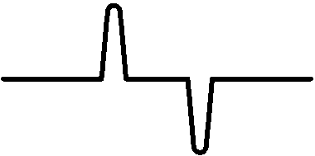
Ground Bouncing
Output Voltage
I=-C_{L}dV/dt
V_{GB}=L ΔI/Δt
Notes:
Ground bounce is usually seen on high density VLSI where insufficient precautions have been taken to supply a logic gate with a sufficiently low resistance connection (or sufficiently high capacitance) to ground. In this phenomenon, when the gate is turned on, enough current flows through the emitter-collector circuit that the silicon in the immediate vicinity of the emitter is pulled high, sometimes by several volts, thus raising the local ground, as perceived by the transistor, to a value significantly above true ground. Relative to this local ground, the BASE voltage can go negative, thus shutting off the transistor. As the excess local charge dissipates, the transistor turns back on, possibly causing a repeat of the phenomenon, sometimes up to a half-dozen bounces.

Slide 52
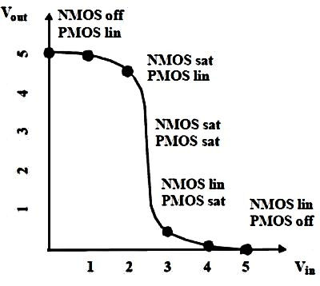
Poorly defined states
States are defined as the High or Low in digital.
The transition region is an unknown
The bigger transition region determines the transition region of the system

Slide 53
Load Problems
The Impedance of the load is too small
  Load regulations are exceeded
  Current will give the maximum current but it will not be enough to achieve the desire voltage or current magnitude
Load Capacitance is too large
  The maximum current charges the Capacitor
  The rate of charge is determined by the maximum Current creating slew rate problems.

Slide 54
Module and system testing
If each device is measured according to its specifications with the load and real input
Then;
  The sum of the parts will work.
Interaction with the other modules should be synchronize if needed.
Board Specs and electrical characteristics should be taken into consideration as load.

Slide 55
Performance test
Inputs N
Amount of testing Vectors 2N
If 10 inputs----1024 possible vectors!!!
Performance should be run only after full assembly is done. Should attempt the high end of specs
Should not be soldered unless all possible module test are run!!!

Slide 56
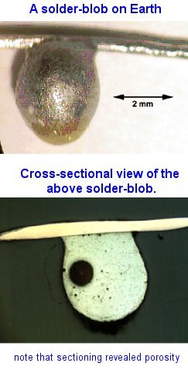
Soldering
Soldering is good for connection
It can heat your devices to failing temperatures and cause catastrophic effects.
All soldered devices should be retested
Soldering can cause no connection

Slide 57
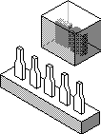
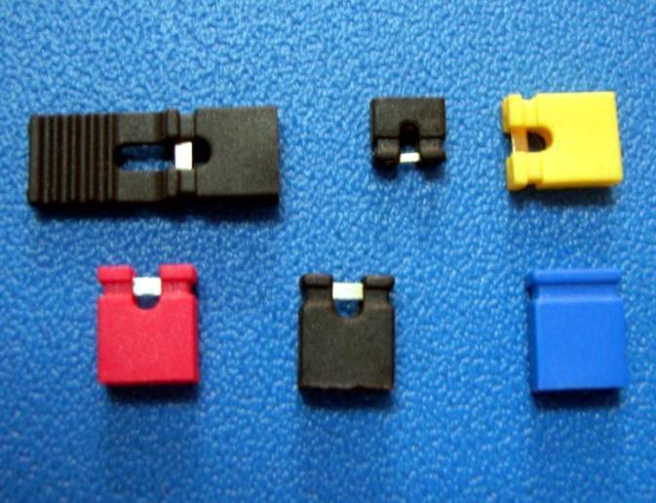
Use of Jumpers
As part of the test that aid in determining faults and their diagnosis
When knowing the current aids in determining possible flaw use a jumper in a board (allows for current test)

Slide 58
Faults and defects
Defect is a physical problem
  Short circuit
  Open
  Wrong value of device
  Incorrect connection
Fault is the electrical manifestation of a defect
  Stuck at one, Stuck at zero
  Voltage drift, Offset, attenuation

Slide 59
Specs of system
Speed is determined by the slowest of your modules.
Heat sinks might be needed (specially for heavily integrated or high speed or power hungry devices.
Output signal determined by the module at the end.
Loading for testing should be considered

Slide 60
Steps to more efficient testing
Determine input and output specs of every device you will use.
If Interface boards are used, design should considered points for testing
A document among the whole team should circulate early on, to integrate the test from the beginning
Connectors should be used for soldering

Slide 61
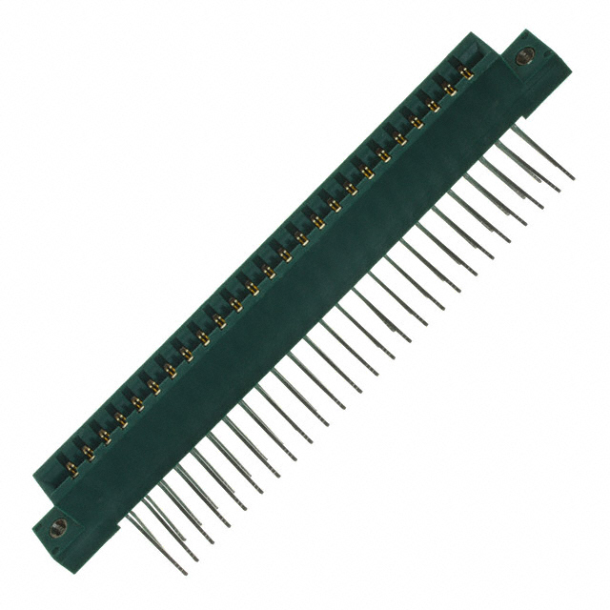
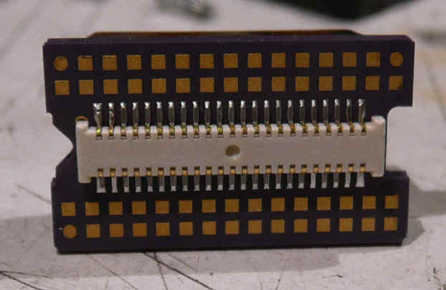
Chip Connectors
Avoid burning of parts due to soldering

Slide 62

If software interacts
Debug
Simulate
Debug
Simulate
And then debug some more ;)

Slide 63
Questions
?

