Slide 1
Writing Formal Reports
Nayda G. Santiago
ICOM 5047
September 14, 2012

Slide 2
Design Process
Define Problem
Gather Information
Concept Generation
Evaluate & Select Concept
Conceptual Design
Product Architecture
Configuration Design
Parametric Design
Detail Design
Embodiment Design

Slide 3
Why?
Flow of information.
Management is impossible without flow of information.
Make decisions.
Need relevant facts.
Constructed in an useful way.

Slide 4
Report Components
Abstract or Summary
Executive Summary
Introduction
Discussion or Body of the Report
Conclusions
Future Work or Recommendations
Appendix
References or Bibliography

Slide 5
Contents (More)
Cover
Title page
Table of contents
List of figures
List of tables
Glossary

Slide 6
Cover and Title page
Cover
Nice
Title page
Title of report
Name of organization
Name of people who wrote the report
Date
Report number
(Section, course)
Dignified

Slide 7
Example
University of PR, Mayaguez Campus
Electrical and Computer
Engineering Department
Title here
By
Nayda G. Santiago
For: Fernando Vega
Course: ICOM 5047, section 030 (031)
Date: Sept 20, 2008
Logo

Slide 8
Abstract or Summary
Purpose – contain the substance of the report
Busy reader can grasp the contents
Author – grasp of central idea
Summary of purpose, main results, and findings
Written at the end
Types
Indicative
Informative
Indicative-informative

Slide 9
Types of abstracts
Indicative
Main subject of the document
Qualitative description
Simple vocabulary
Informative
Point out discoveries
Quantitative description
Technical
Informative-indicative
Combination

Slide 10
Executive Summary
Readers of the report are busy people.
Do not have time to go through the report page after page to find what is valuable for them.
Purpose
Set out the substance of the report briefly in such way that busy readers can see at glance whether the report is relevant to them.
Should not exceed one page.

Slide 11
Table of contents
How to find information
How material has been organized
Important
Headings exactly as they appeared in text
Appendixes must be included
If too many headings
Include only main ones
List of figures and List of Tables
If necessary

Slide 12
Introduction
Prepares the reader
Main components
Background
Purpose
Scope
Other components
Problem Statement
Main contribution
Reference to technical contents

Slide 13
Body of the report
Theoretical Background
Discussion
Detailed account of the work or research performed
Organized
Consider the audience for vocabulary
Over or under estimate reader
Divided in sections
Appropriate title
No Discussion as title
Include tables, charts, figures

Slide 14
System Description
Composition Structure and Block Diagram
In hardware: Block diagram
Describe components and their interconnection
In software: Structure diagram
UML
Class diagram
Component
Object
Structure

Slide 15
UML (From Wikipedia)

Slide 16
System description
Dynamic structure
Changing behavior of the system
Time
UML
Sequence Diagram
Displays the time sequence of the objects participating in the interaction.
This consists of the vertical dimension (time) and horizontal dimension (different objects)
1

Slide 17
System description
Entity relationship diagrams
Visualize different sets of entities, each being of a certain type
Defined by a set of attributes
Arrows represent relations
UML
Component Diagram
Displays the high level packaged structure of the code itself.
Dependencies among components are shown, including source code components, binary code components, and executable components.
Some components exist at compile time, at link time, at run times well as at more than one time

Slide 18
Tables and Figures
Illustrations
Must serve a purpose
Supplement not duplicate information
Referred to in the text
Clear and simple to understand
Caption and figure or table number
Smaller than page
If full page, read from right
Don’t scan tables or figures or copy from web page. Draw them.

Slide 19
Conclusions
Analyze
Provide suggestions
Future work
Summarize (don’t overdo it)
Reasoning

Slide 20
Appendix
Detailed descriptions
Derivations
Lengthy tables
Data
Manufacturer data
Data sheets
Complex analysis
Information that might interrupt the flow of the report.
Must appear in the order cited in the document
Assign a letter to appendix and a title

Slide 21
References or Bibliography
References
Where did we get the information for the report
Please, no web pages if possible
Cited within
Bibliography
Reading material
Might not have been used to prepare the report

Slide 22
References
Essential
Author
Title
Publisher, publication
Year, date, month
Style
Use the same style as the people in your field
Read and you will learn the style

Slide 23
Plagiarism
Written material must be original
Do NOT copy material (cut and paste) from any source
If so, use quotes and reference the material
PLAGIARISM!
Plagiarism is a form of academic
dishonesty punishable by expulsion.

Slide 24
Comparison and Contrast
Ascending order
Most likely to adopt, last
Descending order
Most likely to adopt, first

Slide 25
Cognitive Mapping / Mind Maps
Definition: The representation of a person’s reality as a "cognitive map" consisting of nodes and edges (linkages). Nodes are used to represent the person’s concepts, including events, actions and values, and the edges are used to represent perceived causal relationships. Using a cognitive map, one can identify idea chains or explanatory paths.

Slide 26
Construction of Cognitive Maps
Code the text by identifying the concepts and the explicit or implicit causal linkages between them.
Construct a concept dictionary.
List relationships between concepts.
Draw the cognitive map.

Slide 27
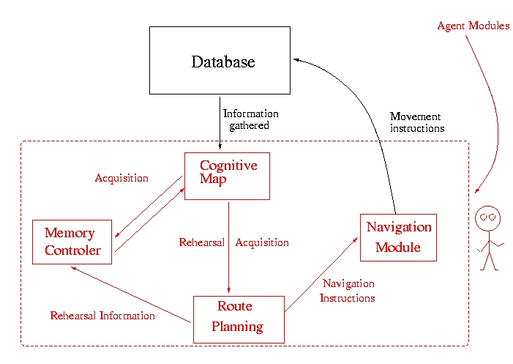
Example

Slide 28
Hints
Use diagrams
Have one person read the report at the end and oversee the overall structure
Enumerate pages and create table of contents
Write when you have something to write
Write body first, abstract last

Slide 29
References
Blicq, Ron S., Writing Reports to Get Results: Guideline for the Computer Age, IEEE Press, 1987.
Lloréns, Baldomero, Class notes ELEG 4165, Univ. of Puerto Rico at Mayagüez, 1991.
Michaelson, Herbert B., How to Write & Publish Engineering Papers and Reports, 3rd Edition, Oryx Press, 1990.
Pringle, Alan S., O’Keefe Sarah S., Burns, Bill, Technical Writing 101 : A Real-World Guide to Planning and Writing Technical Documentation, Scriptorium Press, 2000
Dieter and Schmidt, Engineering Design, Fourth Edition, Mc Graw Hill, 2007

Slide 30
Questions?
?????????????
http://www.ece.uprm.edu/~nayda/Report_Format.pdf

