Slide 1
ICOM 4035 – Data Structures Lecture 6 – Big-O Notation
Manuel Rodriguez Martinez
Electrical and Computer Engineering
University of Puerto Rico, Mayagüez
©Manuel Rodriguez – All rights reserved

Slide 2
Lecture Organization
Part I – Introduce the concept of running time of a program
Part II – Discuss Computational Complexity and Big-O notion
Part III – Present methods to estimate program complexity

Slide 3
Objectives
Discuss ideas for comparing cost/efficiency of data structures & algorithms
Introduce the notion of computational complexity and Big-O notation
Describe basic process to estimate complexity of algorithms
Provide motivating examples

Slide 4
Companion videos
Lecture6 videos
Contains the coding process associated with this lecture
Shows how to build the interfaces, concrete classes, and factory classes mentioned here

Slide 5
Part I
Running time of programs

Slide 6
There are Different Algorithms for Same Task
For a given task, there can be multiple algorithms
All reach the same solution through a different path
Ex. Bag ADT and add() operation
Static implementation
Just add new element or gives error if full
Dynamic implementation
Re-allocate space if full
Add new element
Dynamic implementation has add() operation that does “more” work

Slide 7
Add() Operation in Static Bag
public void add(Object obj) {
if (obj == null){
throw new IllegalArgumentException
("Value cannot be null.");
}
else if (this.size() ==
this.elements.length){
throw new IllegalStateException
("Bag is full.");
}
else {
this.elements[this.currentSize++] = obj;
}
}

Slide 8
Add() Operation in Dynamic Bag
public void add(Object obj) {
if (this.theBag.size() ==
this.currentCapacity){
// bag is full!!!
StaticBag newBag = new
StaticBag(this.size()*2);
// fill the newBag
for (Object obj2 : this.theBag){
newBag.add(obj2);
}
this.theBag.clear();
this.theBag = newBag;
}
this.theBag.add(obj);
}
This loop is extra work!

Slide 9
Key Observation
Not all algorithms take the same effort to complete
Add()
Static Bag – always does assignment or throws exception
Dynamic Bag – can do
assignment
both assignment and array copy
Their running time is different

Slide 10
How do we measure Algorithm running time?
Actual Running time
Wall clock time that algorithms takes
Resource usage time
Time that CPU/disk/memory/network or other resource is being used running algorithm
Number of operations performed
Number of simple tasks performed by algorithm
The running time will be proportional to all these factors!

Slide 11
Why do we want to measure this?
Different algorithms for same task
compute the same result
have different amount of work
We want to use the algorithm that does the least amount of work
Most efficient one for the task at hand
Sometimes we might need to live with inefficiency for the sake of simplicity
From now on, work == running time

Slide 12
Factors that affect running time
Size of program input
Ex. : Number of elements to add to a list or set
Quality of code generated by developer
Quality of code generated by compiler
GNU gcc vs Java compiler vs Microsoft C++
Nature and speed of hardware
CPU, instruction set, RAM, Disk,
Nature of operating system
Linux vs Windows vs Mac OS X, etc
Time complexity of algorithm used

Slide 13
Measuring Running Time: Experimentation
Experimentation
Implement the data structures for ADT
Measure their running time
Make your decision
Problem: Controlled Environment
Time consuming
Need one person implement it all
Account for differences in programming style
Need same computer, compiler, etc.
Experimentation raises the issue of repeatability

Slide 14
Measuring Running Time: Benchmarks
Benchmark
Define operations
Provide sample data
Implement data structures
Measure how they fare on benchmark against best known implementation
Problem: Controlled Environment
Time consuming
Sometimes benchmark are manipulated to show highlights only

Slide 15
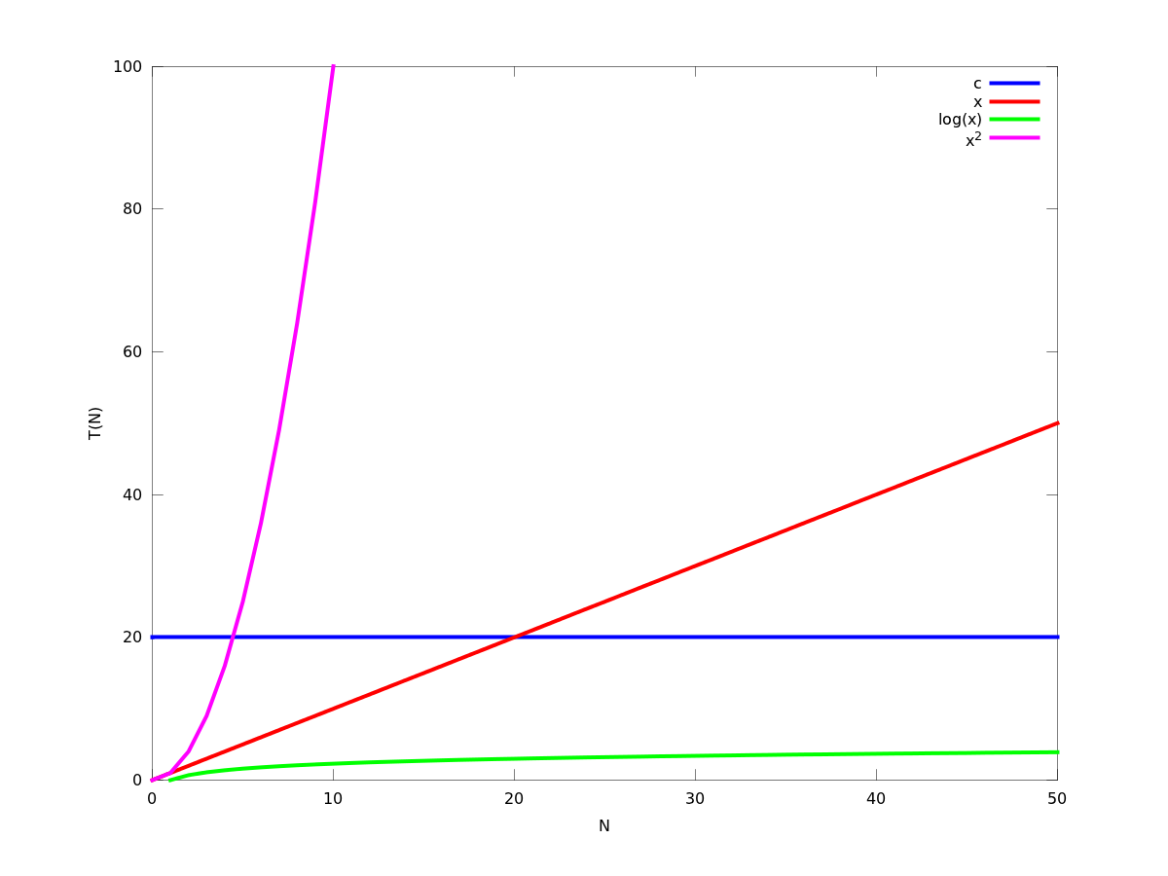
Measuring Running Time: Complexity
We will stick with complexity
Analyze the time complexity of algorithm
Function of input size
Find a function that bounds running time
Observe behavior as input size grows
You want to see behavior as input goes to infinity
Pick the one with smallest growth rate
Time is proportional to growth
Complexity is a rough estimate
But good enough in practice

Slide 16
Part II
Computational Complexity and Big-O notion

Slide 17
Computational Complexity
Provides information about difficulty of some operation
The more complex the operation, the faster its running time will grow
We want to establish a bound on running time
Helps to determine
Comparison point
Worst case behavior
We can analyze operations based on
Best case – best thing than happens (lucky!)
Average case – behavior in most cases
Worst case – behavior on worst case scenario

Slide 18
Typical functions used
Running time T(N) of algorithm
N = size of the input thrown at algorithm
Typical functions that bound T(N)
Constant : T(N) = c, c is some constant
Linear : T(N) = N
Quadratic : T(N) = N²
Logarithmic: T(N) = log(N), base 10 or base 2.
Cubic: T(N) = N³
Exponential: T(N) = 2^{N}
Factorial: T(N) = N!

Slide 19
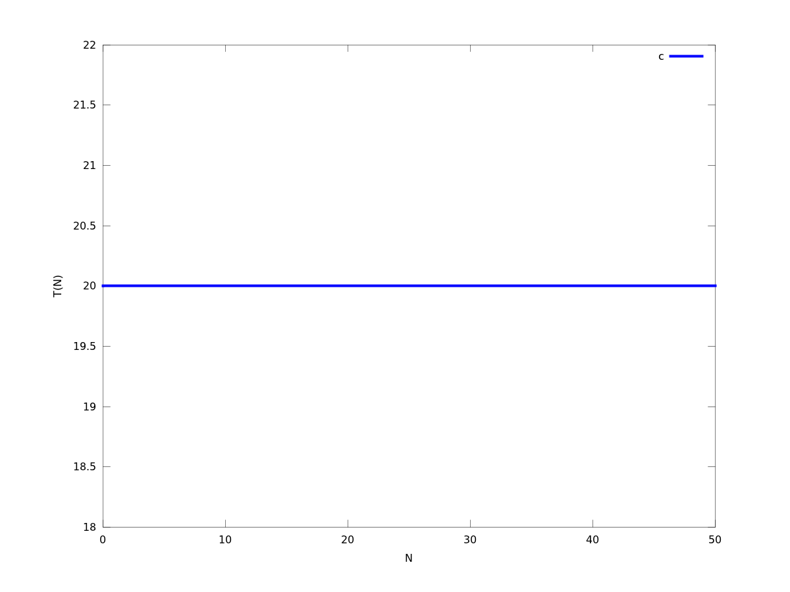
Constant Function
T(N) = c, for some real number c
Running time is always constant
Regardless of input size
Ex: List size, Empty test
Best case scenario

Slide 20
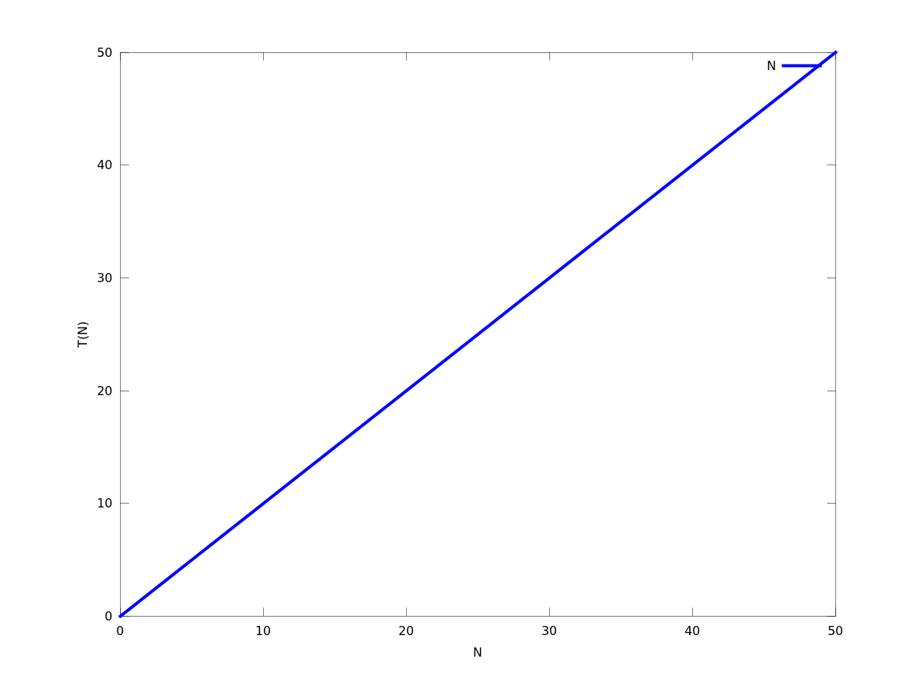
Linear Function
T(N) = N
Running time is proportional to input size
Operation needs to see whole input at least once
Ex: set membership, erase operation

Slide 21
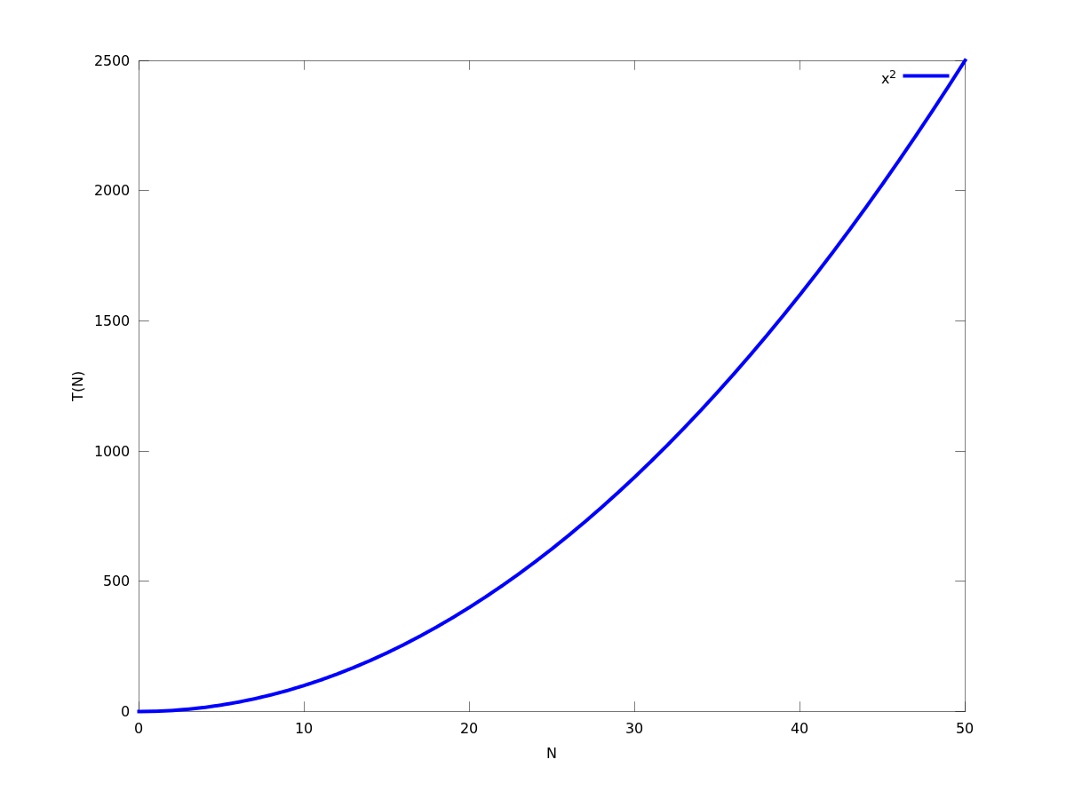
Quadratic Function
T(N) = N²
Running time is proportional to square of input size
For each input element need to inspect whole input again
Ex: Bag eraseAll

Slide 22
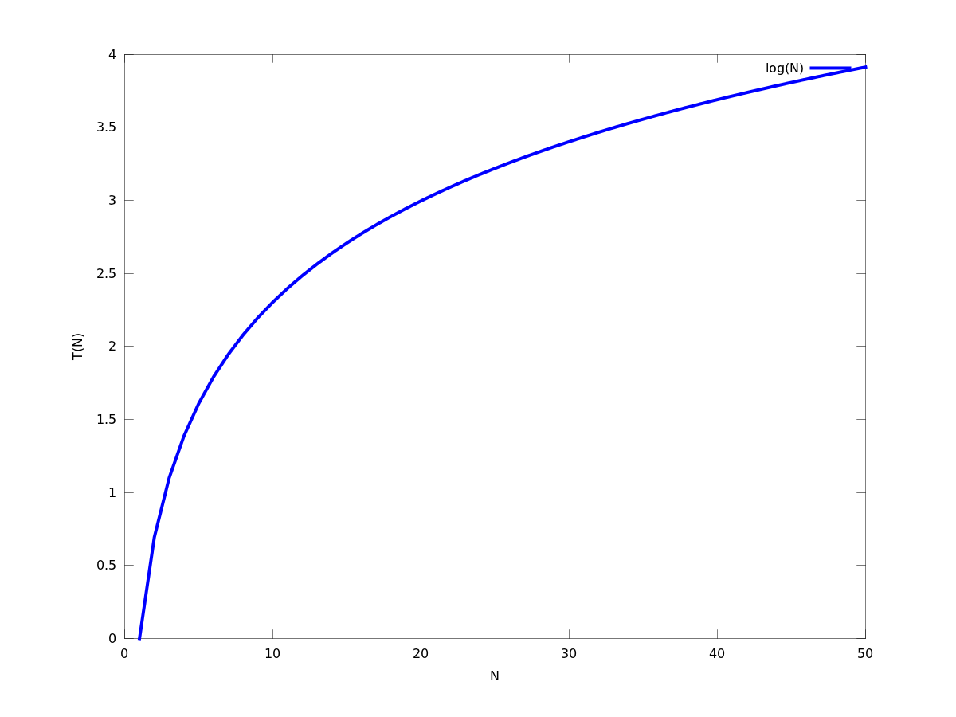
Logarithmic Function
T(N) = log(N)
Base 10 or base 2 (depending on context)
Running time is proportional to logarithm of input size
Slow growth!
Good!!!
Ex: Binary Search on sorted array

Slide 23
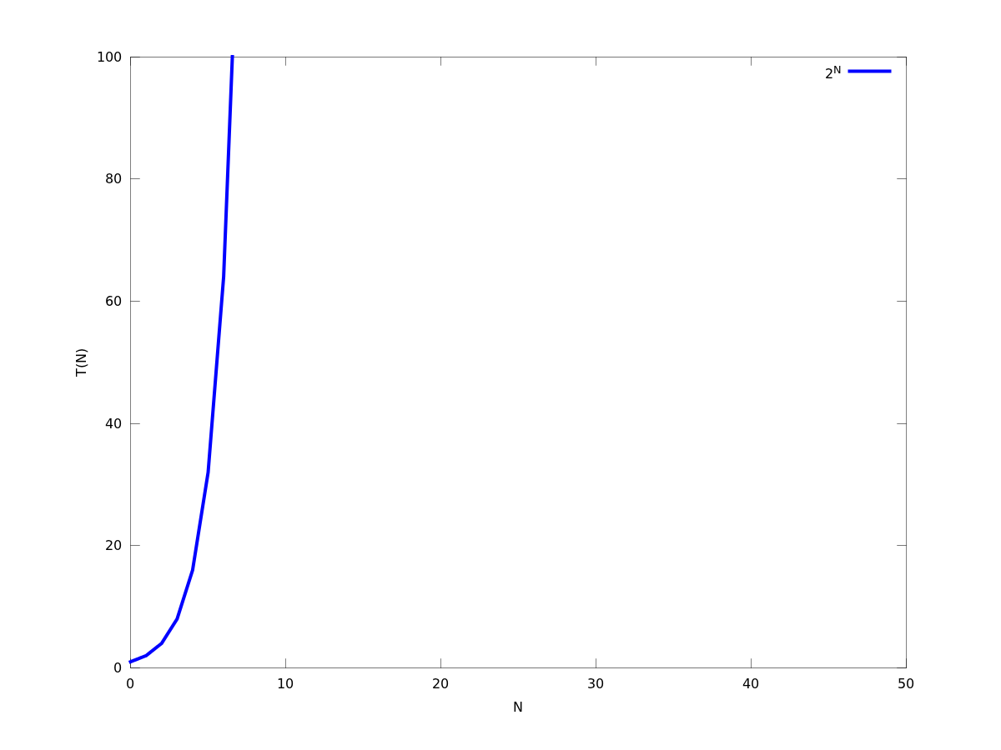
Exponential Function
T(N) = 2^{N}
Running time is proportional to nth power of 2
Very fast growth!
Ex: Scheduling events in a set of rooms

Slide 24
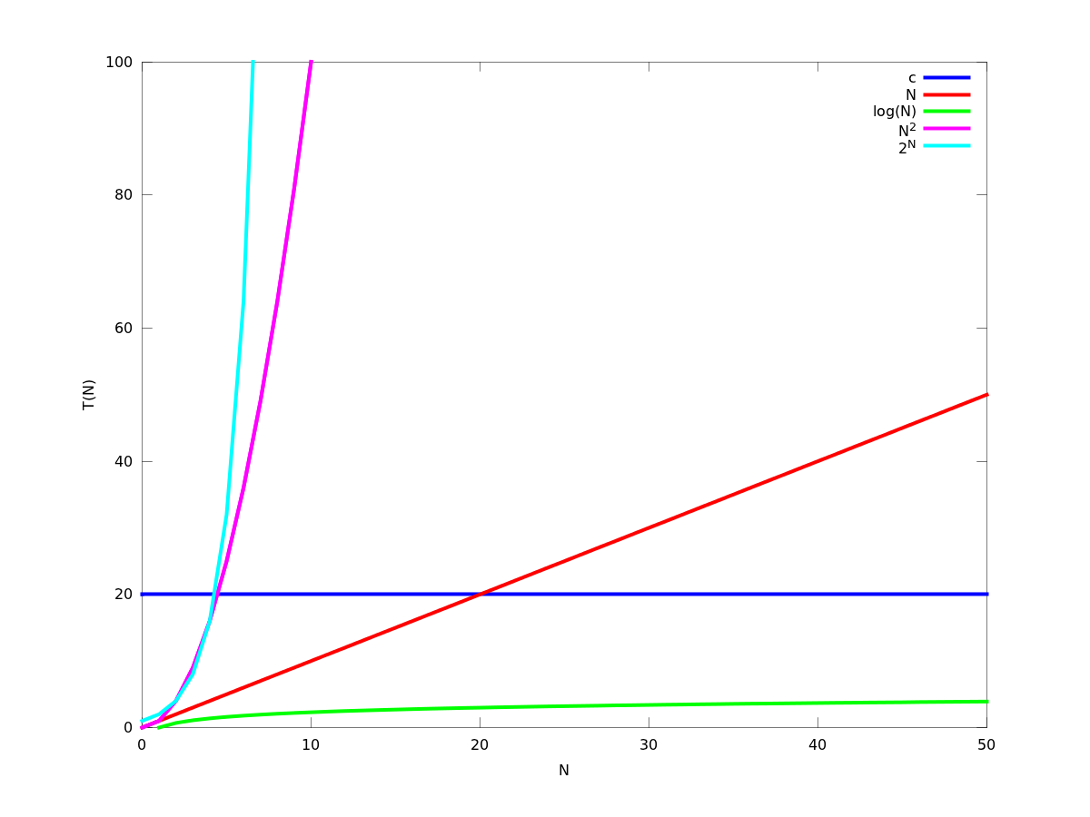
Comparison of growths
Constant is good
Logarithm is good
Linear is OK, we can live with it
Quadratic, live with it
Polynomial are not bad but show slowness
Exponential is terrible
It might take too long to find answer
Need to guesstimate

Slide 25
Bio-O Notation
Mechanism to specify a bound on running time of algorithm
Definition: We say the running time, T(N), of some algorithm (i.e., program or function) is O(f(N)) if and only if there are constants c and N_{o} such that
This is a bound on worst case behavior

Slide 26
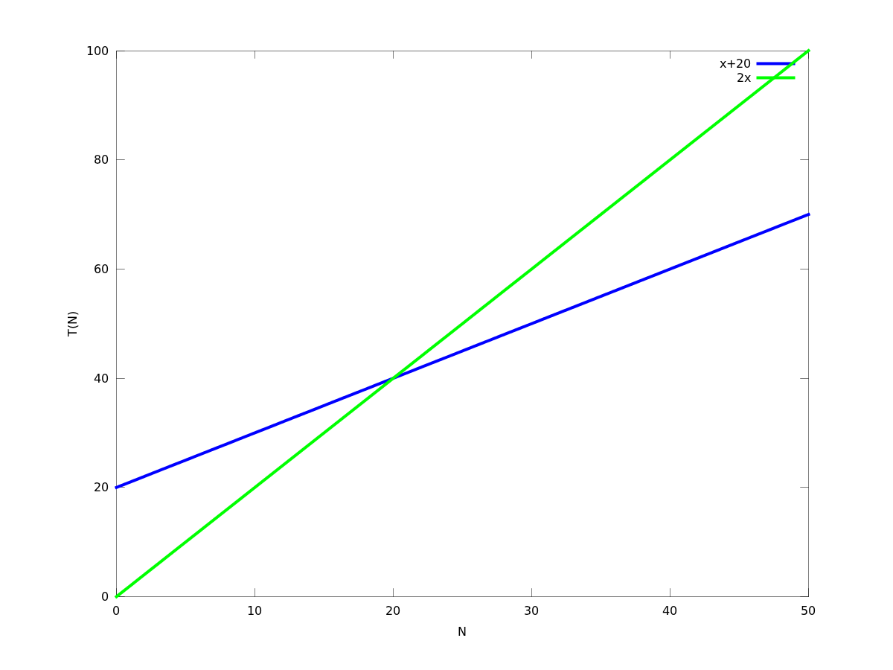
Illustration: Big-O
T(N)=N+20 is O(N)
F(N) = N
2F(N)
T(N)=N+20
N_{o}=20

Slide 27
Examples
T(n) = 3n² is O(n²)
Pick c=3, or c=4, and N₀=1
T(n) = 823183122 is O(1)
Pick c=823183122, or c=823183123, and N₀=1
O(1) means constant time
T(N) independent of input size
T(n) = 8n is O(n)
Pick c = 8 and N₀=1

Slide 28
Common Big-O bounds
Function | Common Name
O(1) | Constant
O(log(n)) | Logarithmic
O(n) | Linear
O(nlog(n)) | LogLinear or linearithmic
O(n²) | Quadratic
O(n³) | Cubic
O(n^{c}), c>1 | Polynomial
O(2^{n}) | Exponential
O(n!) | Factorial

Slide 29
Part III
Present methods to estimate program complexity

Slide 30
Big-O and analyzing growth of functions
With Big-O, we can forget about
Constants
Lower order terms
Only focus on most significant term
Ex: f(n) = 3n³+n²+45n+10000 is O(n³)
3n³+n²+45n+10000 ≤ (3+1+45+1000) n³=cn³ for c=1049 and n_{o} ≥ 1

Slide 31
Single Item Manipulation
Instructions that only manipulate 1 item are O(1)
Ex:
int x = 1;
++i;
i < 10;
t == m // boolean comparison
Integer m = new Integer(20);
System.out.println(“Al is here”);
throw new IllegalArgumentException();

Slide 32
Fixed iterations loops
Loops that iterate a fixed number of times are O(1):
Ex:
for(int i=0; i < 1000; ++i){
System.out.println(i); // This instruction is O(1)
}
int i=0 is O(1), comparison i < 1000 is O(1), ++i is O(1), System.out.println(i) is O(1)
Loop repeats 1000 times a body that is O(1) with all instructions being O(1)
Whole loop is O(1)

Slide 33
Variable iterations loop
Loops that iterate a variable number of times over a O(1) body are O(N), where N is the number of repetitions
Ex:
N is a variable that comes from user, or size of array/list or other data structure
for(int i=0; i < N; ++i){
System.out.println(i); // This instruction is O(1)
}
int i=0 is O(1), comparison i < N is O(1), ++i is O(1), System.out.println(i) is O(1)
Loop repeats N times a body that is O(1) with all instructions being O(1)
Whole loop is O(N)

Slide 34
Pseudo-Variable iterations loop
Loops that iterate a fixed number of times over a O(1) body, but use a variable to store the limit, are O(1)
Ex:
int N = 10002312312312312312;
for(int i=0; i < N; ++i){
System.out.println(i); // This instruction is O(1)
}
int i=0 is O(1), comparison i < 1000 is O(1), ++i is O(1), System.out.println(i) is O(1)
Loop repeats 10002312312312312312 times a body that is O(1) with all instructions being O(1)
Whole loop is O(1)

Slide 35
Nested Loops
Loops that iterate a variable number of times N over a O(N) body are O(N²), where N is the number of repetitions
Ex:
N is a variable that comes from user, or size of array/list or other data structure
for(int i=0; i < N; ++i){
for (int j = 0; j < 2N; ++j){
int m = i+j;
}
}
int i=0 is O(1), comparison i < 1000 is O(1), ++i is O(1), System.out.println(i) is O(1)
Loop repeats N times a body that is O(N) with all instructions being O(1)
Whole loop is O(N²)
In general: repeating N times something that is O(N^{c}) is O(N^{c+1})
This loop repeats N
times an O(N) operation
Therefore it is O(N²)
This loop is O(N)

Slide 36
Nested Loops (2)
Loops that iterate a variable number of times M over a O(N) body are O(M*N), where M and N are independent variables that control the number of repetitions
Ex:
elements -> an array with M = element.length
L -> array list with N= L.size()
for(int i=0; i < elements.length; ++i){
boolean flag =
L.contains(elements[i])
}
}
int i=0 is O(1), comparison i < elements.length is O(1), ++i is O(1), System.out.println(i) is O(1), assignment to flag is O(1)
Loop repeats M times a body that is O(N) with all other instructions being O(1)
Whole loop is O(M*N)
This loop repeats M
times an O(N) operation
Therefore it is O(M*N)
This is O(N)

Slide 37
While Loops
In the case of while loop, need to estimate how many repetitions are done
Ex:
int j = 0;
while (true){
j = i + 10;
if (k < j){ // k is some variable that comes from program
break;
}
}
Body of loop is O(1) – verify!
Loop is repeated at most ck times, where c is a constant: O(k)

Slide 38
Beware when using function calls
The complexity of a function call depends on the body of the function implementation
Ex.
L is an array list of strings
L.contains(“Apu”) is not O(1)
Contains must search through array
L.contains(“Apu”) is O(n), n = L.size()
Always indicate what the variable (i.e., n) is
O(n) -> what is the n?

Slide 39
Summary
Different algorithms solve same problem but have different running times
You want the most efficient algorithm
The one with smallest running time
Exact running time T(N) is hard to get
Use Big-O notation to put a bound O(f(n)) on the running time T(N)

Slide 40
Questions?
Email:
manuel.rodriguez7@upr.edu

