Slide 1
Software version control with GIT
Manuel Rodriguez-Martinez, Ph.D.
Department of Electrical and Computer Engineering
University of Puerto Rico, Mayaguez

Slide 2
Objectives
Introduce the concept of software version control
Show how to manage software repositories using GIT
Show how to use Git and Eclipse in your projects

Slide 3
Tools to be used
Git - distributed version control system
GitLab - web app for Git repository management
  Open source equivalent to Github
Eclipse - IDE for software development

Slide 4
Version control
The issue: software is often developed by
  one person, using different computers
  a team, using different computers
The problem: how to sync all these versions
  Emailing zip with software is not good

Slide 5
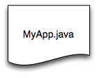






How to share and sync code?

Slide 6
Git
Git - software tool for version control
  Developed by Linus Torvalds to manage Linux kernel code
Key idea:
  Distributed repositories - each repo is a full-fledged repository (peer-to-peer)
  Developers can add files, remove files, update files, merge files commit changes, push changes to other repos, pull changes from other repos,

Slide 7
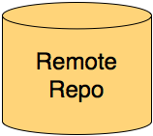
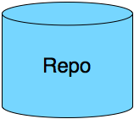
Git Architecture
Remote repo is usually
online 24/7 on the Internet
Ex. Github
Any Repo can exchange files

Slide 8
Git concepts
Local repo - the local repository on the machine that has the version of the code
Staging area (index) - all the code files that are to be added to the local repo (not yet committed)
  think of it as the working directory with changes saved but not committed to the repo
Local repo and staging area are in your local machine
Remote repo - repository located in another machine, typically used as backup/distribution site
  Ex. github.com

Slide 9
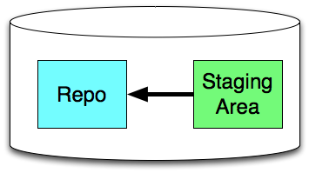
Git concepts (2)
Local
Machine

Slide 10
Git Concepts (3)
Clone project - get a copy from repo A into repo B, you can modify stuff from A
  In github, you can contribute (push) back from cloned project you own
Fork project - get a copy from A into repo B. You cannot modify stuff from A. You have to ask the owner to merge your changes
  It github, you fork repo you want to use. It you want to contribute, then you send pull request for merging code

Slide 11
Operational modes
Basic system Git runs from command line
GitLab/Github provide a web based approach to manage repo (do git commands underneath)
third-party clients provide UI for git commands
Eclipse and other IDEs have UI for git commands
We shall focus on GitLab and Eclipse, since we shall use them for the project

Slide 12
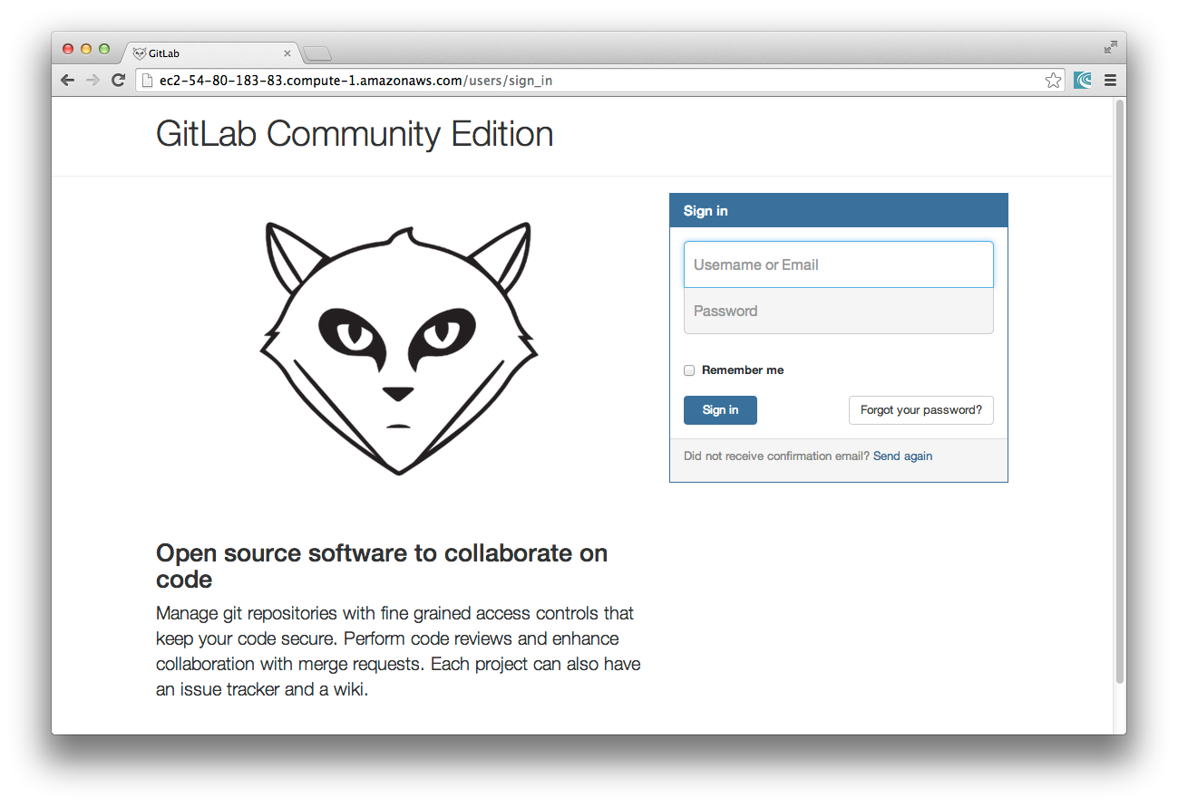
GitLab
Access site with username and password
Password must be changed on 1st login

Slide 13
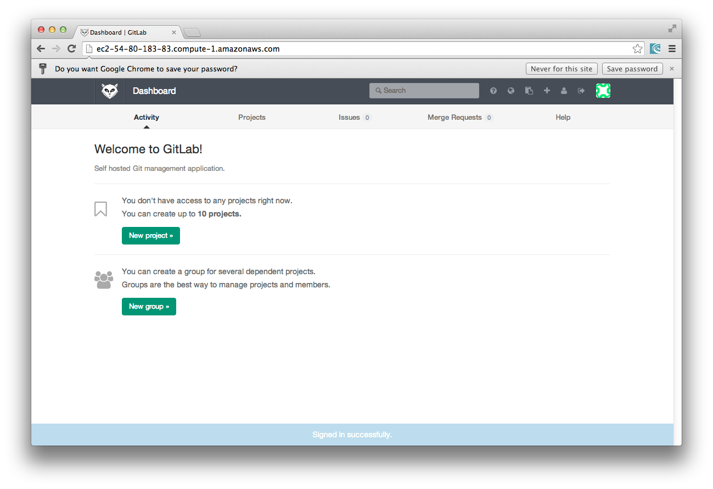
GitLab Console
Console show activity on repo, projects, settings

Slide 14
Actions from the Console
Create projects
View files
Add files
View commit messages
Handle pull request for merge
etc

Slide 15
Next Steps
Watch video with process to create local and remote repos using GitLab and Eclipse

