Slide 1
Oral Communication
Nayda G. Santiago
ICOM 4998: Undergraduate Research
Oct 28, 2009

Slide 2
Outline
Introduction
Elements of communication
Purpose
Audience
Structure
Communication Aids
Delivery

Slide 3
Exercise
We have given you a clapper
Each student should give a 3 min presentation on the following topic:
  Why is my town the best town in Puerto Rico?
When the student is presenting, clap if he or she has done something wrong in the presentation
  Examples: stage fright, moving too much, etc.

Slide 4
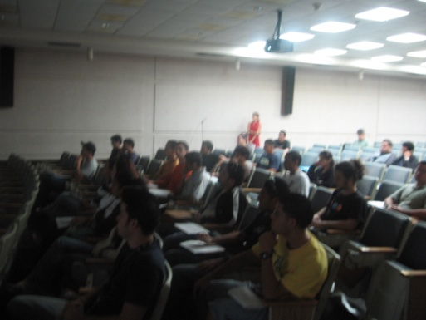
Communication
Audience
Situation
Format
Language

Slide 5
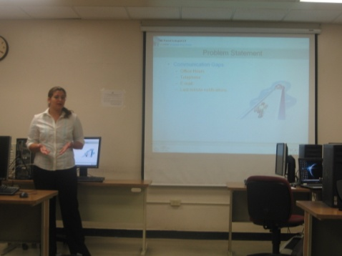
Situation
Particular situation within we are communicating.
  What?
    What is my subject?
  Who?
    To whom do I wish to communicate it?
  Why?
    What is my purpose in communicating it?
  When and where?
    Are there features about the place and time which affect how I should speak?
  How?
    What type of communication? Am I aiming at narration? Description? Exposition? Argument?

Slide 6
Format
Letter
Email
Application
Presentation
Report
Essay
Paper
Dissertation
Etc.

Slide 7
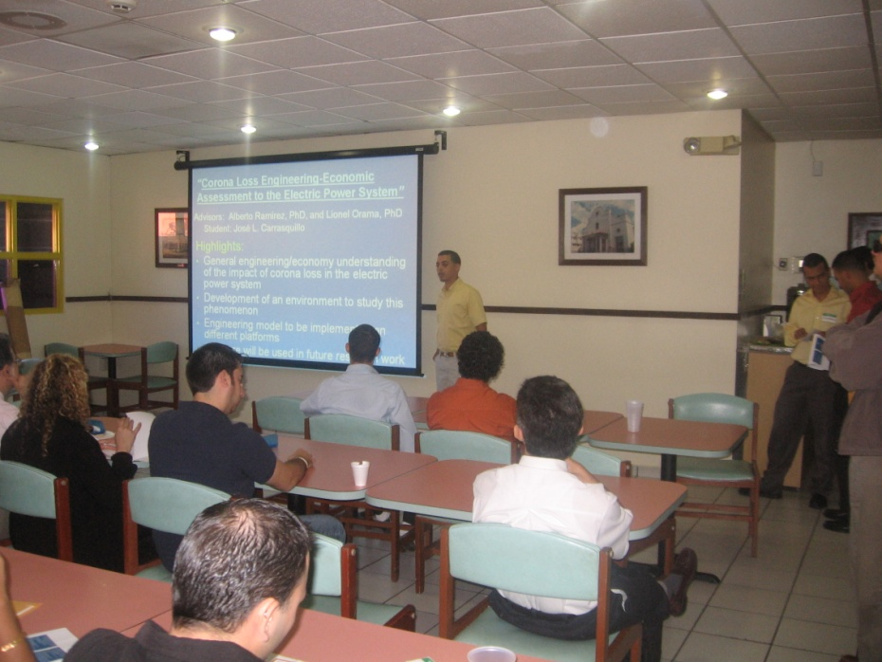
Format
Letter
Email
Application
Presentation
Report
Essay
Paper
Dissertation
Etc.

Slide 8

Language
English
Grammar
Vocabulary
Spelling
Punctuation
Speech

Slide 9

Spoken presentations
Examples
  Company sales
  Training session
  College lecture
  Inform progress, report results
Features
  One or more speakers presenting information and ideas
  Clearly defined purpose
  An audience

Slide 10

Preparation
Careful and intelligent preparation
Failures
  Over-confidence
  Lack of time
  Laziness
Key
  Organization

Slide 11
Purpose
Inform
Persuade
Entertain
Meet and get on with your audience

Slide 12
Purpose – To inform
Provide information
  Straight facts (data)
    Difficult to digest
      Figures, Dates, Names, Events
    Put data in context, patterns, and pictures
  Stories
    Easier to remember
      Pattern, beginning, middle, and end
  Descriptions and explanations
    Functioning of organization, machine, institution
    Visualize what is being described
      Images, analogies

Slide 13
Purpose – To persuade
Persuade audience of something
  Buy my product
  A different way of doing things
  Agree to a course of action
College lecture
  Students
    Take the subject seriously
    Open their minds to a new way of thinking

Slide 14
Purpose – To entertain
Entertain the audience
Usually a secondary purpose such as convince or persuade

Slide 15
Purpose – To meet and get on with the audience
Keep in mind
  Continuing relationship with the audience
  Will be meeting them regularly
Manager
  People he/she will be working with
Professor
  Students

Slide 16
Audience
Where are they now?
  Theoretical knowledge
  Practical knowledge
  Intelligence
  Level of education
  Terminology they can handle
  How quick can they pick up ideas
  Concentration span

Slide 17
Audience
Expectations
  Audience came for a reason
  Students
    Pass a course - compulsory
    8:35am
    Not enough sleep
    Lack of enthusiasm
    MAKE IT INTERESTING!!!

Slide 18


Audience
Practical needs
  Where is the screen, projector, board?
  How is the seating arranged?
    Can everybody see?
    Can everybody hear?
    Where will you place yourself? Move around?
    Lighting?
    Microphone?

Slide 19
Audience
Intellectual needs
  Order in which the material is presented
  Communication aids
    Visual aids
    Audio
    Verbal aids
      Stories, anecdotes, images, analogies, mnemonics
    Handouts
  Rhythm and variety to keep the audience interested and alert

Slide 20
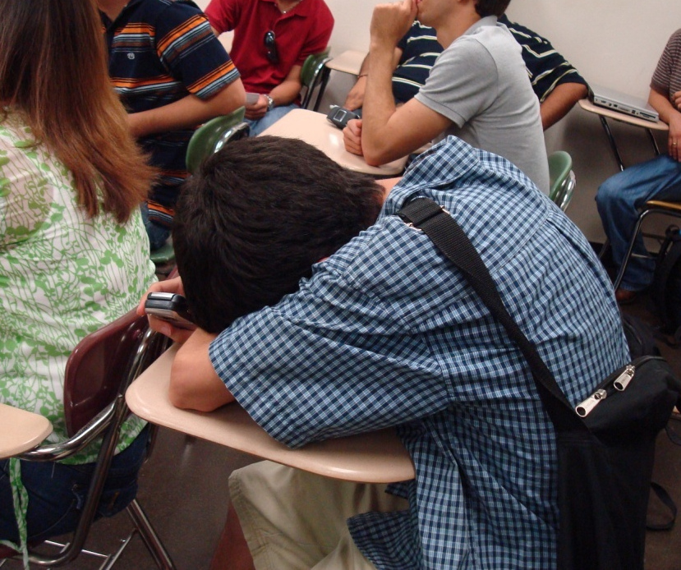

Audience
Personal needs
  Too long
  Exhausting
  Break?
    Coffee
    Stretch legs
    Chat

Slide 21
Build a structure
Content
  What you want to include?
  How much time you have?
  How much your audience can tackle?
Priorities
  Presentation soon will be forgotten
  Select small number of key points

Slide 22
Build a structure
Ordering
  Logic of the subject
  Logic of learning and understanding
  Need for variety
Arrangement
  Introduction
  Body
  Conclusion
Known
Unknown
Easy
Difficult

Slide 23
Communication Aids
Whiteboard
  Pros: Brainstorming, Linking ideas, Summarizing
  Cons: Sloppy handwriting, Erase, Fixed to the wall, Complex diagram?
Flipchart
  Pros: No erasing, material prepared in advance
  Cons: Cannot be used in large space
Overhead projector
  Pros: Everybody sees, Well prepared material, Overlaying complex diagrams built step by step
  Cons: Alignment, Focus, Small letters, Colors (contrast)

Slide 24
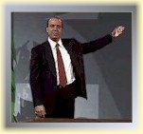
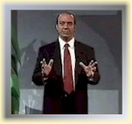
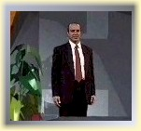
Delivery
Nervous?
What about reading prepared text?
  Not engaging
  Prompt cards
Talk to your audience
  Speak to them
    Look at them – eye contact
  Move around (evenly)
  Interruptions and questions
  Things have to be read (enough time for reading slides)
  Pose
    Hands, clothes
  Voice

Slide 25
References
Houp, Kenneth W. and Thomas E. Pearsall, Reporting Technical Information, 6th edition. Macmillan Publishing Company, New York, 1988.
Seely, John, Oxford Guide to Effective Writing and Speaking, Oxford University Press, 2005

Slide 26
Questions?
?????
Nayda.Santiago@ece.uprm.edu

